Slide 1

Zoom Office Hours
Next ARP Office Hours:
Friday, December 3, at 8:30am
https://unc.zoom.us/j/94011361206?pwd=MjIzWnlzOWxtNGtoUlNjaEV3ZWNPdz09
Meeting ID: 940 1136 1206
Passcode: 522329
Future ARP Office Hours:
Tuesday, December 7, at 12:00pm
Thursday, December 16, at 8:30am

Slide 2
ARP/CLFRF Allowable Expenditures
Address COVID Public Health
Support public health expenditures, by funding COVID-19 mitigation efforts, medical expenses, behavioral healthcare, and certain public health and safety staff;
Address COVID Economic Impact
Address negative economic impacts caused by the public health emergency, including economic harms to workers, households, small businesses, impacted industries, and the public sector;
Replace Lost Revenue
Replace lost public sector revenue, using this funding to provide government services to the extent of the reduction in revenue experienced due to the pandemic;
Premium Pay
Provide premium pay for essential workers, offering additional support to those who have borne and will bear the greatest health risks because of their service in critical infrastructure sectors; and,
Infrastructure Investments
Invest in water, sewer, and broadband infrastructure, making necessary investments to improve access to clean drinking water, support vital wastewater and stormwater infrastructure, and to expand access to broadband internet.
Disproportionately Negatively Impacted by Pandemic

Slide 3
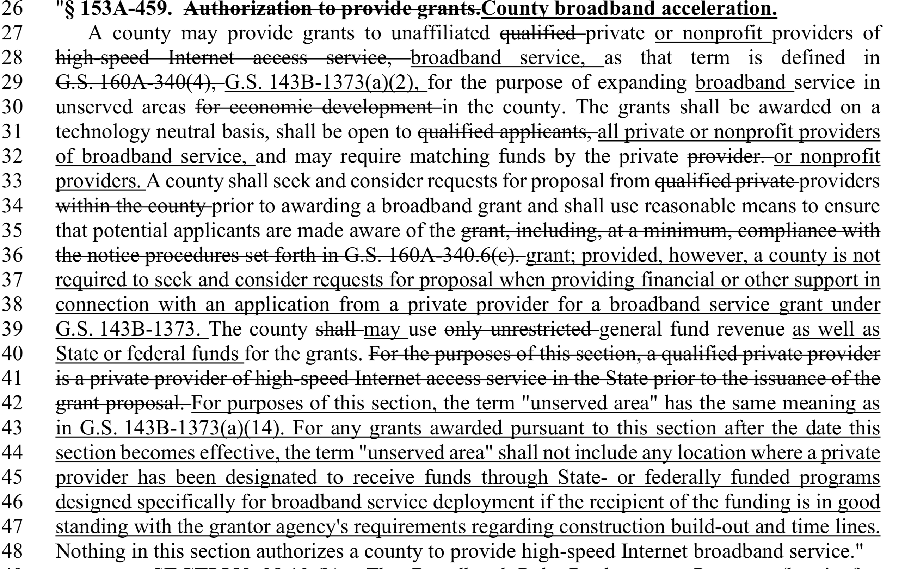

Slide 4
Definitions
Broadband service. – For the purposes of this section, terrestrially deployed Internet access service with transmission speeds of at least 10 megabits per second (Mbps) download and at least one megabit per second upload (10:1).
Unserved area. – A designated geographic area that is presently without access to broadband service, as defined in this section, offered by a wireline or fixed wireless provider. Areas where a private provider has been designated to receive funds through other State or federally funded programs designed specifically for broadband deployment shall be considered served if such funding is intended to result in construction of broadband in the area within 18 months.

Slide 5
ARP/CLFRF Broadband
defined as those that are not currently served by a wireline connection that reliably delivers at least 25 Mbps download speed and 3 Mbps of upload speed.
Broadband infrastructure that is designed to provide service to unserved or underserved households and businesses and that is designed to, upon completion:
  (i) Reliably meet or exceed symmetrical 100 Mbps download speed and upload speeds; or
  (ii) In cases where it is not practicable, because of the excessive cost of the project or geography or topography of the area to be served by the project, to provide service meeting the standards set forth in paragraph (e)(2)(i) of this section:
    (A) Reliably meet or exceed 100 Mbps download speed and between at least 20 Mbps and 100 Mbps upload speed; and
    (B) Be scalable to a minimum of 100 Mbps download speed and 100 Mbps upload speed.

Slide 6
Unserved
State Law | ARP/CLFRF
Terrestrially deployed Internet access service with transmission speeds of at least 10 megabits per second (Mbps) download and at least one megabit per second upload (10:1). A designated geographic area that is presently without access to broadband service, as defined in this section, offered by a wireline or fixed wireless provider. Areas where a private provider has been designated to receive funds through other State or federally funded programs designed specifically for broadband deployment shall be considered served if such funding is intended to result in construction of broadband in the area within 18 months. | Those that are not currently served by a wireline connection that reliably delivers at least 25 Mbps download speed and 3 Mbps of upload speed.

Slide 7
ARP/CLFRF Broadband
The use of “reliably” in the IFR provides recipients with significant discretion to assess whether the households and businesses in the area to be served by a project have access to wireline broadband service that can actually and consistently meet the specified thresholds of at least 25Mbps/3Mbps—i.e., to consider the actual experience of current wireline broadband customers that subscribe to services at or above the 25 Mbps/3 Mbps threshold. Whether there is a provider serving the area that advertises or otherwise claims to offer speeds that meet the 25 Mbps download and 3 Mbps upload speed thresholds is not dispositive.
When making these assessments, recipients may choose to consider any available data, including but not limited to documentation of existing service performance, federal and/or state-collected broadband data, user speed test results, interviews with residents and business owners, and any other information they deem relevant. In evaluating such data, recipients may take into account a variety of factors, including whether users actually receive service at or above the speed thresholds at all hours of the day, whether factors other than speed such as latency or jitter, or deterioration of the existing connections make the user experience unreliable, and whether the existing service is being delivered by legacy technologies, such as copper telephone lines (typically using Digital Subscriber Line technology) or early versions of cable system technology (DOCSIS 2.0 or earlier).
Broadband infrastructure that is designed to provide service to unserved or underserved households and businesses and that is designed to, upon completion:
  (i) Reliably meet or exceed symmetrical 100 Mbps download speed and upload speeds; or
  (ii) In cases where it is not practicable, because of the excessive cost of the project or geography or topography of the area to be served by the project, to provide service meeting the standards set forth in paragraph (e)(2)(i) of this section:
    (A) Reliably meet or exceed 100 Mbps download speed and between at least 20 Mbps and 100 Mbps upload speed; and
    (B) Be scalable to a minimum of 100 Mbps download speed and 100 Mbps upload speed.

Slide 8
ARP/CLFRF Broadband
Broadband infrastructure that is designed to provide service to unserved or underserved households and businesses and that is designed to, upon completion:
  (i) Reliably meet or exceed symmetrical 100 Mbps download speed and upload speeds; or
  (ii) In cases where it is not practicable, because of the excessive cost of the project or geography or topography of the area to be served by the project, to provide service meeting the standards set forth in paragraph (e)(2)(i) of this section:
    (A) Reliably meet or exceed 100 Mbps download speed and between at least 20 Mbps and 100 Mbps upload speed; and
    (B) Be scalable to a minimum of 100 Mbps download speed and 100 Mbps upload speed.
Treasury interprets “businesses” in this context broadly to include non-residential users of broadband, including private businesses and institutions that serve the public, such as schools, libraries, healthcare facilities, and public safety organizations.

Slide 9
For broadband infrastructure investments, what does the requirement that infrastructure “be designed to” provide service to unserved or underserved households and businesses mean? [6/17]
Designing infrastructure investments to provide service to unserved or underserved households or businesses means prioritizing deployment of infrastructure that will bring service to households or businesses that are not currently serviced by a wireline connection that reliably delivers at least 25 Mbps download speed and 3 Mbps of upload speed. To meet this requirement, states and localities should use funds to deploy broadband infrastructure projects whose objective is to provide service to unserved or underserved households or businesses. These unserved or underserved households or businesses do not need to be the only ones in the service area funded by the project.

Slide 10
For broadband infrastructure to provide service to “unserved or underserved households or businesses,” must every house or business in the service area be unserved or underserved? [6/17]
No. It suffices that an objective of the project is to provide service to unserved or underserved households or businesses. Doing so may involve a holistic approach that provides service to a wider area in order, for example, to make the ongoing service of unserved or underserved households or businesses within the service area economical. Unserved or underserved households or businesses need not be the only households or businesses in the service area receiving funds.

Slide 11
Prior Approval for Capital Projects?
1
IFR specifically authorizes capital projects for
Water, wastewater, & broadband
General government capital projects to the extent of lost revenue growth
Certain capital projects related to addressing pandemic and negative economic impacts
FAQs mention other capital projects as examples
FAQ 4.5: Are governments required to submit proposed expenditures to Treasury for approval? [5/27]
No. Recipients are not required to submit planned expenditures for prior approval by Treasury. Recipients are subject to the requirements and guidelines for eligible uses contained in the Interim Final Rule.
§ 200.439 Equipment and other capital expenditures.
(a) See § 200.1 for the definitions of capital expenditures, equipment, special purpose equipment, general purpose equipment, acquisition cost, and capital assets.
(b) The following rules of allowability must apply to equipment and other capital expenditures:
(1) Capital expenditures for general purpose equipment, buildings, and land are unallowable as direct charges, except with the prior written approval of the Federal awarding agency or pass-through entity.
(2) Capital expenditures for special purpose equipment are allowable as direct costs, provided that items with a unit cost of $5,000 or more have the prior written approval of the Federal awarding agency or pass-through entity.
(3) Capital expenditures for improvements to land, buildings, or equipment which materially increase their value or useful life are unallowable as a direct cost except with the prior written approval of the Federal awarding agency, or pass-through entity. See § 200.436, for rules on the allowability of depreciation on buildings, capital improvements, and equipment. See also § 200.465.
(4) When approved as a direct charge pursuant to paragraphs (b)(1) through (3) of this section, capital expenditures will be charged in the period in which the expenditure is incurred, or as otherwise determined appropriate and negotiated with the Federal awarding agency.
(5) The unamortized portion of any equipment written off as a result of a change in capitalization levels may be recovered by continuing to claim the otherwise allowable depreciation on the equipment, or by amortizing the amount to be written off over a period of years negotiated with the Federal cognizant agency for indirect cost.
(6) Cost of equipment disposal. If the non-Federal entity is instructed by the Federal awarding agency to otherwise dispose of or transfer the equipment the costs of such disposal or transfer are allowable.
(7) Equipment and other capital expenditures are unallowable as indirect costs. See § 200.436.
2
3

Slide 12
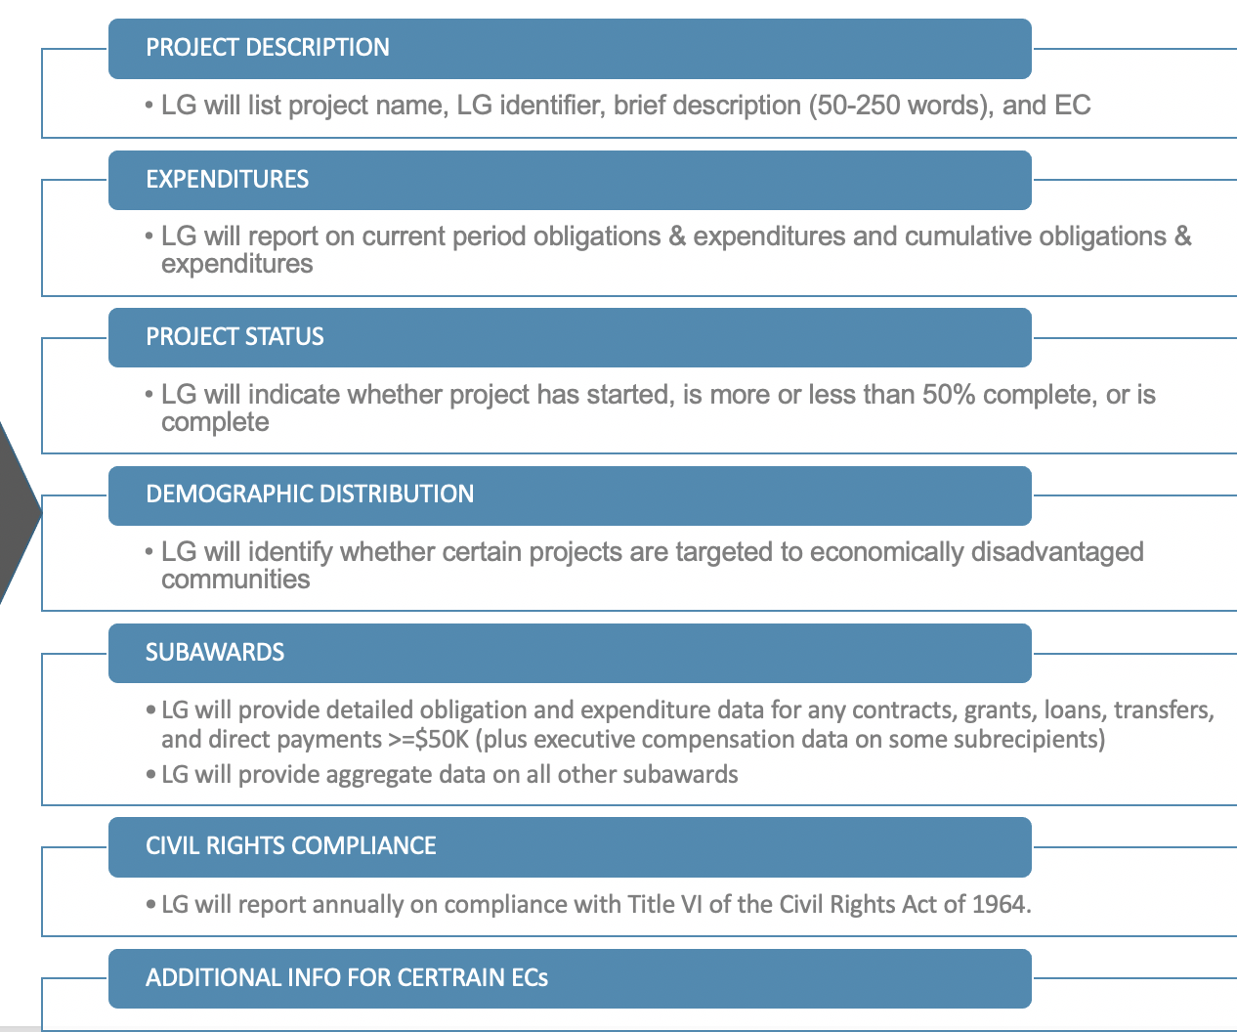
Project Tracking
Project Description
Written Eligibility Determination (citations to IFR/FAQs)
State Law Citation(s)
Expenditure Category (EC)
Internal Tracking Number
Additional Written Justifications (if applicable)
Cost Allowability
https://www.sog.unc.edu/file/arpa-program-file-checklisttmo30docx
https://www.sog.unc.edu/file/arpa-reporting-templatexlsx

Slide 13
Project Proposal Initiated
Complete Eligibility Worksheet
Legal Review
ARP/CLFRF Eligibility
Finance Review
Cost Allowability
Estimate costs
Identify partners (if applicable
State Law Authority
ID Compliance Requirements
Budget Amendments
Project Tracking
Document everything in writing!
Create a project proposal, approval, and implementation process

Slide 14




Cost Allowability
“Recipients must implement robust internal controls and effective monitoring to ensure compliance with the Cost Principles, which are important for building trust and accountability”
.
Who makes cost allowability determinations?
What guides determinations?
What happens if an unallowable cost is inadvertently charged to the grant award?
How to set up project processes to incorporate cost allowability checks?
Reasonable
Allocable
Consistently Treated
Direct vs. Indirect

Slide 15
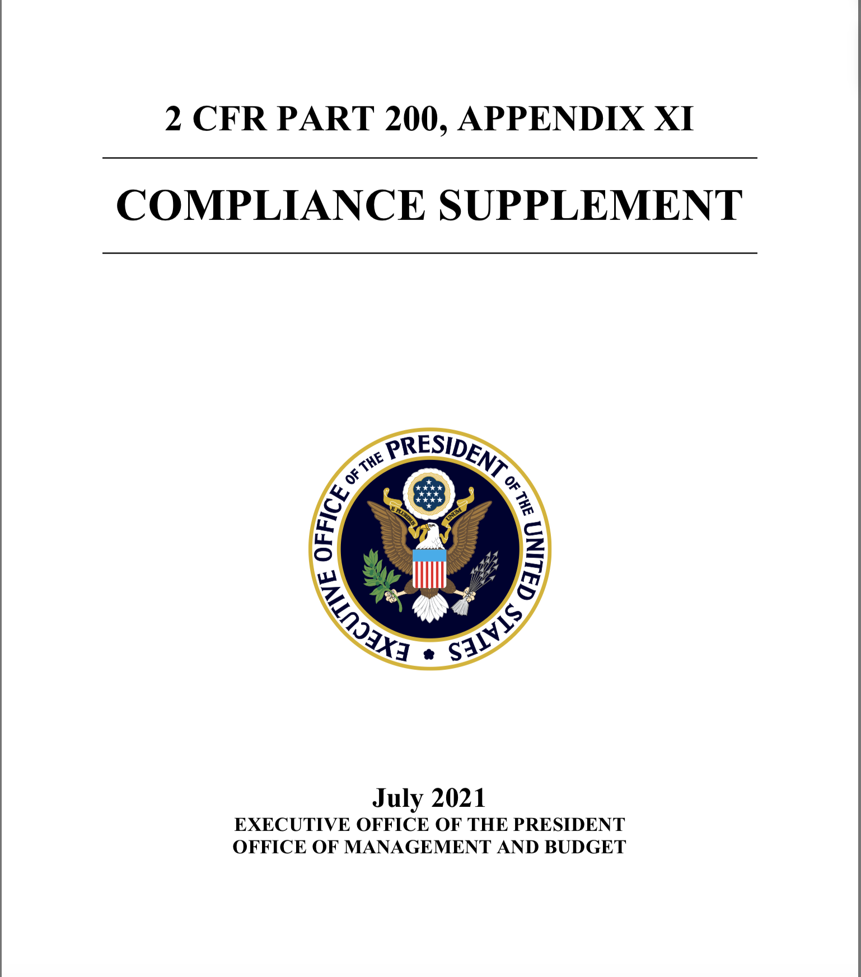
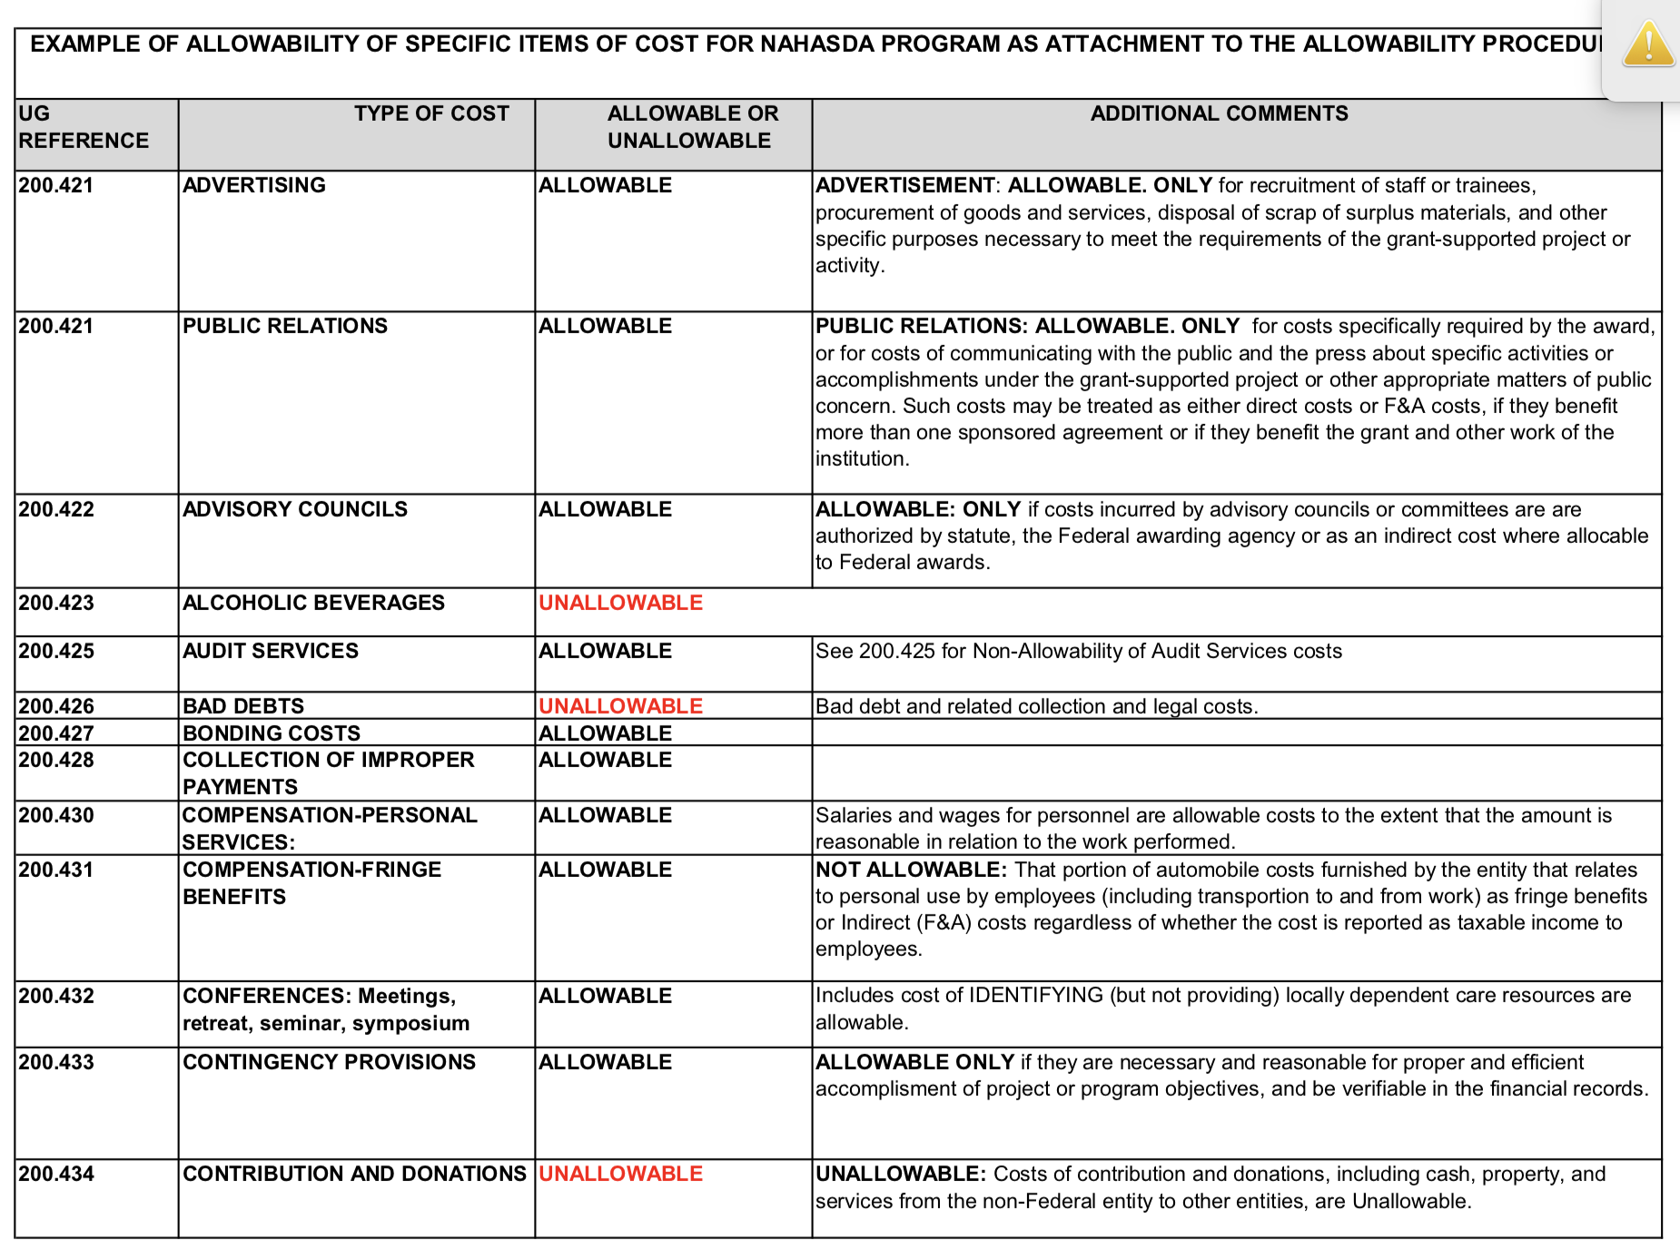
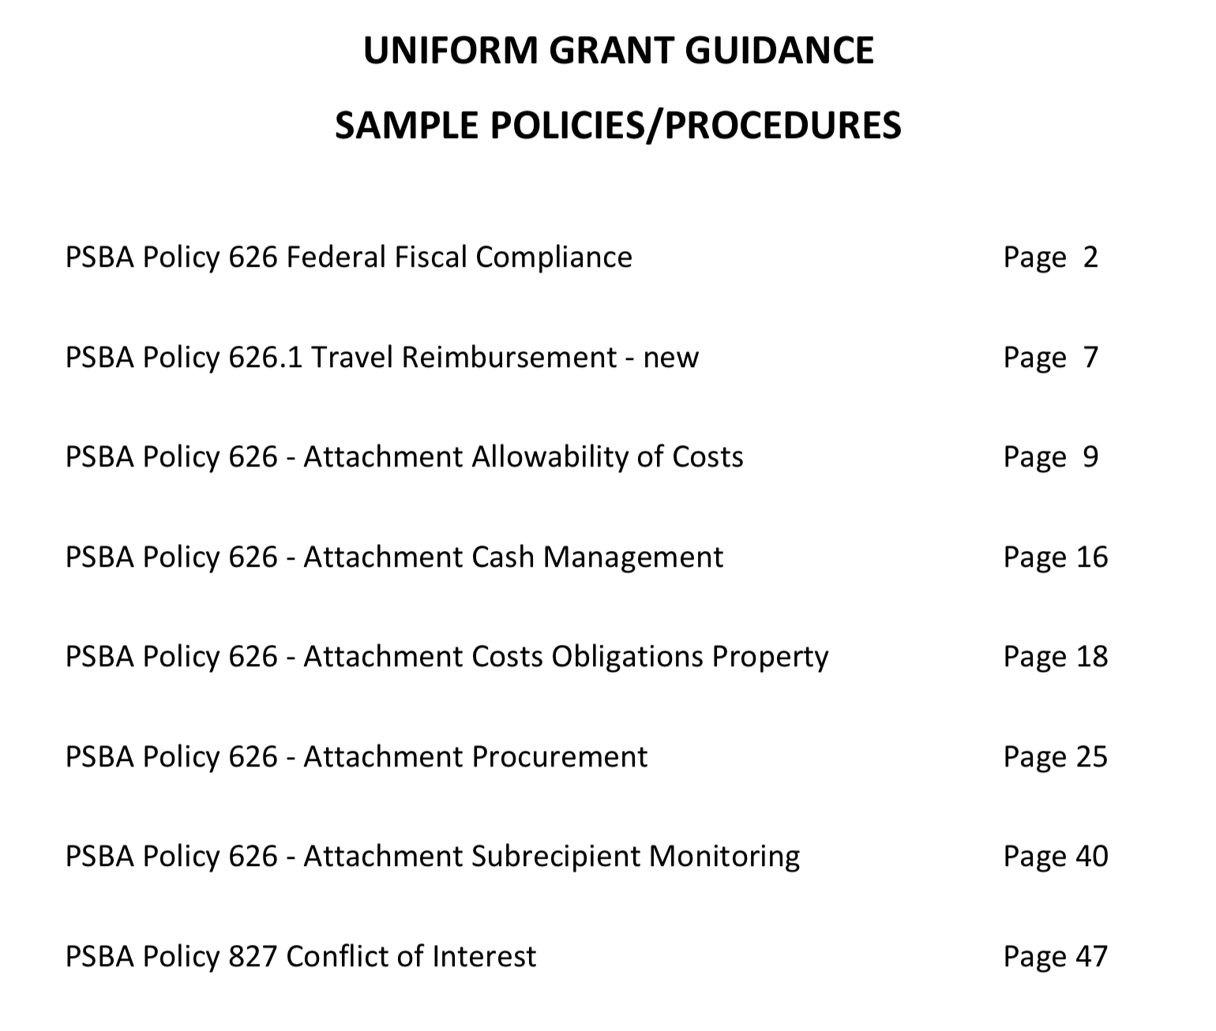
Cost Allowability
Must track expenditures by cost type
Create checklist on allowable costs as part of project request/approval process to aid in back-end compliance determinations
Finance officer must double-check for allowable costs before disbursing payments.
Personnel costs (direct or indirect) (200.430 & 200.431)
Materials & Supplies (200.453)
Equipment & Other Capital (prior written approval?) (200.439)
Consultants/Professional Services (200.459)
Audits (200.425)
Communications (200.421)
Insurance (200.447)
Maintenance & repair (200.452)
Rental costs (200.465)

Slide 16
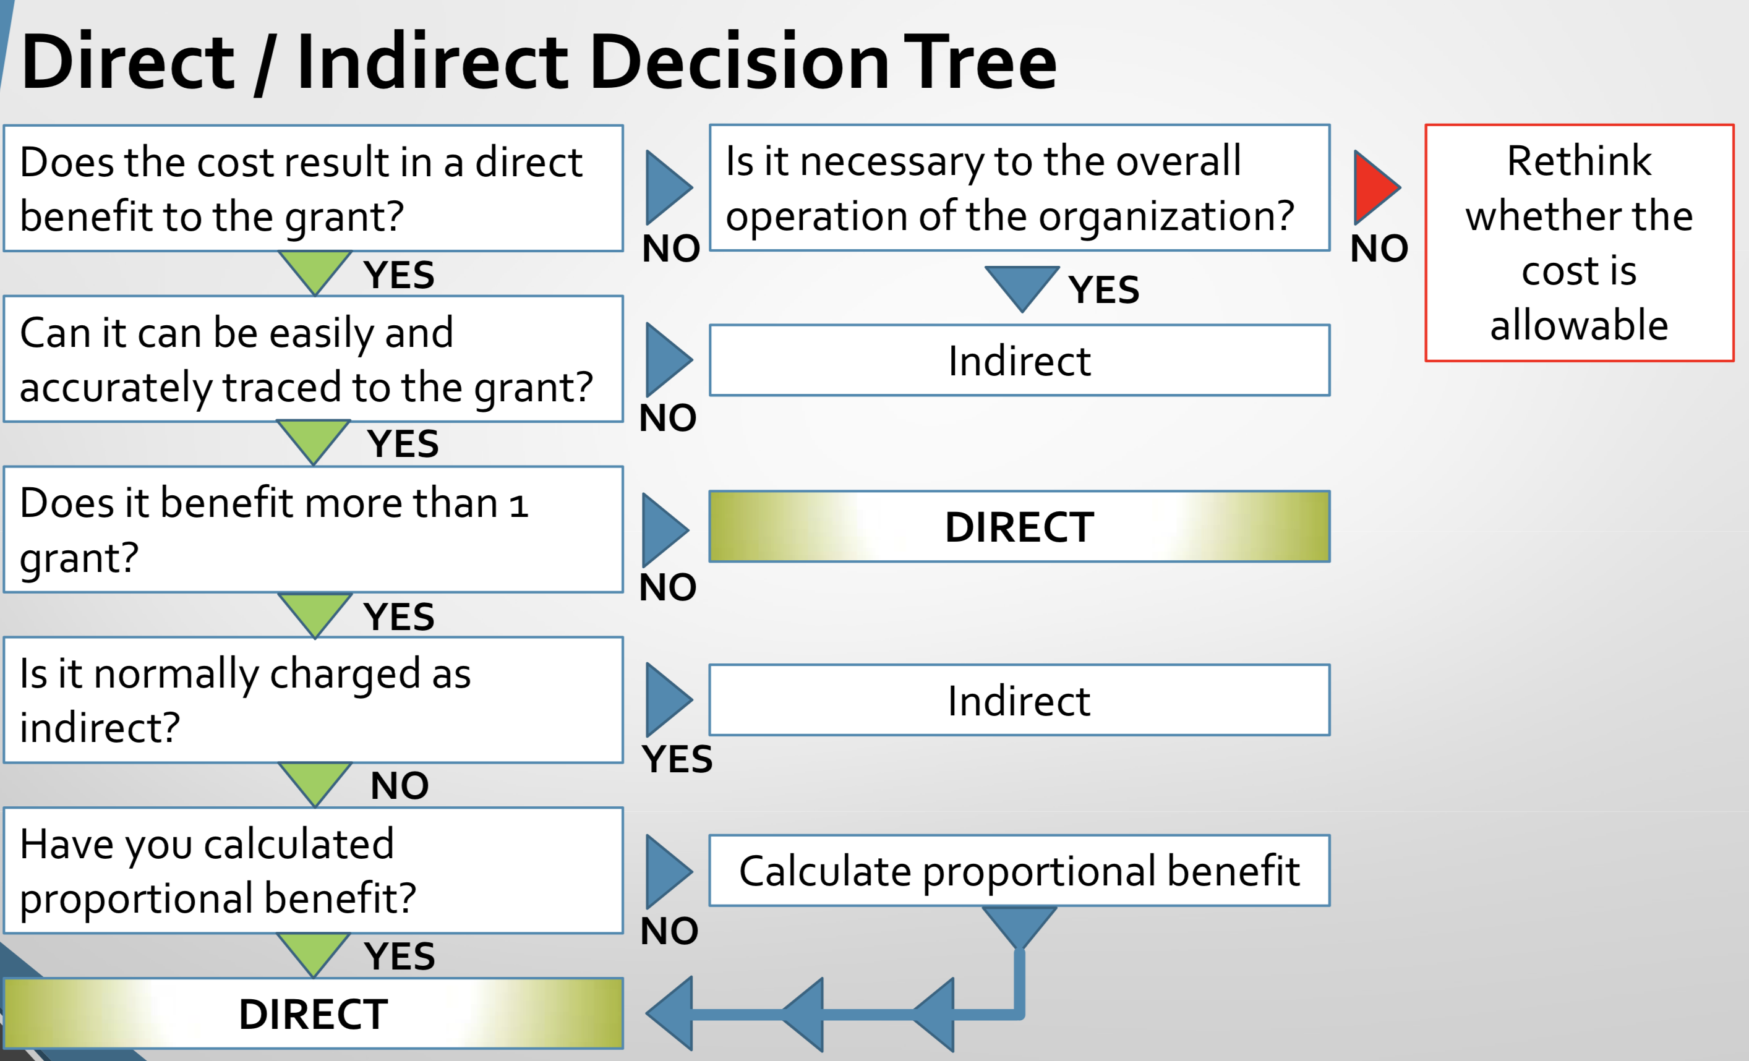
DIRECT COSTS are those that are identified specifically as costs of implementing the ARP/CLFRF program objectives, such as contract support, materials, and supplies for a project.
INDIRECT COSTS are general overhead costs of an organization where a portion of such costs are allocable to the SLFRF award such as the cost of facilities or administrative, clerical, or finance staff.
LG may charge a 10% de minimis rate of modified total direct costs (unless have an existing negotiated indirect cost rate).
Modified total direct costs includes all direct salaries and wages, applicable fringe benefits, materials and supplies, services, travel, and up to the first $25,000 of each subaward.

Slide 17
Cost Object Class | Grant Project |  |  | Total
 | A. Utility Subsidy Program | B. Water line Replacement | C. Premium Pay for LG Employees
Personnel | $22,000
Fringe Benefits | $4,659
Travel
Equipment
Supplies | $562
Contractual
Construction
Leases
Communication | $3,000
Cash Payments | $50,000
…
Total Direct Charges | $80,221
Indirect Charges | $8,022
Total | $88,243

Slide 18






LG Personnel Costs
Replenish LG workforce to pre-pandemic levels. Compensation during award term, plus training and other employment incentives.
Allowable costs for each project include LG staff time dedicated to that project. (Also allowable as indirect costs are general administration, clerical support, and finance personnel.)
  Expenses of providing paid sick and paid family and medical leave to public employees to enable compliance with COVID-19 public health precautions
  Self-insured LG expenses for employee COVID-19 treatment, including the long-term symptoms or effects of COVID-19
Salaries and benefits of public health, public safety, and social services employees to the extent they are Dedicated to COVID-19 response.
Premium Pay for LG employees performing essential work (this is a separate ARP/CLFRF category)

Slide 19
Effort Tracking
Track FTEs
Replenish LG workforce to pre-pandemic levels. Compensation during award term, plus training and other employment incentives.
Effort Certification for Direct Allocations
Allowable costs for each project include LG staff time dedicated to that project. (Also allowable as indirect costs are general administration, clerical support, and finance personnel.)
Track FTEs
Effort Certification
Eligibility Determination
PP Calculation
Time Period
150% Threshold
Track FTEs
Salaries and benefits of public health, public safety, and social services employees to the extent they are Dedicated to COVID-19 response.
Premium Pay for LG employees performing essential work (this is a separate ARP/CLFRF category)

Slide 20
Cash Management
Have a regular policy
Follow it
MUST deposit in Official Depository
MAY co-mingle with other local government monies
DO NOT NEED separate bank account
INVEST according to G.S. 159-30
Investment earnings are considered unrestricted when earned
Investment earnings must be initially allocated proportionally to the accounting funds that earned them (by state law)

