Slide 1

ARP/CSLFRF Office Hours
$0 - $10 million
January 31, 2022
The FINAL RULE

Slide 2
Revamped Zoom Office Hours
https://unc.zoom.us/j/94011361206?pwd=MjIzWnlzOWxtNGtoUlNjaEV3ZWNPdz09
Meeting ID: 940 1136 1206
Passcode: 522329
Local governments receiving $0 to $10 million total ARP/CSLFRF funding
Local governments receiving over $10 million total ARP/CSLFRF funding
Monday, January 31, at 12:00pm
Friday, February 11, at 8:30am
Friday, February 18, at 12:00pm
Friday, February 25, at 8:30am
Thursday, March 3, at 12:00pm
Friday, March 18, at 8:30am
Wednesday, February 2, at 12:00pm
Thursday, February 10, at 8:30am
Wednesday, February 16, at 12:00pm
Monday, February 21, at 8:30am
Monday, March 7, at 12:00pm
Thursday, March 24, at 8:30am

Slide 3
Project & Expenditure Reports!!
First P&E Report Due by January 31, 2022:
If you are a county with over 250K population
If you are a metropolitan city with over 250K population
If you are a county receiving $10 million or more in total ARP/CSLFRF funding
If you are a metropolitan city (over 50K population) AND you are receiving $10 million or more in total ARP/CSLFRF funding
First P&E Report Due by April 30, 2022:
If you are an NEU (municipality under 50K population)
If you are a county under 250K population and receiving less than $10 million in total ARP/CSLFRF funding
If you are a metropolitan city under 250K population and receiving less than $10 million in total ARP/CSLFRF funding
EVERYONE – WATCH THIS! https://www.youtube.com/watch?v=6YTsxrEMS1o

Slide 4
ARP/CLFRF Allowable Expenditures
Address COVID Public Health & Negative Economic Impact
Support public health expenditures, by funding COVID-19 mitigation efforts, medical expenses, behavioral healthcare, and certain public health and safety staff;
Address negative economic impacts caused by the public health emergency, including economic harms to workers, households, small businesses, impacted industries, and the public sector;
Support disproportionately impacted communities
Replace Lost Revenue
Replace lost public sector revenue, using this funding to provide government services to the extent of the reduction in revenue experienced due to the pandemic;
Standard allowance up to $10 million
OR
Formula approach
Premium Pay
Provide premium pay for essential workers, offering additional support to those who have borne and will bear the greatest health risks because of their service in critical infrastructure sectors; and,
Infrastructure Investments
Invest in water, sewer, and broadband infrastructure, making necessary investments to improve access to clean drinking water, support vital wastewater and stormwater infrastructure, and to expand access to broadband internet.

Slide 5
Standard Allowance: $0-$10 million
Replace Lost Revenue
Replace lost public sector revenue, using this funding to provide government services to the extent of the reduction in revenue experienced due to the pandemic;
Premium Pay
Provide premium pay for essential workers, offering additional support to those who have borne and will bear the greatest health risks because of their service in critical infrastructure sectors; and,

Slide 6
Revenue Replacement vs Other Categories
Address COVID Public Health & Economic Impact
Replace Lost Revenue
Premium Pay
Infrastructure Investments
Grant Administration
Revenue Replacement:
Standard Allowance
May spend up to $10 million for General Government Services
May use to cover general government services projects that fall within other eligible ARP/CSLFRF categories.
Should NOT use for premium pay or grant administration costs.
Revenue Replacement:
Formula Option
May spend up to full amount of actual lost revenue growth for General Government Services
May use to cover general government services projects that fall within other eligible ARP/CSLFRF categories.
Should NOT use for premium pay or grant administration costs.

Slide 7
ARP/CLFRF Allowable Expenditures
Address COVID Public Health & Economic Impact
Replace Lost Revenue
Premium Pay
Infrastructure Investments
All Revenue Replacement Funds May be Spent for “General Government Services” defined by reference to a non-exclusive list of examples
  “maintenance or pay-go funded building of infrastructure, including roads; modernization of cybersecurity, including hardware, software, and protection of critical infrastructure; health services; environmental remediation; school or educational services; and the provision of police, fire, and other public safety services.”
  US Treasury Overview Supplement:
    “[g]overnment services generally include any service traditionally provided by a government, unless Treasury has stated otherwise. Here are some common examples, although this list is not exhaustive: Construction of schools and hospitals; Road building and maintenance, and other infrastructure; Health services; General government administration, staff, and administrative facilities; Environmental remediation; [and] Provision of police, fire, and other public safety services (including purchase of fire trucks and police vehicles).”
Must track expenditures for reporting purposes
Must follow all Uniform Guidance requirements
Updated Blog Post: https://canons.sog.unc.edu/2022/01/american-rescue-plan-act-of-2021-coronavirus-state-local-fiscal-recovery-funds-final-rule-spending-funds-for-general-government-purposes-2/

Slide 8
Maximize Benefit, Minimize Burden
2
Engage in strategic process to identify best use of funds
1
You must spend all your ARP/CSLFRF funds! (No reserves)
Fully obligated by December 31, 2024 & fully expended by December 31, 2026
3
Supplant to the extent possible to minimize administrative/reporting burden

Slide 9
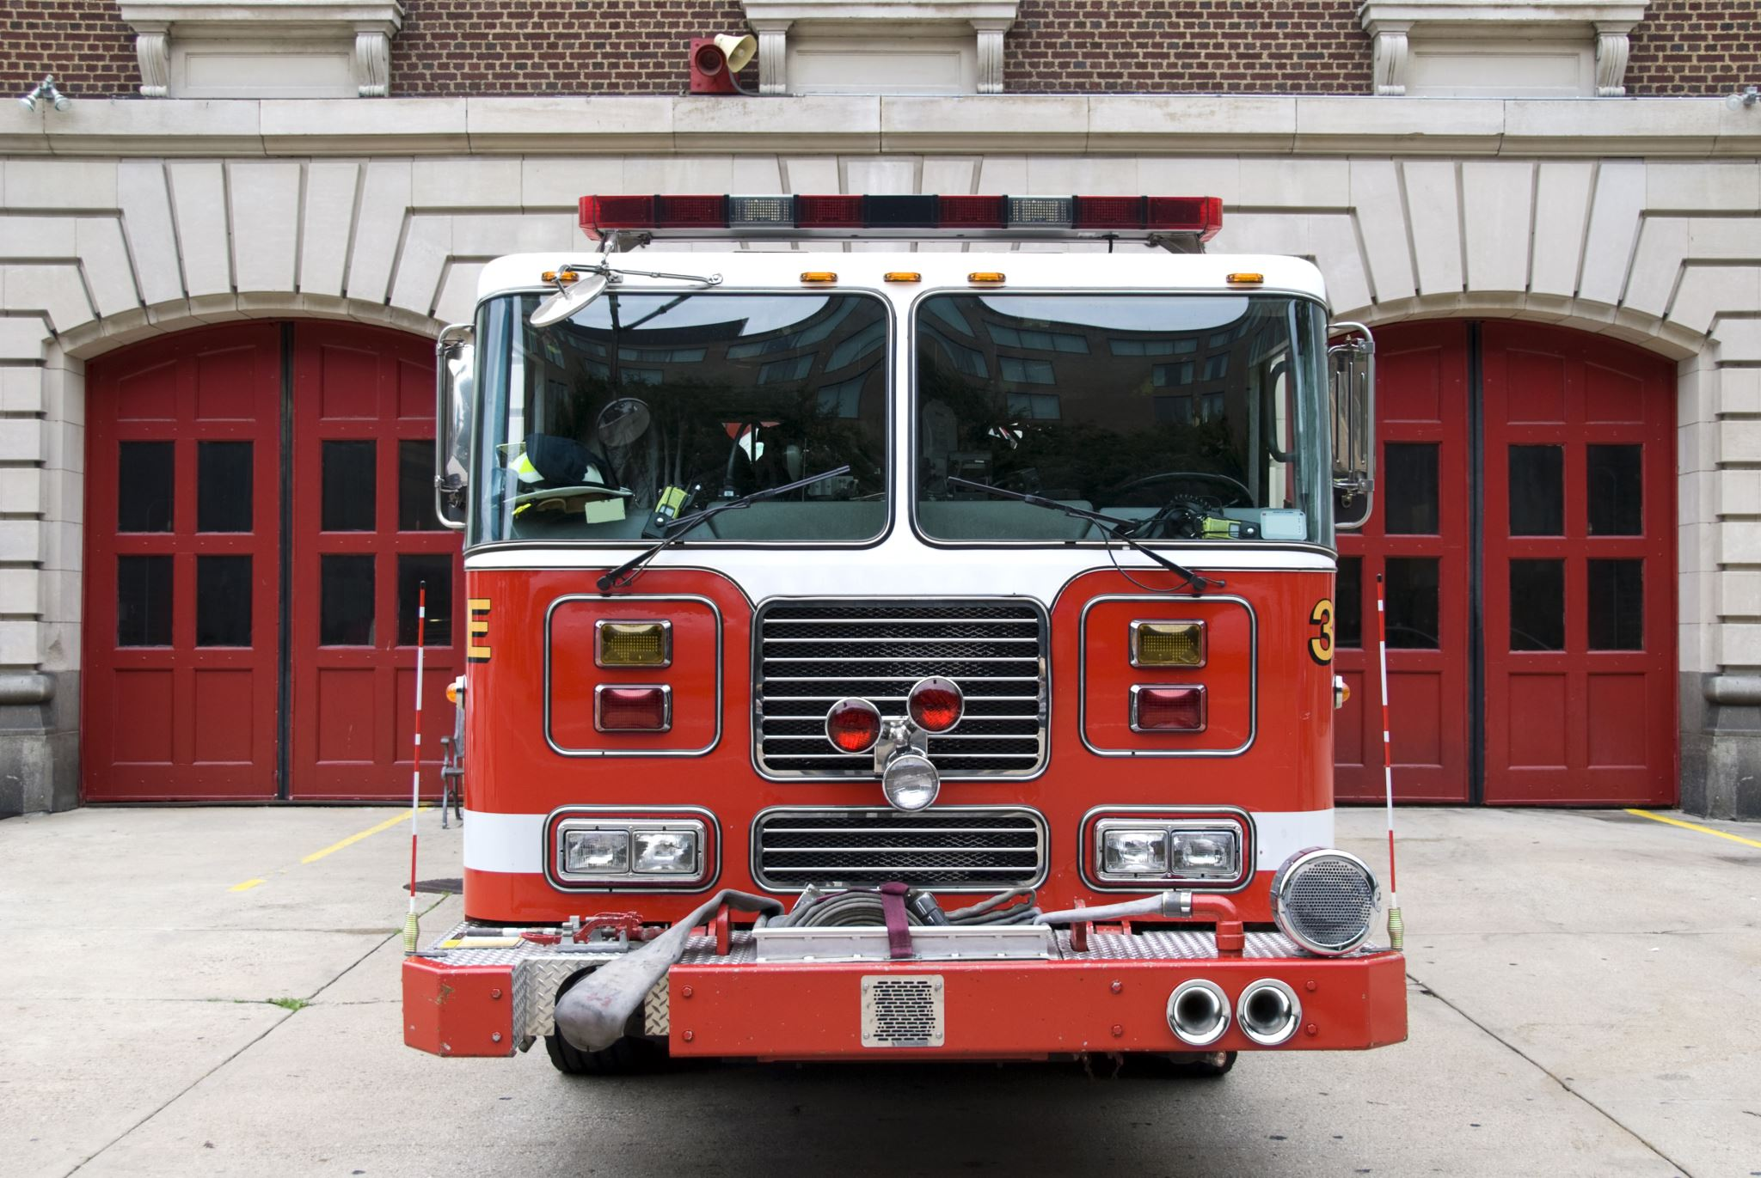
Example: Funding a Fire Truck
Option 1
Use ARP/CSLFRF monies directly to fund fire truck
Budget & Track Expenditures
UG Compliance Requirements:
Eligibility documentation
Allowable costs policy (sample here)
Conflicts of interest policy
Financial management / internal controls policy
Human resources policy
Records retention policy
Nondiscrimination policy
Procurement policy
Property management policy
Option 2
Use ARP/CSLFRF funds to fund salaries/benefits, and use general fund monies to fund fire truck
Budget & Track Expenditures
UG Compliance Requirements:
Eligibility documentation
Allowable costs policy (sample here)
Conflicts of interest policy
Financial management / internal controls policy
Human resources policy
Records retention policy
Nondiscrimination policy
Procurement policy
Property management policy

Slide 10
Local Government Internal Expenses
Revenue Replacement
General government services, including LG salaries/benefits
Premium Pay
LG employees who performed essential work during pandemic
Strong emphasis on low- and moderate-income employees
Addressing COVID & Negative Impacts
Salaries/benefits for public health, public safety, human services employees to extent working on COVID
Backfilling LG positions
Addressing increased maintenance or deferred maintenance costs

Slide 11
ARP/CLFRF Allowable Expenditures
Address COVID Public Health & Economic Impact
Replace Lost Revenue
Premium Pay
Infrastructure Investments
May award premium pay to any local government employee who performed essential work during the pandemic
Essential work is work that is performed in person with regular interactions with others (including co-workers) OR regularly handling items handled by others
May pay retroactively back to January 27, 2020 or prospectively until December 31, 2026, but must be for work actually performed
Must treat as regular salary for ALL withholding purposes (taxes, retirement, health ins., etc.)
Must target low- or moderate-income employees OR be able to provide justification for including higher income employees based on their special risks due to COVID
  Employee NOT EXEMPT from FLSA overtime provisions OR
  Employee’s total wages and remuneration does not exceed 150% of the state or county average for all occupations, whichever is higher
May provide subaward to nonprofit fire departments or similar entities to provide premium pay to their employees –must be for work that LG has state statutory authority to perform itself and that is also eligible under ARP/CSLFRF
Updated Blog Post: https://canons.sog.unc.edu/2022/01/american-rescue-plan-act-coronavirus-state-and-local-fiscal-recovery-funds-final-rule-premium-pay-for-local-government-employees/

Slide 12

Uniform Guidance Compliance
The Assistance Listing: Coronavirus State and Local Fiscal Recovery Funds and Part 2 of the US Treasury State and Local Fiscal Recovery Funds Compliance and Reporting Guidance(Compliance Guide), the following UG provisions apply to the ARP/CSLFRF grant award (with a few modifications):
  Subpart A, Acronyms and Definitions
  Subpart B, General provisions
  Subpart C, Pre-Federal Award Requirements and Contents of Federal Awards (except 2 CFR 200.204, .205, .210, and .213)
  Subpart D, Post Federal; Award Requirements (except 2 CFR 200.305(b)(8) & (9), .308, .309, and .320(c)(4))
  Subpart E, Cost Principles
  Subpart F, Audit Requirements
  2 CFR Part 25 (Universal Identifier & System for Award Management)
  2 CFR Part 170 (Reporting Subaward and Executive Compensation Information)
  2 CFR Part 180 (OMB Guidelines to Agencies on Governmentwide Debarment and Suspension (Non-procurement)

