Slide 1
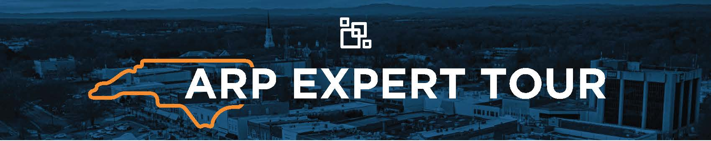



Brought To You By
In Partnership With

Slide 2
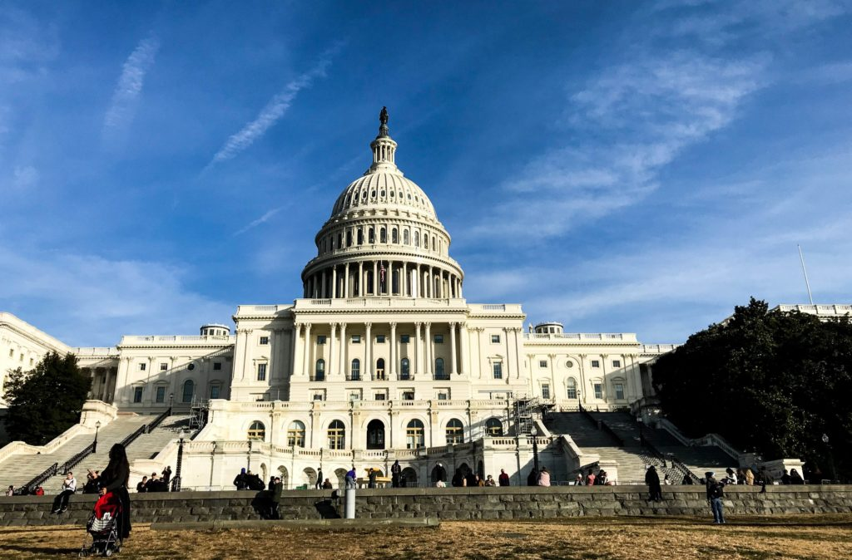
ARP Overview
American Rescue Plan signed into law on March 11
$1.9 trillion bill to respond to impacts of the COVID-19 pandemic
$350 billion in Fiscal Recovery Funds to states, counties, and municipalities
More than $9 billion to N.C. governments
  State: $5.6 billion
  Counties: $2 billion
  Cities: $1.3 billion

Slide 3
American Rescue Plan: $9B to N.C.

Slide 4
Metropolitan Cities
Apex | Gastonia | Lenoir
Asheville | Goldsboro | Morganton
Burlington | Greensboro | New Bern
Cary | Greenville | Raleigh
Chapel Hill | Hickory | Rocky Mount
Charlotte | High Point | Salisbury
Concord | Huntersville | Wilmington
Durham | Jacksonville | Winston-Salem
Fayetteville | Kannapolis

Slide 5

How Did We Get Here?

Slide 6

Key Milestones
March 2021: ARP passed

Slide 7
Key Milestones
March 2021: ARP passed
Spring 2021: Funding estimates

Slide 8
Key Milestones
March 2021: ARP passed
Spring 2021: Funding estimates
Summer 2021: Interim Final Rule (IFR) & first tranche of funds

Slide 9
Key Milestones
March 2021: ARP passed
Spring 2021: Funding estimates
Summer 2021: Interim Final Rule (IFR) & first tranche of funds
Fall 2021: Oct. 31 reporting delayed

Slide 10
Key Milestones
March 2021: ARP passed
Spring 2021: Funding estimates
Summer 2021: Interim Final Rule (IFR) & first tranche of funds
Fall 2021: Oct. 31 reporting delayed
November 2021: State of N.C. Budget

Slide 11
Key Milestones
March 2021: ARP passed
Spring 2021: Funding estimates
Summer 2021: Interim Final Rule (IFR) & first tranche of funds
Fall 2021: Oct. 31 reporting delayed
November 2021: State of N.C. Budget
January 2022: Final Rule

Slide 12
Key Milestones
March 2021: ARP passed
Spring 2021: Funding estimates
Summer 2021: Interim Final Rule (IFR) & first tranche of funds
Fall 2021: Oct. 31 reporting delayed
November 2021: State of N.C. Budget
January 2022: Final Rule
April 2022: NEU P&E Report

Slide 13
Key Milestones
March 2021: ARP passed
Spring 2021: Funding estimates
Summer 2021: Interim Final Rule (IFR) & first tranche of funds
Fall 2021: Oct. 31 reporting delayed
November 2021: State of N.C. Budget
January 2022: Final Rule
April 2022: NEU P&E Report
Summer 2022: Updated guidance & second tranche of funds

Slide 14

Key Considerations
All expenditures must comply with state law
Spending deadlines:
  Dec. 31, 2024: Obligation of funds
  Dec. 31, 2026: Expenditure of funds

Slide 15
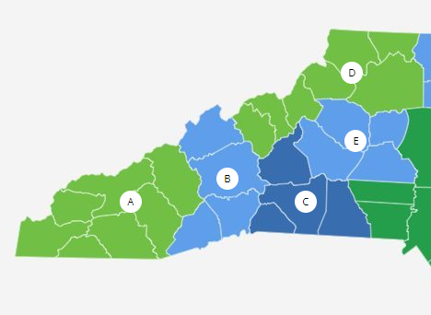
Facts & Figures
More than $200 million in first tranche of LFRF to region
  $141 million to counties
  $66 million to cities
Cities report having spent $23 million as of March 31, 2022
83% of budgeted funds spent as revenue replacement

Slide 16

What If I Haven’t Spent?
You’re not alone!
Deadlines remain in 2024/2026
That’s why we’re here today

Slide 17
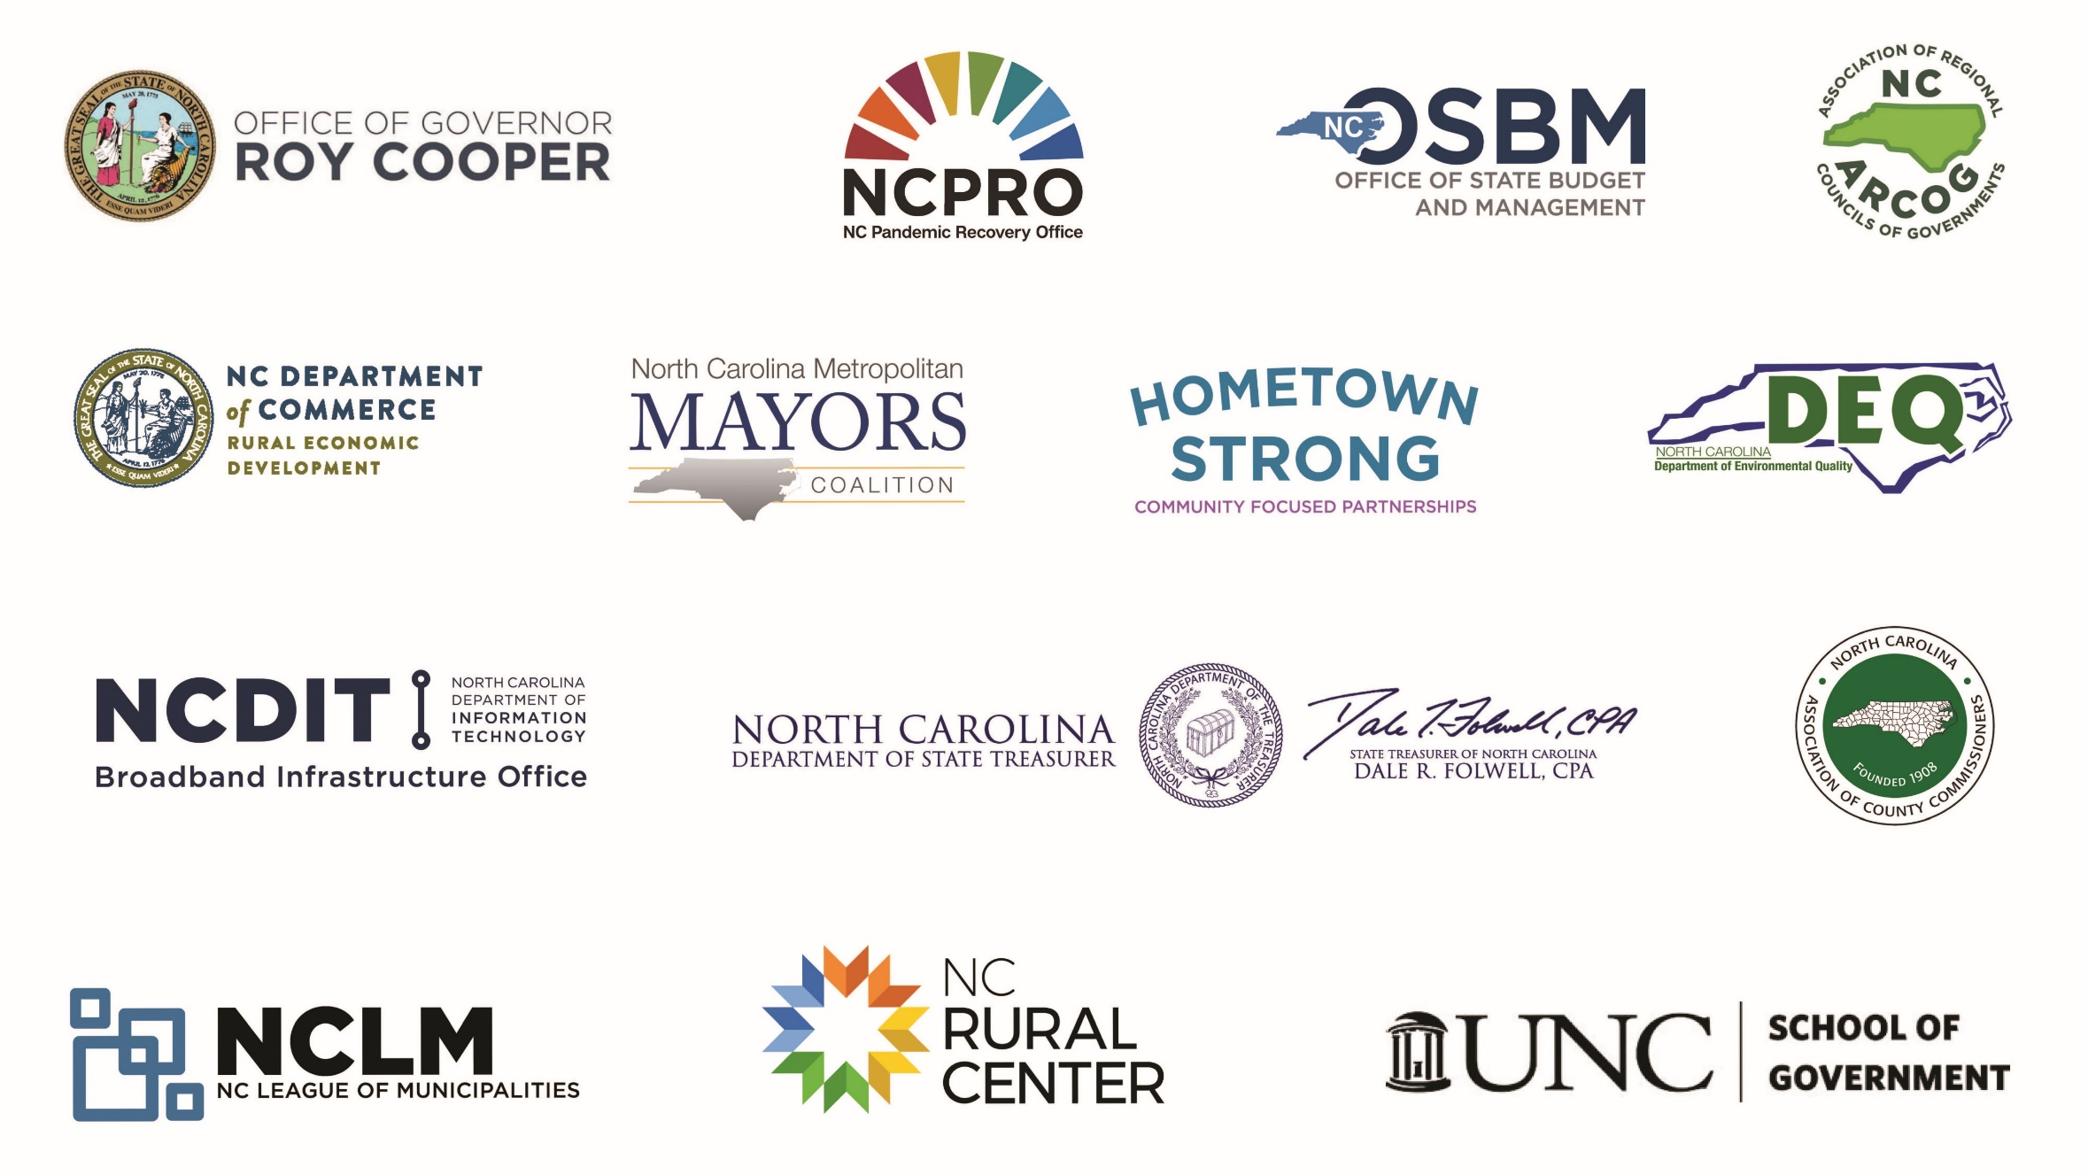
Rest of the ARP

Slide 18
ARPA LFRF REPORTING REVIEW
ARP Expert Tour, September 8, Hickory, 2022
Julie Metz, ARP Member Services Specialist
Notes:
Hello! I am Julie Metz and work for the League as an ARP Member Services Specialist. Thank you all for coming today.
In the second Revision of Treasury’s Final Rule in November 2021, they implemented a tiered approach to reporting. Since that time, we are now at Revision 4.2 with the last version updated on August 15, 2022. Many of these revisions have impacted or supported your reporting activities. In this 10 minute presentation, I am going to go over what your requirements are, based on what Tier category you are in, at a fairly high level, and remind you of your upcoming deadlines and schedule. For specific reporting questions, I encourage you to ask them during our panel Q&A at lunch, visit our reporting portal help desk or at the close of the day, we have more opportunity for specific questions.

Slide 19

Reminder
Reporting Portal Help Desk
Notes:
Just want to remind everyone we have a couple folks from either NCPRO, COG and NCLM staffing a booth located __________ to receive general ARP questions and to help you get familiar with what the Treasury’s ARP reporting portal looks like.
Also, later in the day, Abbie Britt will be sharing some tips based on our experience helping many NC towns, beginning in April of 2022 with their first report deadline. We learned some valuable lessons while trying to help towns submit their first reports earlier this year that she will share with you to avoid headaches when approaching your next report deadline. Otherwise, we may all need Lucy’s psychiatric help by the end of 2026.

Slide 20

What Tier Am I?
Six Possible Tiers
NC LFRF Tier 1: Charlotte, Raleigh, Durham and Greensboro
NC LFRF Tier 2: Gastonia, Winston-Salem, Fayetteville, Wilmington, Concord, Chapel Hill, High Point, Asheville, Rocky Mount, Burlington, Greenville, Cary, Garner, Holly Springs, Indian Trail, Matthews, Monroe, Mooresville, Wake Forest, Wilson
NC LFRF Tier 5: Everyone Else
SLFRF-Recipient-Tiers-April-2022-Reporting.xlsx (live.com)

Slide 21


Tier 1
Tier 1 SLFRF entities are defined as States, U.S. territories, metropolitan cities and counties with a population that exceeds 250,000 residents.
You have the highest level of responsibilities to meet the SLFRF statute, the Uniform Guidance, and Treasury’s final rule.
Charlotte, NC
Notes:
Lets Start with Tier 1.

Slide 22
2022 Tier 1 Reporting
Requirements & Due Dates
Status | Report | Due Date | Period Covered
Done | Initial P&E Report | 1/31/2022 | 3/3/2021 to 12/31/2021
Done | P&E Report | 4/30/2022 | 1/1/2022 to 3/31/2022
Done | Annual Recovery Plan & Performance Report | 7/31/2022 | 7/1/2021 to 6/30/2022
Upcoming | P&E Report | 10/31/2022 | 7/1/2022 to 9/30/2022
Upcoming | P&E Report | 1/31/2023 | 10/1/2022 to 12/31/2022
April 30, 2027
Notes:
Interim Report & Initial Recovery Plan. These were due by August 31, 2021. Hopefully, your initial Recovery Plan and your one-time interim report are complete and were submitted, congratulations! Your next annual Recovery Plan Performance Report is due July 31, 2022.
Quarterly Progress & Expenditure Reports. You are required to submit a Progress & Expenditures report quarterly until the end of the ARP expenditure period on December 31, 2026. Quarterly reports will cover one calendar quarter and must be submitted to Treasury by the last day of the month following the end of the period covered. Quarterly reports are not due concurrently with applicable annual reports.
Recovery Plan Performance Report (Recovery Plan). You are required to submit a Recovery Plan, each year, to cover a 12-month period and, submit the report to Treasury after the end of the 12-month period by July 31. Tier 1 cities will be required to complete seven of these, including the initial Recovery Plan with the last one being due April 30, 2027, to cover the July 1 to December 31, 2026 period.

Slide 23
Tier 1 Annual Recovery Plans
• Must be posted on the public-facing website by the same date recipient submits report. 3 clicks or fewer.
• General form and content at your discretion but must include the minimum information required by Treasury. Treasury template.
• Should include both retrospective information covering the period and prospective information on future work to be or on the planning that has been undertaken during the covered period.
Notes:
We also provide elected official and city management consultation services to help them get to where they need to be, whether that is……

Slide 24
Tier 1 Annual Recovery Plans
The Recovery Plan must include:
1. An Executive Summary
2. Description of Uses of Funds
3. Description of How the Plan Promote Equitable Outcomes
4. Description of Community Engagement Efforts
5. Description of Labor Practices
Description of Whether and How Evidence-based Interventions and/or Program Evaluations
Performance Report – Please note: There are mandatory performance indicators and programmatic data that are required, where applicable.
8. A Project Inventory
Notes:
We also provide elected official and city management consultation services to help them get to where they need to be, whether that is……

Slide 25
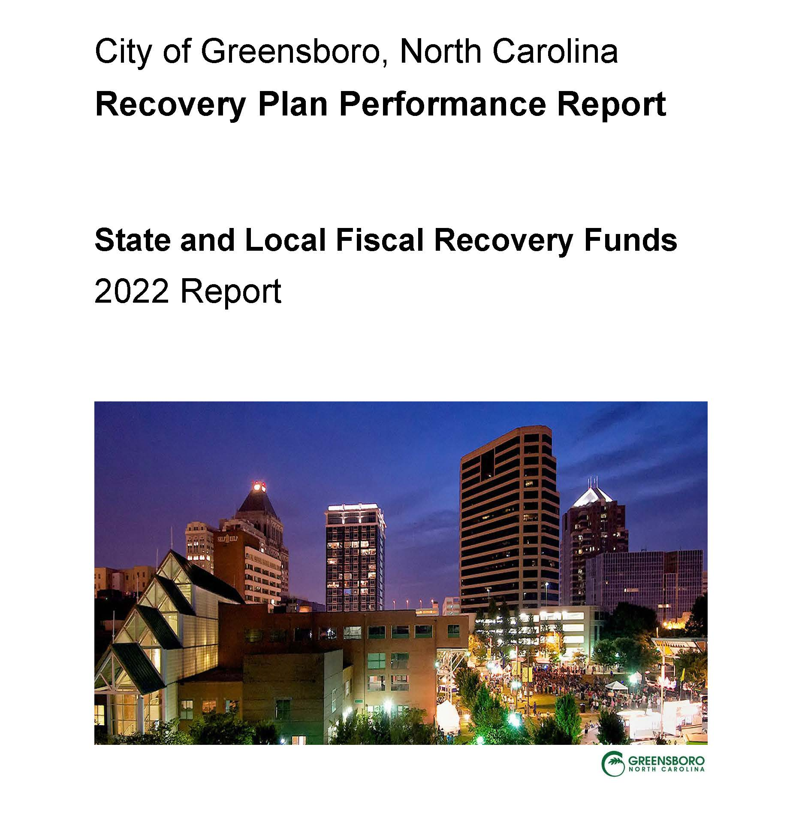
Tier 1 Annual Recovery Plans
For more details, go to page 39 of the Compliance and Reporting Guidance for SLFRF, Version 4.1, June 17, 2022 document.
SLFRF-Recovery-Plan-Performance-Report-Template.docx (live.com)
Notes:
Interim Report & Initial Recovery Plan. These were due by August 31, 2021. Hopefully, your initial Recovery Plan and your one-time interim report are complete and were submitted, congratulations! Your next annual Recovery Plan Performance Report is due July 31, 2022.
Quarterly Progress & Expenditure Reports. You are required to submit a Progress & Expenditures report quarterly until the end of the ARP expenditure period on December 31, 2026. Quarterly reports will cover one calendar quarter and must be submitted to Treasury by the last day of the month following the end of the period covered. Quarterly reports are not due concurrently with applicable annual reports.
Recovery Plan Performance Report (Recovery Plan). You are required to submit a Recovery Plan, each year, to cover a 12-month period and, submit the report to Treasury after the end of the 12-month period by July 31. Tier 1 cities will be required to complete seven of these, including the initial Recovery Plan with the last one being due April 30, 2027, to cover the July 1 to December 31, 2026 period.

Slide 26
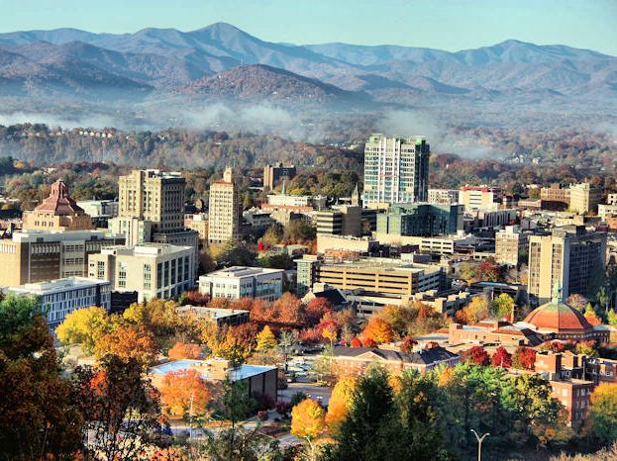
Tier 2
Tier 2 includes metropolitan cities and counties with a population below 250,000 residents that are allocated more than $10M in SLFRF funding, and NEUs that are allocated more than $10M in SLFRF funding.
Asheville, NC

Slide 27
2022 Tier 2 Reporting
Requirements & Due Dates
Status | Report | Due Date | Period Covered
Done | Initial P&E Report | 1/31/2022 | 3/3/2021 to 12/31/2021
Done | P&E Report | 4/30/2022 | 1/1/2022 to 3/31/2022
Done | P&E Report | 7/31/2022 | 4/1/2022 to 6/30/2022
Upcoming | P&E Report | 10/31/2022 | 7/1/2022 to 9/30/2022
Upcoming | P&E Report | 1/31/2023 | 10/1/2022 to 12/31/2022
April 30, 2027

Slide 28
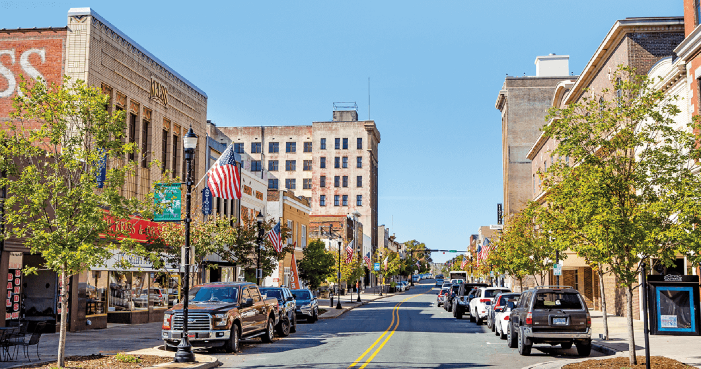
Tier 2 Quarterly Reports
• Microsoft Word - SLFRF PE Report User Guide.JULY Version 3.1 Final (treasury.gov)
SLFRF Compliance and Reporting Guidance (treasury.gov)
Gastonia, NC

Slide 29
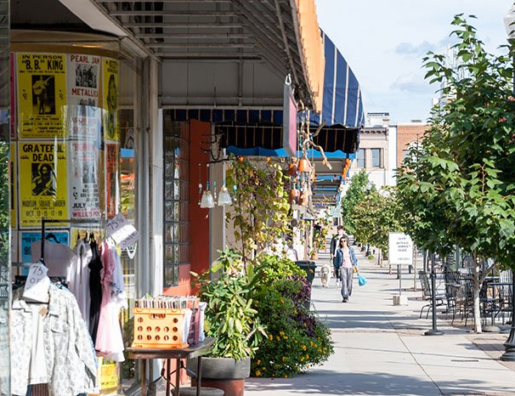
Tier 5
Tier 5 include metropolitan cities and counties with a population below 250,000 residents that are allocated less than $10M in SLFRF funding, and NEUs that are allocated less than $10M in SLFRF funding
Hickory, NC

Slide 30
Tier 5 Reporting
Requirements & Due Dates
Report | Period Covered | Due Date
1 | 3/3/21 – 3/31/22 | 4/30/22
2 | 4/1/22 – 3/31/23 | 4/30/23
3 | 4/1/23 – 3/31/24 | 4/30/24
4 | 4/1/24 – 3/31/25 | 4/30/25
5 | 4/1/25 – 3/31/26 | 4/30/26
6 | 4/1/26 – 12/31/26 | 4/30/27

Slide 31
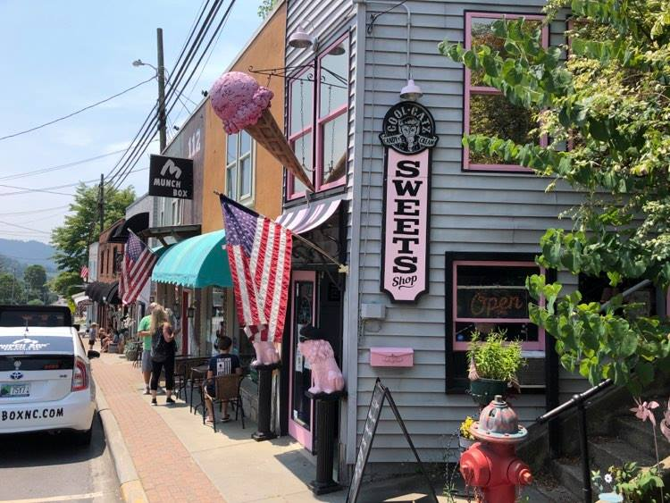
Tier 5 Annual Reports
• Microsoft Word - SLFRF PE Report User Guide.JULY Version 3.1 Final (treasury.gov)
SLFRF Compliance and Reporting Guidance (treasury.gov)
Burnsville, NC

Slide 32
Noteworthy
As of July 8, Treasury has a new position on Revenue Replacement that rescinds the former position that a one-time election to either calculate revenue loss according to the original formula or elect a “Standard Allowance” of up to $10 million, not to exceed the award allocation, to spend on government services throughout the period of performance.
Recipients were asked to make this election during the April 2022 reporting deadline. Based on feedback, Treasury decided to keep this portion of the reporting portal open, which will permit recipients to update their prior revenue loss election, as appropriate.
Treasury expects to keep this open through the April 2023 reporting period.

Slide 33

Noteworthy
Reports Are Now Public
https://home.treasury.gov/policy-issues/coronavirus/assistance-for-state-local-and-tribal-governments/state-and-local-fiscal-recovery-funds/recipient-compliance-and-reporting-responsibilities

Slide 34
Questions?
Notes:
Thank you for your time today and allowing me to share the passion of the League. Questions?

Slide 35
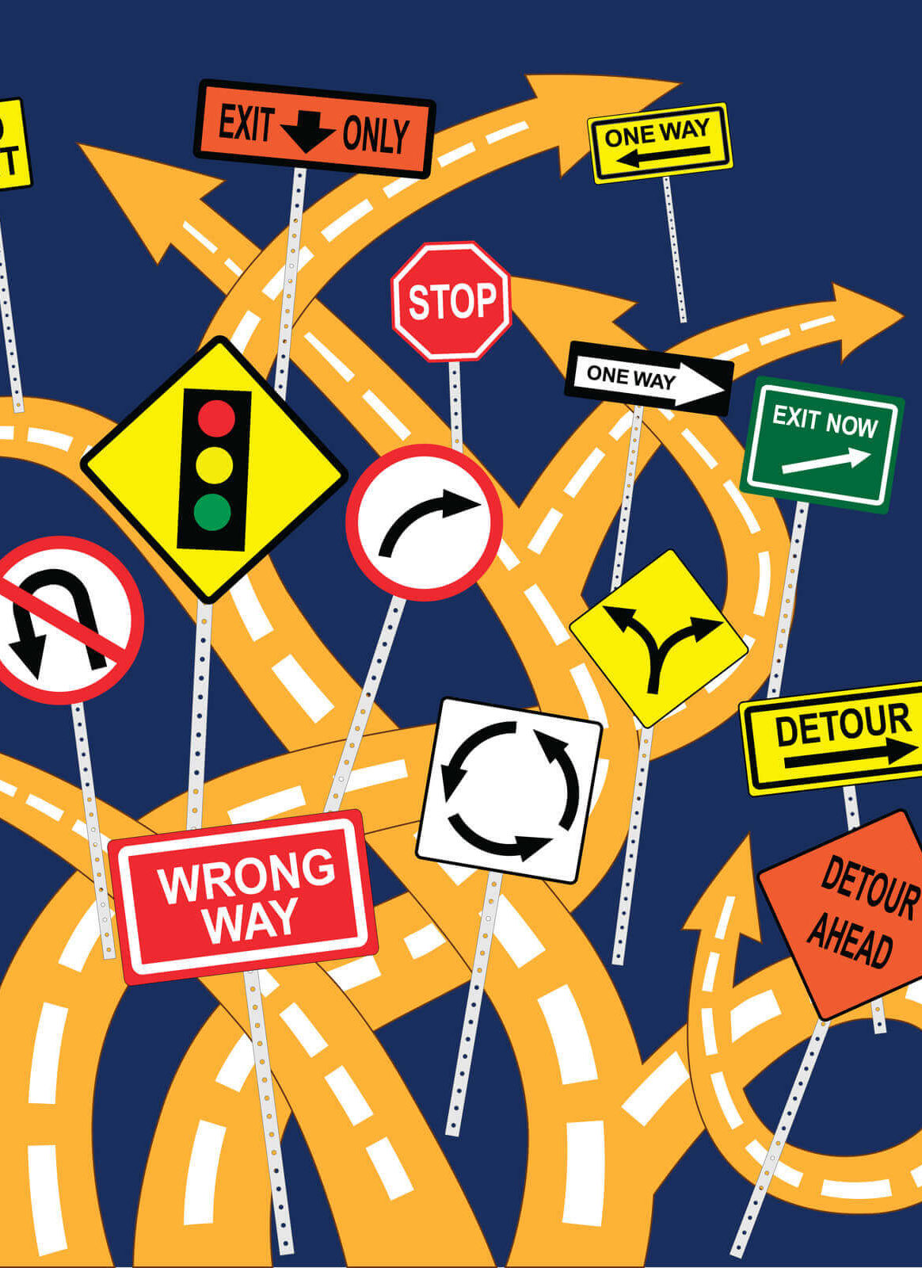
Implementing the American Rescue Plan Act of 2021: Coronavirus State and Local Fiscal Recovery Fund
NCLM American Rescue Plan Expert Tour
Fall 2022
Kara A. Millonzi, Robert W. Bradshaw, Jr. Distinguished Professor of Public Law and Government, UNC Chapel Hill School of Government
millonzi@sog.unc.edu

Slide 36
American Rescue Plan Act of 2021
1
$350B: Coronavirus State & Local Fiscal Recovery Fund
5
$211.57B: Education & Childcare (CCDBG, Education Stabilization, Child Care Entitlements, LIHEAP, LIHWAP, Head Start)
2
$10B: Coronavirus Capital Projects
6
$86.24B: Health (Emergency Rural Development Grants, Behavioral Health Clinic Expansion, Various Mental Health and Substance Abuse Programs, Testing & Vaccine Grants, etc.)
3
$656.18B: Direct Financial Assistance (Stimulus Checks, Unemployment, Tax Credits, EIDL, PPP, etc.)
7
$40.16B: Transportation (Transit Infrastructure Grants, Relief for Airports, Amtrak)
4
$56.27B Assistance to Individuals & Families (SNAP, EBT, WIC, Nutrition Assistance, IDEA, Veterans Affairs, Family Violence Prevention, Pandemic Emergency Assistance, OAA, Elder Justice Act, Rental Assistance, Homelessness Assistance, Homeowner Assistance, Rural Housing, etc.)
8
$61.32B: Other Programs (Disaster Relief Fund, Emergency Food and Shelter Programs, Assistance to Firefighter and Emergency Response Grants, Emergency Management Performance Grants, Economic Development Assistance Programs, Environmental Justice Grants, etc.)
.

Slide 37
ARP/CLFRF are Public Funds!
A project must be ARP-CLFRF- eligible AND authorized by state law
A local government must follow BOTH federal and state compliance requirements
1
2
ARP/CLFRF Eligible
State Law Authority
Federal Law Compliance
State Law Compliance

Slide 38

What is ARP/CSLFRF Eligible?
ADDRESS COVID PUBLIC HEALTH & NEGATIVE ECONOMIC IMPACT
Support public health expenditures, by funding COVID-19 mitigation efforts, medical expenses, behavioral healthcare, and certain public health and safety staff;
Address negative economic impacts caused by the public health emergency, including economic harms to workers, households, small businesses, impacted industries, and the public sector;
Support disproportionately impacted communities
REPLACE LOST REVENUE
Replace lost public sector revenue, using this funding to provide government services to the extent of the reduction in revenue experienced due to the pandemic;
$10 million standard allowance OR formula approach
PREMIUM PAY
Provide premium pay for essential workers, offering additional support to those who have borne and will bear the greatest health risks because of their service in critical infrastructure sectors;
Target low-and moderate- income employees or employees who face(d) added risks during pandemic
INFRASTRUCTURE INVESTMENTS
Invest in water, sewer, and broadband infrastructure, making necessary investments to improve access to clean drinking water, support vital wastewater and stormwater infrastructure, and to expand access to broadband internet.
Know Your Category!

Slide 39
Federal Compliance Requirements
Award Terms | Prohibited Expenditures | Uniform Guidance (UG)
All funds obligated by December 31, 2024 & fully expended by December 31, 2026 Reporting requirements Project & Expenditure reports (quarterly or yearly, depending on size) -- Document data elements for certain EC’s Performance Plan reports (for largest units only) Civil rights compliance / nondiscrimination policy Compliance with all applicable Uniform Guidance provisions Records retention policy with retention for at least 5 years after award term ends Special audit requirements | NO: Pension fund contributions NO: Borrowing money NO: Financial reserves / rainy day fund NO: Settlement/judgement/consent decree NO: Undermines or discourages compliance with CDC guidelines NO: Violates conflict of interest provisions NO: Violates state law or other federal laws and regulations, including applicable Uniform Guidance | General Financial Management Internal Controls Eligible Projects Determination & Documentation Policy Cost Principles/Allowable Costs Policy Procurement, Suspension, & Debarment Policy Subaward Policy Program Income Policy Property Management Policy
Applies to ALL projects
Applies ONLY TO SOME projects and DOES NOT apply to Revenue Replacement
What local government agreed to as condition of receiving funds. Applies to ALL categories.
The Final Rule prohibits certain expenditures no matter what. Applies to ALL categories
Set of federal compliance regulations that apply to federal awards.

Slide 40
ARP/CSLFRF Timing
March 3, 2021:
ARP/CLFRF Effective Date
January 27,
2020:
Pandemic Begins
May 2021:
Interim Final Rule
Premium Pay: May be applied retroactively to beginning of pandemic
Assistance Programs: May address negative impacts from beginning of pandemic
Revenue Loss: Will be calculated from beginning of pandemic. May cover expenses from March 3, 2021 onward
Water/Wastewater/Broadband: May be used for projects that started before March 3, 2021, but only for expenses after that date
Obligation means an order placed for property and services and entering into contracts, subawards, and similar transactions that require payment.
Summer 2021:
First ½ Distribution
Fall 2021:
Various Compliance Guides
January 2022: Final Rule
Summer 2022:
Second ½ Distribution
December 31, 2024:
All Funds Obligated
December 31, 2026:
All Funds Fully Expended

Slide 41

If ARP/CSLFRF allocation is between $0 and $10 million, may spend all ARP/CSLFRF funds in this category.
DO NOT HAVE TO SHOW ANY ACTUAL REVENUE LOSS!!!
REPLACE LOST REVENUE
May spend Revenue Replacement ARP/CSLFRF on almost any expenditure that authorized to undertake by State Law, including reimbursements back to
March 3, 2021
General fund expenditures
Enterprise fund expenditures
Operating costs
Capital costs
Internal expenditures (eg salaries & benefits)
External expenditures (eg contracts, partnerships, interlocal agreements)
If ARP/CSLFRF allocation is over $10 million, may spend up to $10 million in this category (standard allowance) or more if formula shows actual lost revenue growth due to pandemic exceeds $10 million.
But Avoid These PROHIBITED Expenditures:
NO: Pension fund contributions
NO: Borrowing money
NO: Financial reserves / rainy day fund
NO: Settlement/judgement/consent decree
NO: Undermines or discourages compliance with CDC guidelines
NO: Violates conflict of interest provisions
NO: Violates state law or other federal laws and regulations, including applicable Uniform Guidance

Slide 42
Revenue Replacement Compliance:
Exempt from Some UG Provisions
Award Terms | Prohibited Expenditures | Uniform Guidance (UG)
All funds obligated by December 31, 2024 & fully expended by December 31, 2026 Reporting requirements Project & Expenditure reports (quarterly or yearly, depending on size) – Document data elements for certain ECs Performance Plan reports (for largest units only) Civil rights compliance / nondiscrimination policy Compliance with all applicable some Uniform Guidance provisions Records retention policy with retention for at least 5 years after award term ends Special audit requirements | NO: Pension fund contributions NO: Borrowing money NO: Financial reserves / rainy day fund NO: Settlement/judgement/consent decree NO: Undermines or discourages compliance with CDC guidelines NO: Violates conflict of interest provisions NO: Violates state law or other federal laws and regulations, including applicable Uniform Guidance | General Financial Management Internal Controls Eligible Projects Determination & Documentation Policy Cost Principles/Allowable Costs Policy (limited review) Procurement, Suspension, & Debarment Policy Subaward Policy Program Income Policy Property Management Policy
In the July 2022 FAQs, US Treasury exempted Revenue Replacement expenditures from some provisions of the Uniform Guidance as reflected here.

Slide 43
Using ARP/CSLFRF For Salaries / Benefits or Reimbursement Expenditures
(aka MB²)
Use ARP/CSLFRF to cover salaries and benefits or reimburse other local government expenses
Comply with award terms and Uniform Guidance requirements that apply to salaries and benefits or other reimbursed expenses
Free up non-grant revenues that would have been used to cover salaries and benefits or other reimbursements
May reimburse salary and benefit or other local government expenditures from March 3, 2021 through today and/or for future salary and benefit expenditures from today through December 31, 2024
Must adopt certain Uniform Guidance policies and follow all Award Terms related to expenditure of ARP/CSLFRF funds on salaries/benefits or reimbursement expenditures
Freed up non-grant revenues are NOT subject to Award Terms, including timing requirements, and Uniform Guidance. They may be spent for any public purpose authorized by state law and at any time.

Slide 44
Revenue Replacement Options:
Land Purchase
Option 1
Option 2
Expend ARP/CSLFRF funds on salaries and benefits and/or reimbursement expenditures by December 31, 2024. Document compliance for these expenditures, including allowable costs and conflict of interest.
Free up non-grant funds to purchase land at any time (even after grant term ends), without any federal compliance requirements. Just follow state law.
Expend ARP/CSLFRF funds directly on land purchase. Execute purchase contract by December 31, 2024, and fully expend funds for land purchase by December 31, 2026. Document compliance for land purchase, including allowable cost, conflict of interest, suspension/debarment check.
ARP/CSLFRF-Enabled
ARP/CSLFRF Direct Expenditure

Slide 45
What is ARP/CSLFRF Eligible?
ADDRESS COVID PUBLIC HEALTH & NEGATIVE ECONOMIC IMPACT
Support public health expenditures, by funding COVID-19 mitigation efforts, medical expenses, behavioral healthcare, and certain public health and safety staff;
Address negative economic impacts caused by the public health emergency, including economic harms to workers, households, small businesses, impacted industries, and the public sector;
Support disproportionately impacted communities
PREMIUM PAY
Provide premium pay for essential workers, offering additional support to those who have borne and will bear the greatest health risks because of their service in critical infrastructure sectors;
Target low-and moderate- income employees or employees who face(d) added risks during pandemic
INFRASTRUCTURE INVESTMENTS
Invest in water, sewer, and broadband infrastructure, making necessary investments to improve access to clean drinking water, support vital wastewater and stormwater infrastructure, and to expand access to broadband internet.
If allocation is over $10 million, likely have to spend some funds in one or more of these categories.

Slide 46
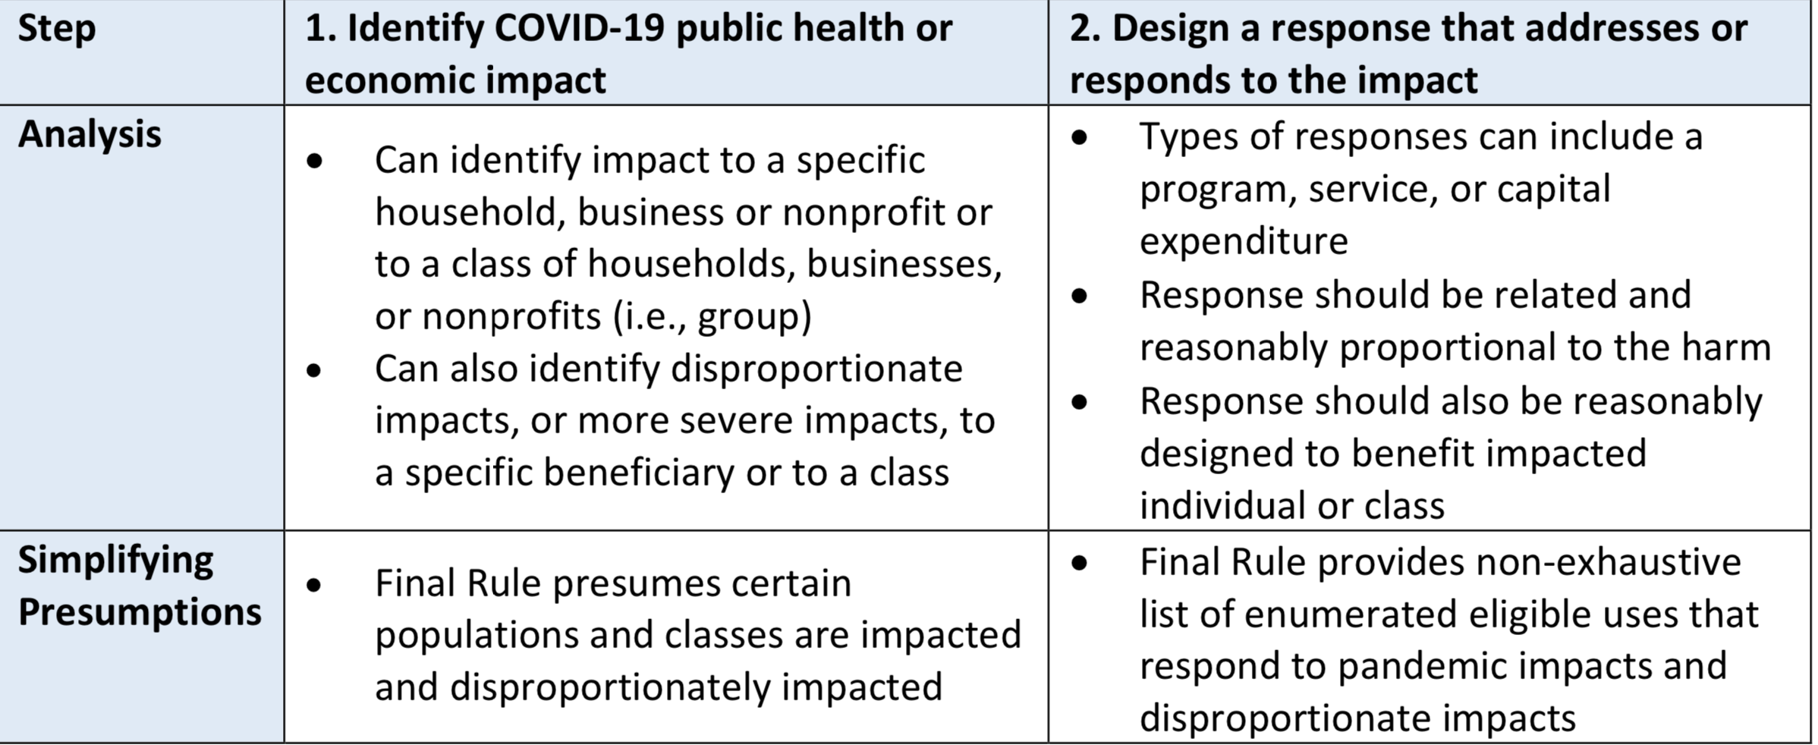
What is ARP/CSLFRF Eligible?
Identify targeted beneficiary that was harmed due to COVID and design project/ program to address that harm
ADDRESS COVID PUBLIC HEALTH & NEGATIVE ECONOMIC IMPACT
See Final Rule Overview for lists of safe harbor projects.

Slide 47
Address COVID & Negative Economic Impact
Must also clearly identify state law authority. There is broad state law authority to assist low- or moderate- income citizens and senior citizens but very limited state law authority to directly aid small businesses and nonprofits.
Who is the beneficiary?
Safe harbor beneficiary (enumerated list) or general analysis?
What is the harm (addressing COVID or its negative economic impact)?
How does proposed project address the harm?
Safe harbor project (enumerated list) or general analysis?
Is the proposed project reasonably designed to benefit and proportional response to harm?
If proposed project, involves capital over $1m, additional justification required
Evidence based?
Safe harbor related and reasonably proportional list?
Must track demographic distribution of funds
Navigating affordable housing projects under state law
(by Tyler Mulligan)

Slide 48
Address COVID & Negative Economic Impact
General Analysis
Program, service, capital expenditure eligible if LG identifies harm or impact to beneficiary or class caused or exacerbated by COVID or its negative economic impacts AND the program, service, or capital expenditure responds to the harm.
Who is the beneficiary?
Safe harbor beneficiary (enumerated list) or general analysis?
What is the issue (addressing COVID or its negative economic impact)?
How does proposed project address the issue?
Safe harbor project (enumerated list) or general analysis?
Is the proposed project reasonably designed to benefit and proportional response to issue?
If proposed project, involves capital over $1m, additional justification required
Evidence based?
Safe harbor related and reasonably proportional list?
Must track demographic distribution of funds
The final rule presumes that all enumerated eligible uses for programs and services, including COVID-19 mitigation and prevention programs and services, are reasonably proportional responses to the harm identified unless a response is grossly disproportionate to the type or extent of harm experienced.
Navigating affordable housing projects under state law (by Tyler Mulligan)

Slide 49
Public Sector Capacity & Workforce
Payroll and covered benefit expenses for public safety, public health, health care, human services, and similar employees to the extent that the employee’s time is spent mitigating or responding to the COVID-19 public health emergency;
Payroll, covered benefit, and other costs associated with programs or services to support the public sector workforce and with the LG:
  Hiring or rehiring staff to fill budgeted full-time equivalent positions that existed on January 27, 2020 but that were unfilled or eliminated as of March 3, 2021; or
  Increasing the number of its budgeted full-time equivalent employees by up to the difference between the number of its budgeted full-time equivalent employees on January 27, 2020, multiplied by 1.075, and the number of its budgeted full-time equivalent employees on March 3, 2021, provided that funds shall only be used for additional budgeted full-time equivalent employees above the recipient’s number of budgeted full-time equivalent employees as of March 3, 2021;
Costs to improve the design and execution of programs responding to the COVID-19 pandemic and to administer or improve the efficacy of programs addressing the public health emergency or its negative economic impacts
Costs associated with addressing administrative needs of recipient governments that were caused or exacerbated by the pandemic.
Note that these limitations only apply to the “purple” category expenditures. If using Revenue Replacement, may pay for any government costs, except those on prohibited list.

Slide 50
Capital Outlay for Address COVID and
Negative Economic Impact Category
If a project has total expected capital expenditures of | and the use is enumerated in (b)(3), then | and the use is not enumerated in (b)(3), then
Less than $1 million | No Written Justification required | No Written Justification required
Greater than or equal to $1 million, but less than $10 million | Written Justification required but recipients are not required to submit as part of regular reporting to Treasury | Written Justification required and recipients must submit as part of regular reporting to Treasury
$10 million or more | Written Justification required and recipients must submit as part of regular reporting to Treasury
Written justification must include the following elements:
Describe the harm or need to be addressed;
Explain why a capital expenditure is appropriate; and
Compare the proposed capital expenditure to at least two alternative capital expenditures and demonstrate why the proposed capital expenditure is superior.

Slide 51
PREMIUM PAY
May provide subaward to nonprofit fire departments, rescue squads, or similar entities to provide premium pay to their employees –must be for work that LG has state statutory authority to perform itself and that is also eligible under ARP/CSLFRF
May award premium pay to any local government employee who performed essential work during the pandemic
  Essential work is work that is performed in person with regular interactions with others (including co-workers) OR regularly handling items handled by others
  Must target low- or moderate-income employees OR be able to provide justification for including higher income employees based on their special risks due to COVID
    Employee NOT EXEMPT from FLSA overtime provisions OR
    Employee’s total wages and remuneration does not exceed 150% of the state or county average for all occupations, whichever is higher
$13 / hour & $25K total maximums
May pay retroactively back to January 27, 2020 or prospectively until December 31, 2024, but must be for work actually performed (no pre-payments)
Low- or moderate- income criteria

Slide 52
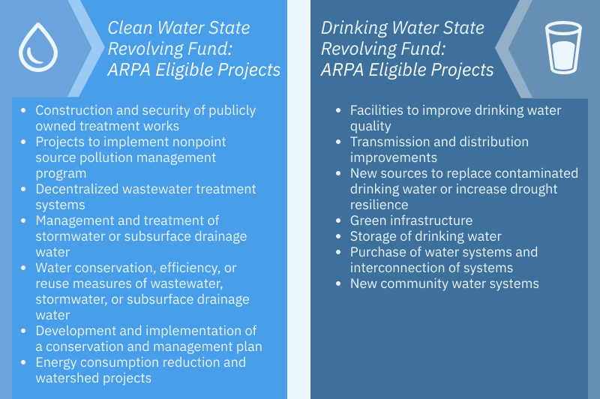
INFRASTRUCTURE INVESTMENTS
Presumed Eligible:
Projects allowed under Clean Water State Revolving Fund (CWSRF) and Drinking Water State Revolving Fund (DWSRF) programs
Must be Necessary

Slide 53
Infrastructure Investments:
Additional Eligibility
Stormwater
Culvert repair, resizing, and removal, replacement of storm sewers, etc.
Residential Wells
Testing initiatives, and treatment/remediation strategies that address contamination
Lead Remediation
Eligible regardless of water quality benefit
Infrastructure to improve access to drinking water
Replacement of internal plumbing and fixtures in schools and childcare facilities
Projects regardless of pipe material, but full length of service line must be replaced
Lead testing, lead service line replacement, water quality testing, compliance monitoring, and remediation activities
Dam & Reservoir Remediation
Primary purpose of dam or reservoir is for drinking water supply
May consider reasonable population growth
Drinking Water Infrastructure
Designed to support reasonable growth only
Must be cost-effective to achieve a minimum level of service
Must be sustainable over its estimated useful life
Must be Necessary
  Responsive to an identified need to achieve or maintain an adequate minimum level of service, which may include a reasonable projection of increased need, whether due to population growth or otherwise,
  A cost-effective means for meeting that need, taking into account available alternatives, and
  For investments in infrastructure that supply drinking water in order to meet projected population growth, projected to be sustainable over its estimated useful life.

Slide 54

Every Local Government Must:
Finance
Set up financial management system
Internal Controls
Adopt written internal controls
Policies
Adopt and implement certain federal policies
Document
Document! Document! Document!
Adopt grant project ordinance

Slide 55
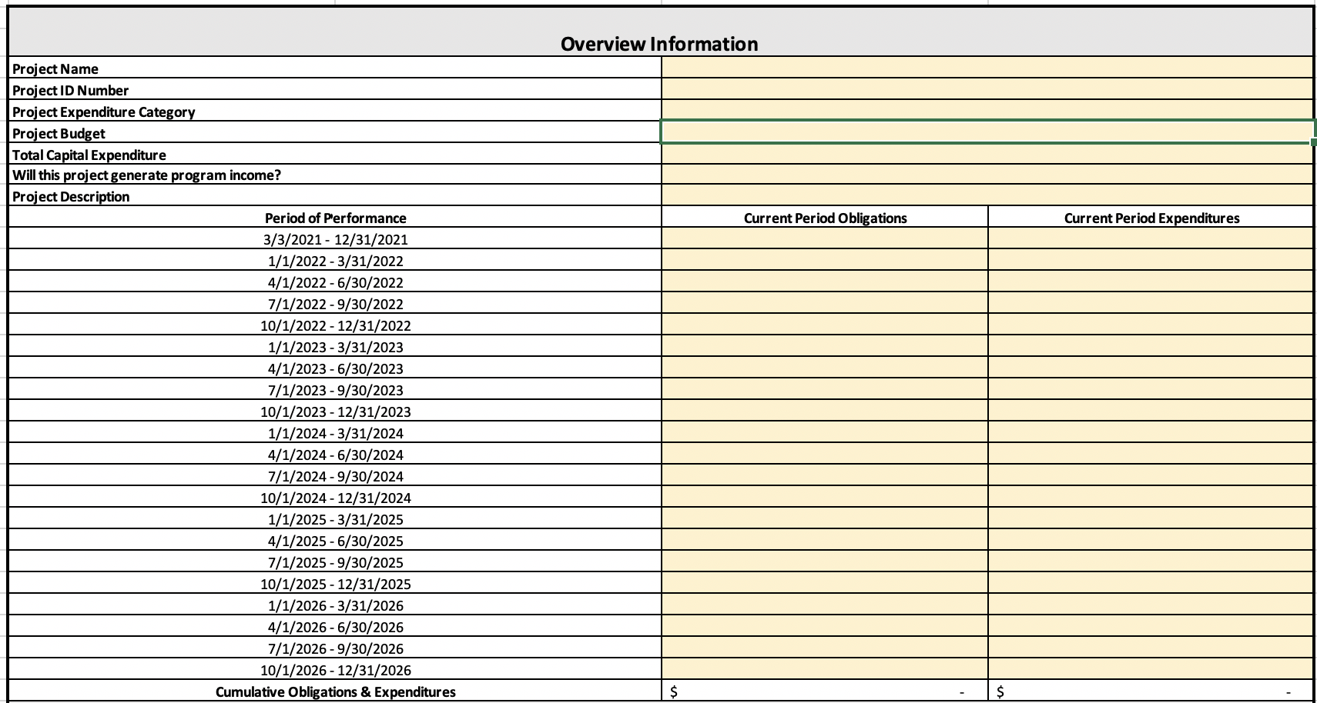
General Compliance: Financial Management
Financial administration
(2 CFR 200.302). A local government must have a financial management system that is sufficient to allow it to complete all necessary reporting requirements related to the ARP/CSLFRF award. At a minimum, a local government must track obligations and expenditures of ARP/CSLFRF funds by project and include real-time comparisons to budgeted amounts for those projects.

Slide 56
General Compliance: Internal Controls
Control Environment
Commitment to integrity & ethics
Risk Assessment
Specifies suitable objectives
Control Activities
Develops control activities
Info & Communication
Monitoring Activities
Effective oversight by leadership
Clear structure and procedures
Commitment to competence
Enforces accountability
Identifies & analyzes risk
Assesses fraud risk
Identifies & analyzes significant changes
General controls over technology
Thorough policies and procedures
Communicates expectations and control activities clearly within and outside organization
Provides sufficient training for staff
Conducts ongoing monitoring
Identifies, evaluates, and communicates deficiencies
Addresses deficiencies in a timely manner
A local government must have a written set of internal controls related to its financial transactions. The nature of these controls will vary based on the size of the unit and its staffing capacity, but there are some minimum requirements. The regulation prompts a local government to generally conform its internal controls to those that apply to federal agencies through what is known as the federal Green Book or COSO Framework. That does not mean that a local government must adopt all the specific controls that apply to federal agencies; rather, it should simply follow the same general framework for its own controls.

Slide 57
General Compliance:
Adopt and Implement these Policies
Record Retention
This policy supplements a local government’s regular records retention policy to establish procedures to retain all ARP/CSLFRF-related information for at least 5 years after the end of the award term (through December 31, 2031). (Sample policy here.)
Civil Rights Compliance
This policy reaffirms the local government’s commitment to compliance with federal civil rights laws and establishes processes for reporting potential violations and tracking complaints and resolutions. (Sample policy here.)
Eligible Use
This is a simple policy that indicates allowable and unallowable projects, based on the expenditure categories in the ARP/CSLFRF Final Rule. It requires a local government to identify staff to document and review ARP/CSLFRF expenditures. That documentation must be retained according to the record retention requirements. (Sample policy here.)
Allowable Cost
This is a more complex policy that requires a local government to do a detailed review of each cost item and ensure compliance with special limitations and documentation mandates for certain cost items. (Sample policy here.) [If using Revenue Replacement ARP/CSLFRF, there will be a more limited allowable cost review.]
Conflict of Interest
The UG requires recipients and subrecipients of federal financial assistance to maintain written standards of conduct covering conflicts of interest and governing the actions of its employees engaged in the selection, award, and administration of contracts. (Sample policy here.)

Slide 58
Additional Compliance for
Purple, Green, and Blue Categories ONLY
Sign-up for FREE on-demand video instructions and sample policies for each of these requirements.
Thanks to the NC Association of Regional Councils of Government for sponsoring the course!
UG Procurement. Adopt and implement a procurement policy that complies with federal and state law requirements.
UG Property Management. Adopt and implement policy for managing, using, and disposing of real property, equipment, and supplies, acquired or improved with federal funds.
UG Subawards. Adopt and implement policy for partnership agreements with external parties.
UG Program Income. Adopt and implement policy for identifying, tracking, and re-obligating program income earned as a result of grant award.

Slide 59
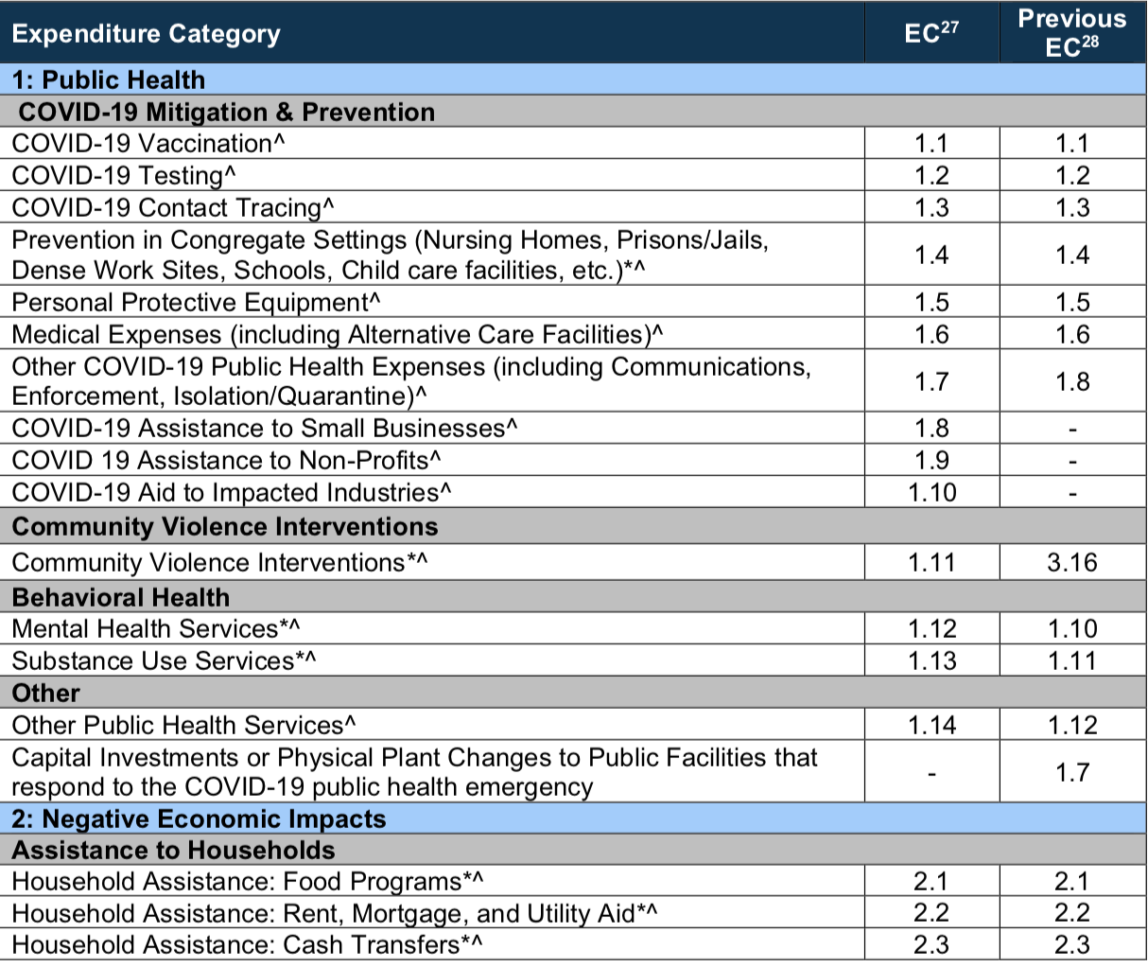
Compliance Guide Lists Expenditure Categories (EC) within each broad grouping. Local government must align each project with one (and only one) EC
Must track data elements for certain ECs
* Projects that local government will report on amount of funds spent on evidenced-based projects
^ Projects that local government will report on number of disproportionately impacted beneficiaries

Slide 60
School of Government Resources
From A to Z: Using American Rescue Plan Act Fiscal Recovery Funds to Directly Fund a Capital Project
In this online workshop (via Zoom), we detailed all the legal requirements involved in spending American Rescue Plan Act Coronavirus State and Local Fiscal Recovery Funds (ARP/CSLFRF) directly for a capital project. Using a specific capital project as an example, we highlighted the substantive and process requirements for expending ARP/CSLFRF funds appropriately and demonstrated how to adopt and implement the various state and federal budgeting and compliance provisions,
The course was held live on August 10, 2022. On demand video recordings of the course are available now and are divided into segments that can be viewed separately or as a single course. The on-demand videos and other resources are available for FREE here.
Sponsored by NC Association of Regional Councils of Government
ARP Office Hours:
Monday, September 12, at 12:00pm
Friday, September 23, at 8:30am
Friday, September 30, at 12:00pm
Friday, October 7, at 8:30am
Friday, October 14, at 12:00pm
Wednesday, October 19, at 8:30am
Monday, October 24, at 12:00pm
Monday, November 1, at 8:30am
The Zoom link for all sessions is
https://zoom.us/j/91906998701?pwd=eWg0anp1MFJzSFVsU0FIYmduU3ZQUT09
Meeting ID: 919 0699 8701
Passcode: 912104
Coates Canons Blog Posts
ARP Webpage

Slide 61




US Treasury Compliance Guidance
US Treasury Final Rule FAQs
US Treasury is routinely updating Final Rule FAQs, and compliance and reporting guidelines. Make sure you are relying on the most current guidance.
US Treasury Resource Page
Final Rule
Assistance Listing (21.027)
UG Compliance Supplement
US Treasury Final Rule Summary
ARP/CSLFRF
Where to go for the latest guidance on ARP/CLFRF

Slide 62

Bonus Info

Slide 63
Budgeting & Accounting
GPO/CPO
(G.S. 159-13.2)
Extends for life of capital project or grant
Must be balanced
Adopt at any time, by simple majority of board present and voting, if there is a quorum
No public hearing required
Must be included in board minutes with copies filed with finance officer, budget officer, and clerk
Info about expected projects/programs relayed to board during annual budget process
Board may amend at any time, as long as it continues to be balanced
If grant project ordinance, account as special revenue fund
Adopt Grant Project Ordinance (GPO) to appropriate $1.2 million for water project
Account for ARP/CSLFRF monies in special revenue fund
Expend ARP/CSLFRF funds for project directly out of GPO
Amend GPO to reflect any changes as needed (including to account for any program income)

Slide 64
UG: Property Management
Definitions of Property
2 CFR 200.1
Computing devices: machines used to acquire, store, analyze, process, and publish data and other information electronically, including accessories (or “peripherals”) for printing, transmitting and receiving, or storing electronic information. See also the definitions of supplies and information technology systems in this section.
Equipment: tangible personal property (including information technology systems) having a useful life of more than one year and a per-unit acquisition cost which equals or exceeds the lesser of the capitalization level established by the [county/City/Town/Village] for financial statement purposes, or $5,000. See also the definitions of capital assets, computing devices, general purpose equipment, information technology systems, special purpose equipment, and supplies in this section.
Information technology systems: computing devices, ancillary equipment, software, firmware, and similar procedures, services (including support services), and related resources. See also the definitions of computing devices and equipment in this section.
Intangible property: property having no physical existence, such as trademarks, copyrights, patents and patent applications and property, such as loans, notes and other debt instruments, lease agreements, stock and other instruments of property ownership (whether the property is tangible or intangible).
Personal property: property other than real property. It may be tangible, having physical existence, or intangible.
Property: real property or personal property.
Real property: land, including land improvements, structures and appurtenances thereto, but excludes moveable machinery and equipment.
Supplies: all tangible personal property other than those described in the definition of equipment in this section. A computing device is a supply if the acquisition cost is less than the lesser of the capitalization level established by the local government for financial statement purposes or $5,000, regardless of the length of its useful life. See also the definitions of computing devices and equipment in this section.

Slide 65
UG: Property Management
Real Property
  Title vests in local government
  Must be used for ARP/CSLFRF purpose, or disposed of according to US Treasury instructions and with repayment of federal share
  Must not encumber during award term
  Must be insured in same way as other local government property
Equipment
Title vests in local government
Must be used for ARP/CSLFRF purpose, used for other federal programs, or disposed of according to US Treasury instructions and with repayment of federal share
Must not encumber during award term
Must be insured in same way as other local government property
Must be tracked in property management system (with several required data elements) and inventoried at least every 2 years
Noncompetition provision
Supplies
Must be used for ARP/CSLFRF purpose or other federal award purpose
Any inventory of unused supplies exceeding $5000 in total aggregate value, local government may retain or sell, but must compensate US Treasury for federal share
Noncompetition provision

Slide 66
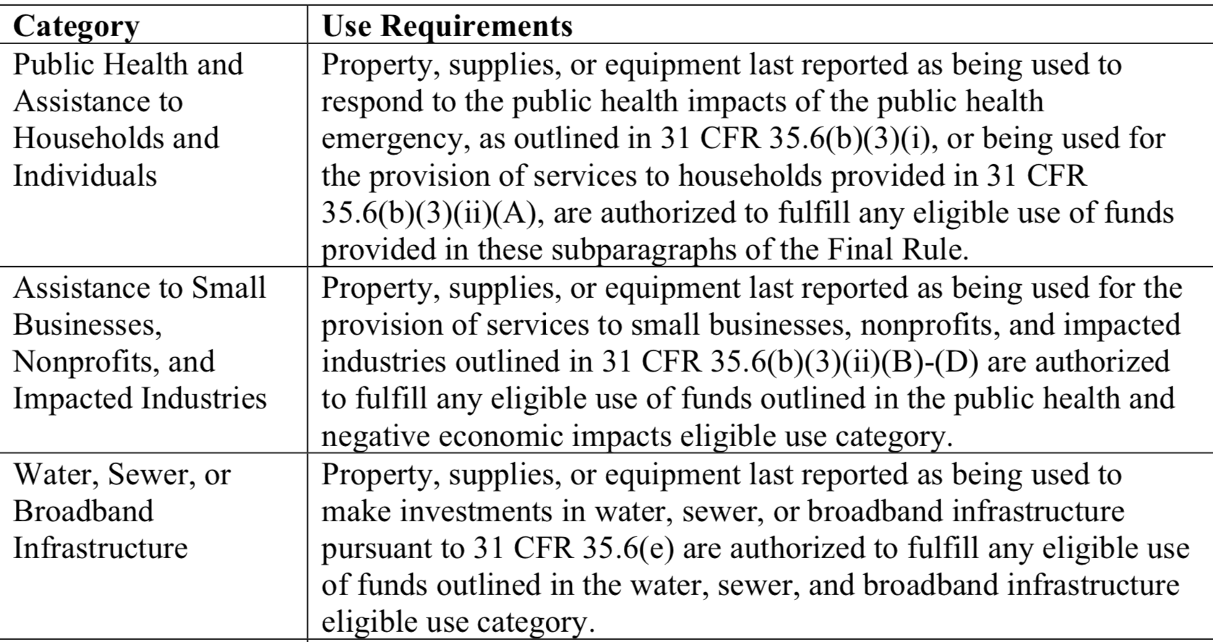
Use of Property
During Award Term
A local government “may use property, supplies, or equipment purchased or improved with [ARP/CSLFRF] funds for a purpose other than the purpose for which it was purchased or improved if such other purpose is also consistent with the eligible use requirements.”
After Award Term
“[T]he property, supplies, or equipment must be used consistent with the purpose for which it was purchased or improved or for any other eligible purpose in the same category as the purpose reported to Treasury as of the final reporting period, as set forth in the table below.”
Local governments are responsible for being able to substantiate their determinations on whether the use of an asset is authorized and maintain a record of that determination.
Local governments are not required to seek or obtain the approval of Treasury prior to changing the use within the parameters of the authorized purpose.

Slide 67
What if Sell Property or Change Use of Property Outside ARP/CSLFRF Parameters?
During Award Term
If a local government changes the use of an asset to an ineligible use or sells the asset prior to the end of the period of performance, then the local government must follow the disposition procedures in the Uniform Guidance. See 2 CFR 200.311, 200.313, 200.314, and 200.315.
After Award Term
If an asset’s use shifts outside the parameters of the eligible purpose according to the table after the grant term ends, then the local government (and any subrecipient) must follow the disposition procedures in the Uniform Guidance. See 2 CFR 200.311, 200.313, 200.314, and 200.315.
Real Property |  |  | Equipment |  |  | Supplies
Retain title and compensate US Treasury the “federal share” | Sell the property and compensate US Treasury the “federal share” | Transfer title to US Treasury or to a third party designated/ approved by US Treasury | If FMV of $5K or less, local government may retain, no compensation to US Treasury | If FMV over $5K must request disposition instructions from US Treasury. If US Treasury does not provide instructions within 120 days, may sell or use for different purpose, but must repay US Treasury “federal share” | Transfer title to US Treasury or to a third party designated/ approved by US Treasury | If there is a residual inventory of unused supplies exceeding $5,000 in total aggregate value upon termination or completion of the project and the supplies are not needed for any other Federal award, the local government must retain the supplies for use on other activities or sell them, but must, in either case, repay US Treasury “federal share”
Must get specific instructions from US Treasury on which option to take.

Slide 68
UG: Program Income
Program Income is the gross income earned by the non-Federal entity that is directly generated by a supported activity or earned as a result of the Federal award during the period of performance.
2 CFR 200.1
Program income requirements DO NOT apply to income earned from expenditures of Revenue Replacement ARP/CSLFRF funds
Program Income
Program income may apply to certain projects funded in the Necessary Infrastructure category or the Responding to COVID and Its Negative Economic Impacts category.

Slide 69
Program Income Defined
Program Income Includes
Not Program Income
Fees for services performed with grant funded programs or assets
  Income from previously unavailable services (new user fees, connection fees, other fee-for-service income)
  Incremental income from the sale of upgraded services
Income from leasing facilities or equipment
Repayment of principal and interest on loans (see ARP-specific requirements)
Proceeds from the sale of real property or equipment (must follow property management rules)
Rebates, credits, discounts, and interest earned on any of them
Taxes, special assessments, levies, fines, or other governmental revenues
Interest earned on ARP/CSLFRF funds

Slide 70
Treatment of Program Income
2 C.F.R. 200.307(e)
Deduction Method: Program income is deducted from total allowable costs to determine net allowable costs.
§ 200.307(e)(1)
Addition method applies to program income earned from expenditures of ARP/CSLFRF funds. FAQ 13.11
Addition Method: Program income is added to the funds committed to the project and expended on eligible projects.
§ 200.307(e)(2)
Program Income
Matching Method: Program income is used to finance the non-federal share of the project (i.e., meet cost-sharing commitments).
§ 200.307(e)(3)
Notes:
Use of program income. If the Federal awarding agency does not specify in its regulations or the terms and conditions of the Federal award, or give prior approval for how program income is to be used, paragraph (e)(1) of this section must apply.

Slide 71
Repayment of Principal & Interest
Loans of Infrastructure Investment ARP/ CSLFRF
Loans of Revenue Replacement ARP/CSLFRF
Program Income
Loans that mature on or before December 31, 2026
  Repayment of principal and interest shall be an addition to the total award (i.e., follow the addition method)
Loans that mature after December 31, 2026
  No obligation to track and account for the repayment of principal or interest
  See Treasury FAQ 4.9 for additional details on the treatment of loans of ARP/CSLFRF funds
Repayment of principal and interest of loan of Revenue Replacement funds exempt from program income requirements
The same applies to any contribution of Revenue Replacement funds to a revolving loan fund FAQ 4.9

Slide 72
External Contract for Construction,
Goods, or Services?
The Final Rule and Uniform Guidance group external payments of ARP/CSLFRF funds into 3 categories.
Contracts | Subawards | Beneficiary Payments
If a local government uses ARP/CLSRF funds to pay for an agreement with another entity (government, nonprofit, for profit) whereby the other entity provides goods or services for the benefit of the local government, it is a contractor relationship. The agreement is referred to as a “contract.” | If a local government uses ARP/CSLFRF funds to pay for an agreement with another entity (government, nonprofit, for profit) whereby the other entity carries out an ARP/CSLFRF eligible project instead of the local government, it is a subrecipient relationship. The agreement is a “subaward.” | If the payment is made directly to the beneficiary of an ARP/CSLFRF eligible project, it is neither a contract nor a subaward for federal regulatory purposes.
A local government must document whether an external agreement is a contract or subaward, according to this checklist.
Note that Uniform Guidance “contract” and “subaward” requirements
DO NOT APPLY to Revenue Replacement expenditures.

Slide 73




UG: Subaward Process
Local Government “should develop written policies and procedures for subrecipient monitoring and risk assessment and maintain records of all award agreements identifying or otherwise documenting subrecipients’ compliance obligations.”
Determination of relationship: Subrecipient or Contractor
2 CFR 200.331
Risk Assessment
2 CFR 200-332(b)-(c)
Formation and issuance of subaward agreement
2 CFR 200.332(a)
Post-award monitoring
2 CFR 200.332(d)-(h)

Slide 74

Subaward Vocabulary
Recipient: Local government that received ARP/CLFRF award
Pass-through Entity: Local government that provides a subaward to a subrecipient to carry out part of the ARP/CLFRF award program
Subaward: Award provided by a pass-through entity to a subrecipient to carry out part of the ARP/CLFRF award received by the pass-through entity
Subrecipient: Entity the receives a subaward from a pass-through entity to carry out part of the ARP/CLFRF award program.

Slide 75
Contract vs. Subaward
Contractor Relationship
Subrecipient Relationship
A procurement relationship
Provides goods and services within normal business operations
Provides similar goods and services to many purchasers
Normally operates in a competitive environment
Provides goods or services that are ancillary to the federal program
Not subject to compliance requirements of the federal program
An assistance relationship (LG assisting subrecipient)
Subrecipient determines eligibility of beneficiaries
Performance measured against federal program objectives
Responsible for programmatic decision-making
Adheres to applicable federal program requirements
Uses federal funds to carry out a program for public purposes specified in statutes, as opposed to providing goods or services for the benefit of the pass-through entity
Make sure to document the determination in the Checklist form.

Slide 76
Subawards
Eligibility restrictions
Award terms and prohibitions
Uniform guidance requirements
Local Government
Partner Organization
Subawards are agreements between the pass-through entity (local government) and subrecipient (partner organization) setting the terms of the subrecipient’s performance duties.
All of the ARP/CSLFRF eligibility restrictions, award terms and prohibitions, and Uniform Guidance requirements flow down to the subrecipient.

Slide 77


Recipient (Local Government) / Subrecipient Relationship
A Subrecipient must:
Provide appropriate progress reports and financial reports to the LG
  Be accountable to the LG for how it uses the federal funds provided under the subaward
  Follow applicable federal rules regarding financial mgmt, internal controls, cost principles, and audit requirements
Collect and provide financial and performance data for the recipient to include in its reports to LG
A LG must require a subrecipient to comply with – and must monitor a subrecipient for compliance with – all the conditions and restrictions that apply to the ARP/CLFRF award.

Slide 78

Subrecipient Risk Assessment
Subrecipient must permit State agency and auditors to have access to the subrecipient's records and financial statements as necessary for the State agency to meet the risk assessment & monitoring requirements
1. CHECK SAM.GOV AND DOCUMENT THAT ENTITY IS NOT DISBARRED OR SUSPENDED
2. CHECK AND ADDRESS ANY CONFLICT OF INTEREST (2 C.F.R. 200.318(c)(1))
PRIOR AWARD EXPERIENCE
How familiar is State agency with entity?
How much experience does entity have implementing federal award programs?
How does entity’s experience relate to current program size?
PRIOR AUDIT EXPERIENCE
Has entity had a single audit or other recent audits?
Have any valid audit findings been corrected or resolved?
Risk Assessment
Does entity have personnel who are familiar with federal req’ts?
Does entity have seasoned finance directors and accounting staff?
Are entity’s systems for financial mgmt., purchasing, property mgmt., and records retention in place, well designed, and operational?
STAFFING & SYSTEMS
EXTENT OF ANY FEDERAL MONITORING
Can State agency build on existing monitoring framework of other federal awards?

Slide 79
Sample Mapping of Risk Assessment to Additional Compliance
Low Risk
Periodic review of financial and performance reports
Med. Risk
Payments on reimbursement basis
High Risk
Quarterly status meetings
Other action plans established by LG
Required technical training and assistance
More detailed financial reports
Review of financial mgmt. systems and policies and procedures to ensure adequacy to meet minimum requirements
Monthly financial, performance, and compliance reports
Follow-up an ensure timely action on all identified deficiencies detected through audits, on-site reviews, and other reports from subrecipient. (Document all follow-up)
Management decisions for applicable audit findings related to this award (2 CFR 200.521)
Arranging for procedures engagement, if subrecipient not subject to Single Audit (2 CFR 200.425)
Verify audits
Withholding authority to proceed to next phase until sign off on acceptable performance
Supporting documentation for all expenditures
Additional project monitoring
Minimum req’ts
All the above PLUS
Must notify subrecipient of add’l req’ts in subaward and state reason for them

Slide 80








Subrecipient Monitoring: Required Provisions
Review financial and performance reports (quarterly basis).
Consider whether audit results or other factors necessitate adjustment to State agency records
1
5
Verify single audit compliance (if applicable). Obtain audit from Federal Audit Clearinghouse (FAC)
Consider whether enforcement actions are necessary
2
6
Document all monitoring actions and keep records of all subrecipient expenditures
3
Ensure corrective actions on deficiencies (financial or performance)
7
Issue management decisions on relevant audit findings (must issue w/in 6 months after audit report accepted by FAC)
4
Collect additional documentation if cost sharing required
8

Slide 81

CITY OF GASTONIA
American Rescue Plan Presentation
Quentin T. McPhatter – Assistant City Manager
Clayton Smith – Grants Manager
Kate Wear– ARPA Grants Administrator
September 8, 2022

Slide 82
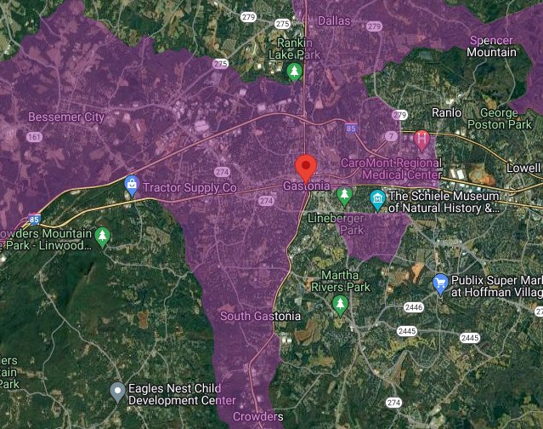
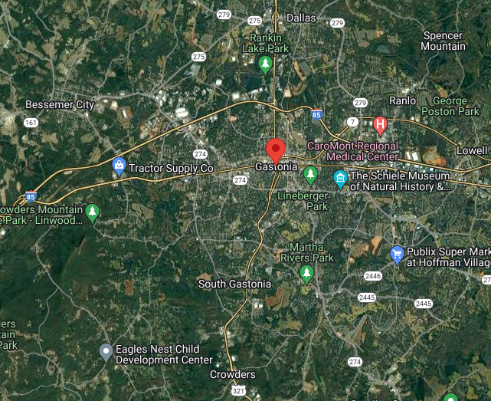

Spans Across
51.87 Square Miles
Population Size of 82,145
Vast Majority of Gastonia resides in a Qualified Census Tract
*2022 Census Data
Notes:
Gastonia: Facts
Largest city and serves as the seat for Gaston County
Spans across 51.87 square miles
Gastonia has a population density of approximately 1,511 people per square mile and a growth rate of 50%.
2019 American Community Survey, the overall poverty rate of Gastonia is 16.8 %, which is significantly higher than that of Gaston County (11.6%) and North Carolina (13.6%). The median income for Gastonia is $49,460 and is approximately 6.8% less than Gaston County ($52,835) and 10.4% less than North Carolina ($54,602).
Gastonia incorporates eight census tracts categorically labeled as Qualified Census Tracts (QCT)due to pervasive poverty and below-average median income

Slide 83

Gastonia received $15,611,923 in ARPA funding directly from the US Treasury
May 2021, the first allotment of $7,830,962
June 2022, the final allotment of $7,830,961

Slide 84
Under Revenue Replace, Gastonia elected to claim the Standard Allowance which provides a maximum of $10 million to be used for general government provisions
$5,611,923 million is obligated toward expenditure categories
Public Health
Administrative Services
Infrastructure
Negative Economic Impacts
Notes:
The Final Rule that went effective in April 2022, broaden the category of Revenue Replacement allowing municipalities to take a Standard Allowance of $10 million. Which Gastonia unquestioning elected to take.
We used this expenditure category, the City is able to supplant their normal budget and address some of the larger capital items which we’ll discuss later on in the slides.
With the remaining difference, we were able to address some areas of concern which fall into
Public Health (Category 1)
Infrastructure (5)
Administrative (7)
Negative Economic Impacts (2)

Slide 85
PUBLIC HEALTH
Reimburse for COVID-19 Medical Expenses going back to March 1, 2021
Reimburse for the cost of COVID-19 Testing
Reimburse FMLA and ESICK taken for related COVID-19
Reimburse ourselves for the cost of administration of vaccinations
Employee Vaccination Incentive Program
Notes:
Covid-19 medical expenses:
EC: 1.6 Medical Expenses (including Alternative Care Facilities)
Original Budget-$200,000
Actual- $310,566
Covid-19 testing:
EC: 1.2 COVID-19 Testing
Original budget-$40,000
Actual-$43,462
ESICK/EFMLA
EC: 1.7 Other COVID-19 Public Health Expenses (including Communications, Enforcement, Isolation/Quarantine)
Vaccine Administration:
EC: 1.1 COVID-19 Vaccination
The vaccination was free. Mainly the cost of the administration of vaccines (wages)
Original budget-$50,000
Actual- $51,347

Slide 86

Employee Vaccination Incentive
$250 was given to each employee who provided proof of vaccination
Additional $250 to each vaccinated employee if we achieved a 75% vaccination rate among the workforce.
Possible that vaccinated employees received $500
Notes:
Vaccine Incentive-$22.431
Ran from Sept to Dec 2021
EC: 1.1 COVID-19 Vaccination
$250 per year employee with proof of vaccination (both shots)
Vaccinated employee had the chance of getting an additional $250 ($500 total) if we reached 75% total vaccinated work force

Slide 87

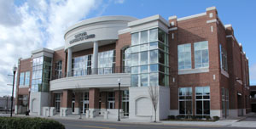
ADDRESSING NEGATIVE ECONOMIC IMPACTS
Advertising Campaign
  Billboards along HWY 74
  Obligated ARPA funds to supplement
  Communications and Marketing operating budget over 3 years
  Improvements to Conference Center
Notes:
Advertising Campaign:
EC: 2.35 Aid to Tourism, Travel, or Hospitality
HWY 74 runs right through Gastonia on the way to Charlotte
Budget used to supplant normal annual budget for a 3 year period
Improvements to the Conference Center to create appeal and increase number of events that were limited due to the panedemic

Slide 88
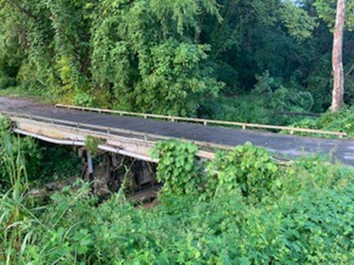
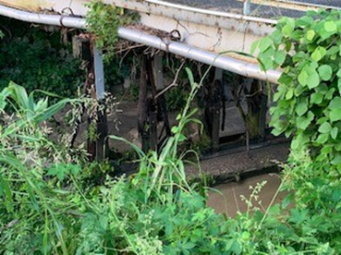
  Catawba Creek Golf Course Bridge Repair
Notes:
Catawba Creek Golf Course Bridge:
Expenditure Category : 2.22 Strong Healthy Communities: Neighborhood Features that Promote
Health and Safety
Catawba Creek Golf Course is a municipality own course
Work consists of the removal and replacement of the interior bridge bent pilings.
KCI has completed the design for $16,000 and bids were opened on 8-4-22
Lee Construction was chosen on 8-23-22
Construction to be complete by March 2023

Slide 89
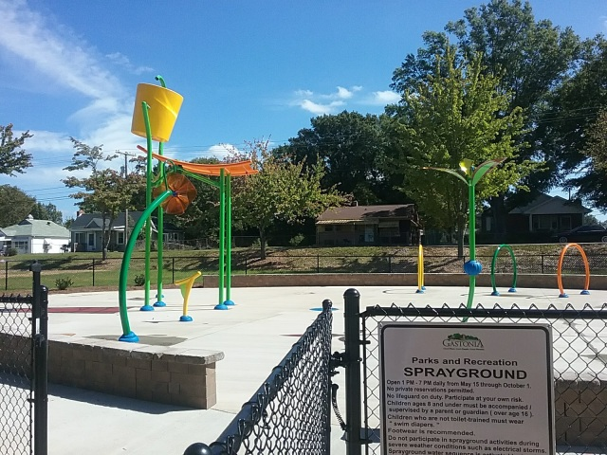
Erwin Center Pool and Pool House Renovation
Complete overhaul of the existing pool to Include
New Pool House for changing and storage
Waterslide and additional features geysers, water buckets, 4 lap lanes
Modernize pumps, filters, and automated systems for pool maintenance
Notes:
Erwin Recreation Center Pool
EC: 2.22 Strong Healthy Communities: Neighborhood Features that Promote Health and Safety
For this project, we actively seeking Design-Build contractors
Time crunch to complete the project
Erwin Center resides in the Highland Community
Highest poverty areas in Gastonia
Lowest educational achievement levels
Citizens in this community typically have higher levels of health related issues

Slide 90
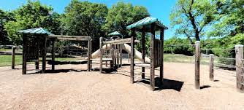
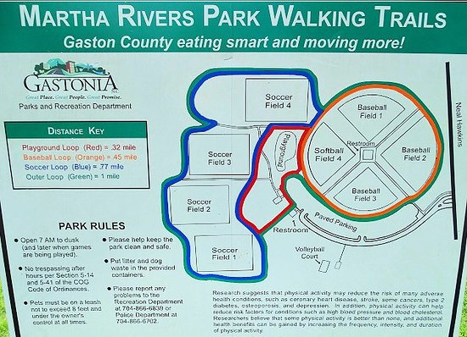
Playgrounds
Upgrade existing structures Erwin Center, Bradley Center, Phillips Center, Jeffers Center
Installing CCTV security cameras at Martha Rivers Community Center
Erwin Center Playground
Notes:
Playgrounds:
EC: 2.22 Strong Healthy Communities: Neighborhood Features that Promote Health and Safety
Erwin Center: $123,826
Bradley Center: $117,378
Phillips Center: $125,491
T. Jeffers Center: $125,528
Security at Martha Rivers
EC: 2.22 Strong Healthy Communities: Neighborhood Features that Promote Health and Safety
Wayfinding Signs:
Farmer’s Market welcome sign
EC: 2.22 Strong Healthy Communities: Neighborhood Features that Promote Health and Safety

Slide 91

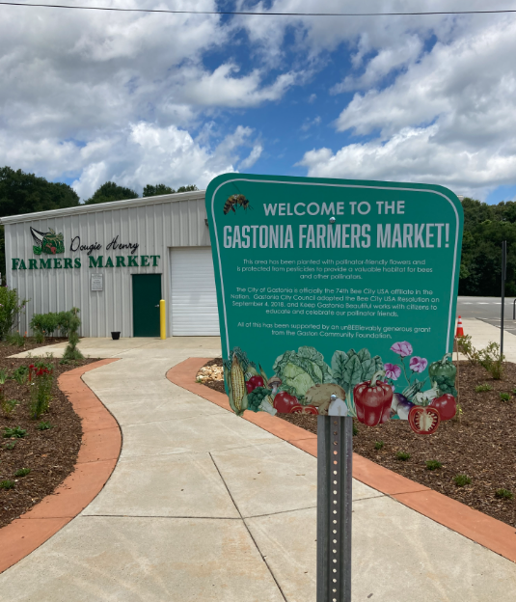
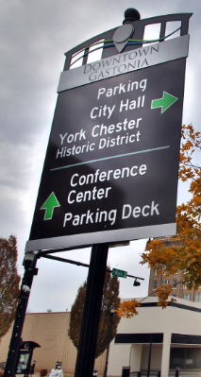
Wayfinding Signs
providing directions to city parks and
Gastonia Farmer’s Market
Notes:
Cybersecurity: Currently in procurement phase
EC: 5.21 Broadband: Other projects
$8,000 Albert Intrusion Detection/Prevention server
$111,000 (6) Core Network Switch replacements
$48,830 Additional (10) Network Switch replacements (different timing)
$63,490 Aruba Wireless Network Device replacements

Slide 92

ARPA GRANT ADMINISTRATOR
100% ARPA Funded
Technical Advisor to departments on requirements
Monitor Accounts and Budgeting
Determines If Objectives Are Allowable
Notes:
ARPA Grant Administrator
Reviews Projects for allowablity
Serves as technical advisor to departments on UG and Treasury Final Rule
Attends all the training and discussions on ARPA, need someone to attend
100% grant funded over the life of the grant
Salary and Benefits

Slide 93

CYBERSECURITY
Update Core Network Switch
Intrusion Detection and Prevention
Server
    Protects Our Utilities and Core Services from Ransomware
Notes:
Cybersecurity: Currently in procurement phase
Gastonia IT maintains the networking for city own utilities such as water and electric
EC: 5.21 Broadband: Other projects
$8,000 Albert Intrusion Detection/Prevention server
$111,000 (6) Core Network Switch replacements
$48,830 Additional (10) Network Switch replacements (different timing)
$63,490 Aruba Wireless Network Device replacements

Slide 94
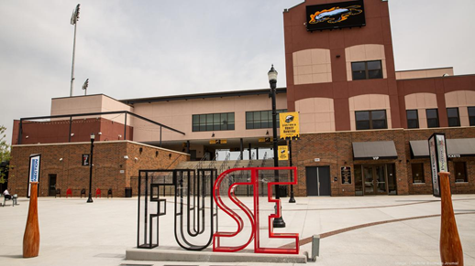
REVENUE REPLACEMENT
Assisting Gaston College with construction of BLET training facility
Upgrades FUSE District
Agreement in place to assist Grier Junior Middle with improvements
New Tasers and Body Cameras with increased Cloud Storage for Police Department

Slide 95

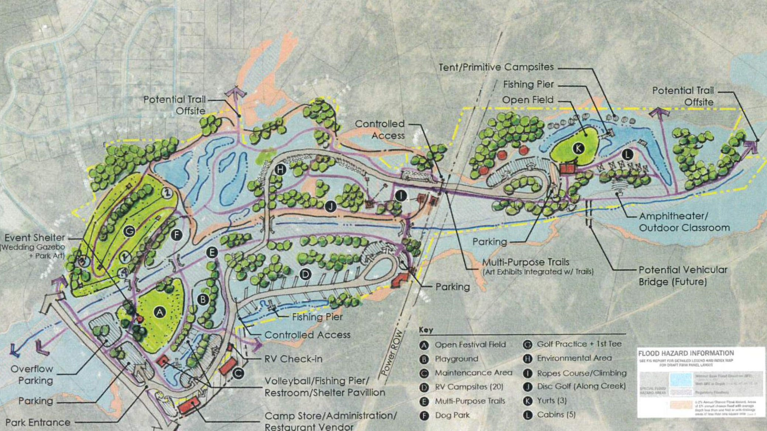
Linwood Springs Park
Match Requirement for PARTF Grant
Additional Funds to Expedite the Redevelopment
Notes:
$500k additional funds to expedite the redevelopment
$500k Match Requirement for PARTF Grant
Use Federal funds as match for State grants

Slide 96
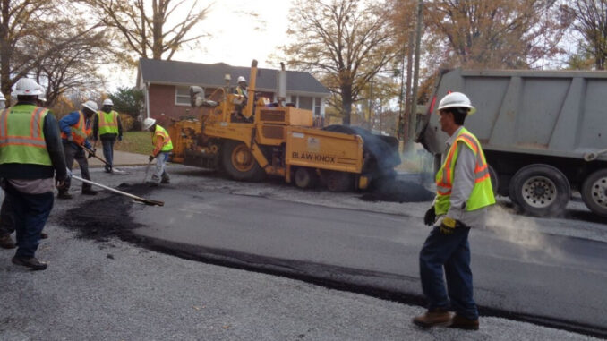
Street Resurfacing
  Resurfacing of various streets in Qualified Census Tract (QCT) Zones throughout the city. Approximately $750,000 will be constructed in the spring of 2023 with the remainder of the funding to be used in 2024
Traffic Remote Devices Partnership with NCDOT
Upgrade Public Works Facility
Notes:
Street Resurfacing
EC: 6.1 Provision of Government Services
Streets in need already chosen
Focus on roads in the worse condition and in QCT zones
NCDOT Partnership
EC: 6.1 Provision of Government Services
Final stage of project
Upgrade to Public Works
EC: 6.1 Provision of Government Services
First upgrade of 4 total needed
Phase I estimated to cost $4 million

Slide 97
QUESTIONS?
Clayton Smith
Grants Manager
claytons@cityofgastonia.com
(704) 869 - 7858
Quentin T. McPhatter
Assistant City Manager
quentinm@cityofgastonia.com
(704) 866 - 6013
Kate Wear
ARPA Grants Administrator
katew@cityofgastonia.com
(704) 854 - 6637

Slide 98

WAYNESVILLE
HOW DO WE SPEND ARP FUNDS?

Slide 99
BUDGET BACKGROUND
ARP ALLOCATION $3,231,910
1 CENT ON TAX RATE = $ 144,800
AD VALOREM TAX RATE $ .4395 (per $100)
GENERAL FUND BUDGET $17,079,739
ENTERPRISE FUND BUDGETS $17,807,091
TOTAL TOWN BUGET $34,886,830

Slide 100
THINGS TO CONSIDER
EXPENDITURES THAT REDUCE FUTURE COSTS
STATE MANDATED PROJECTS
“NICE TO HAVE” EQUIPMENT
RESERVE ARP FOR FY 2023-24

Slide 101
THINGS THAT REDUCE FUTURE COSTS
ITEM COST TOTAL SAVINGS POLICE VEHICLES (6) $ 41,667 $ 250,000 $ 53,812*
FIRE SUVS (2) $ 41,125 $ 82,250 $ 17,704
DISPATCH UPGRADE $124,870 $ 124,870 $ 26,878
GREENWAY BRIDGE $ 265,911 $ 265,911 $ 57,237
SANITATION CARTS $310,141 $ 310,141 $ 66,757
PW VEHICLES $ 63,500 $ 127,000 $ 27,336
TOTAL $847,214 $1,160,172 $ 249,724
$249,724 = 1.72 cents on tax rate for 5 yrs.
* 5 year borrowing @ 2.5%

Slide 102
STATE MANDATED W&S
(CASH FLOW SAVINGS)
PROJECT COST 5 YR. SAVINGS
WATER PLANT REPAIR $ 300,000 $ 64,574*
INFLOW/INFILTRATION $1,178,500 $253,668
TOTAL $ 1,478,500 $318,242
*5 YR. @ 2.5%

Slide 103
NICE TO HAVE
ITEM COST
GARAGE VEHICLE LIFT $ 40,000
SHORT TERM SHELTER GRANT $ 70,000
TOTAL $110,000
RESERVE FOR 2023-2024
  $483,238.76

Slide 104
TOTAL ARP BUDGET
EXPENDITURES THAT REDUCE FUTURE COSTS $1,160,172
STATE MANDATED W&S PROJECTS $1,478,500
NICE TO HAVE CAPITAL ITEMS $ 110,000
ARP RESERVE FOR FY 2023-2024 $ 483, 238
TOTAL ARP $3,231,910

Slide 105

Lynda Sossamon, Sylva Mayor
Population: 2,473
ARPA Distribution: $872,000
Annual Budget: $4,521,572

Slide 106


Air Filtration/Purification upgrades in Town Building $8,000
Audio/Video equipment to stream Town Meetings
$15,000

Slide 107


Skate Ramp Project
$10,000

Slide 108
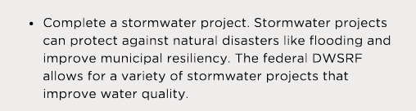

Bridge Park Stormwater Project
$700,000

Slide 109
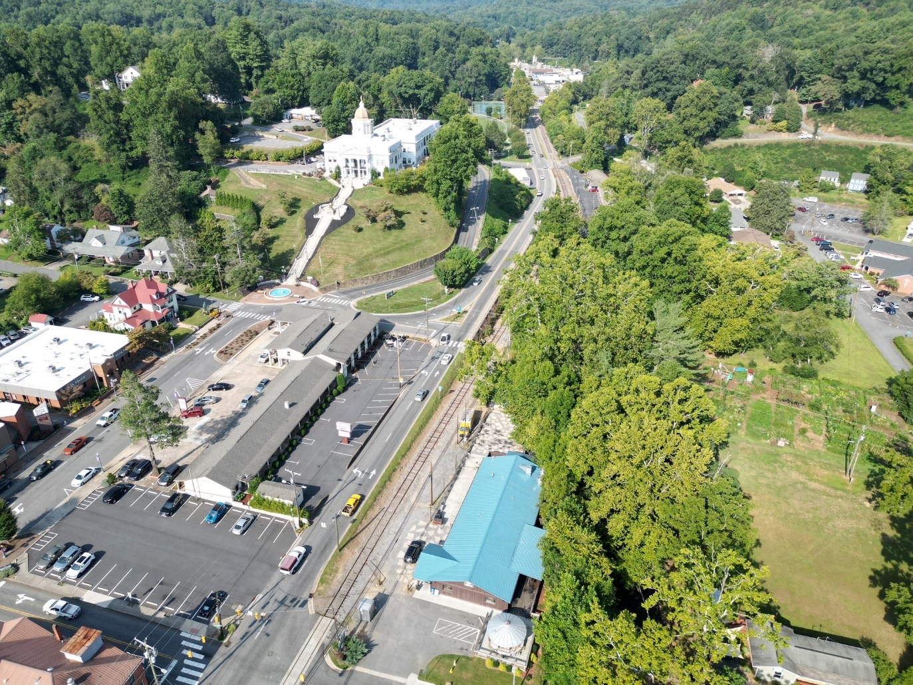
Downtown Sylva

Slide 110
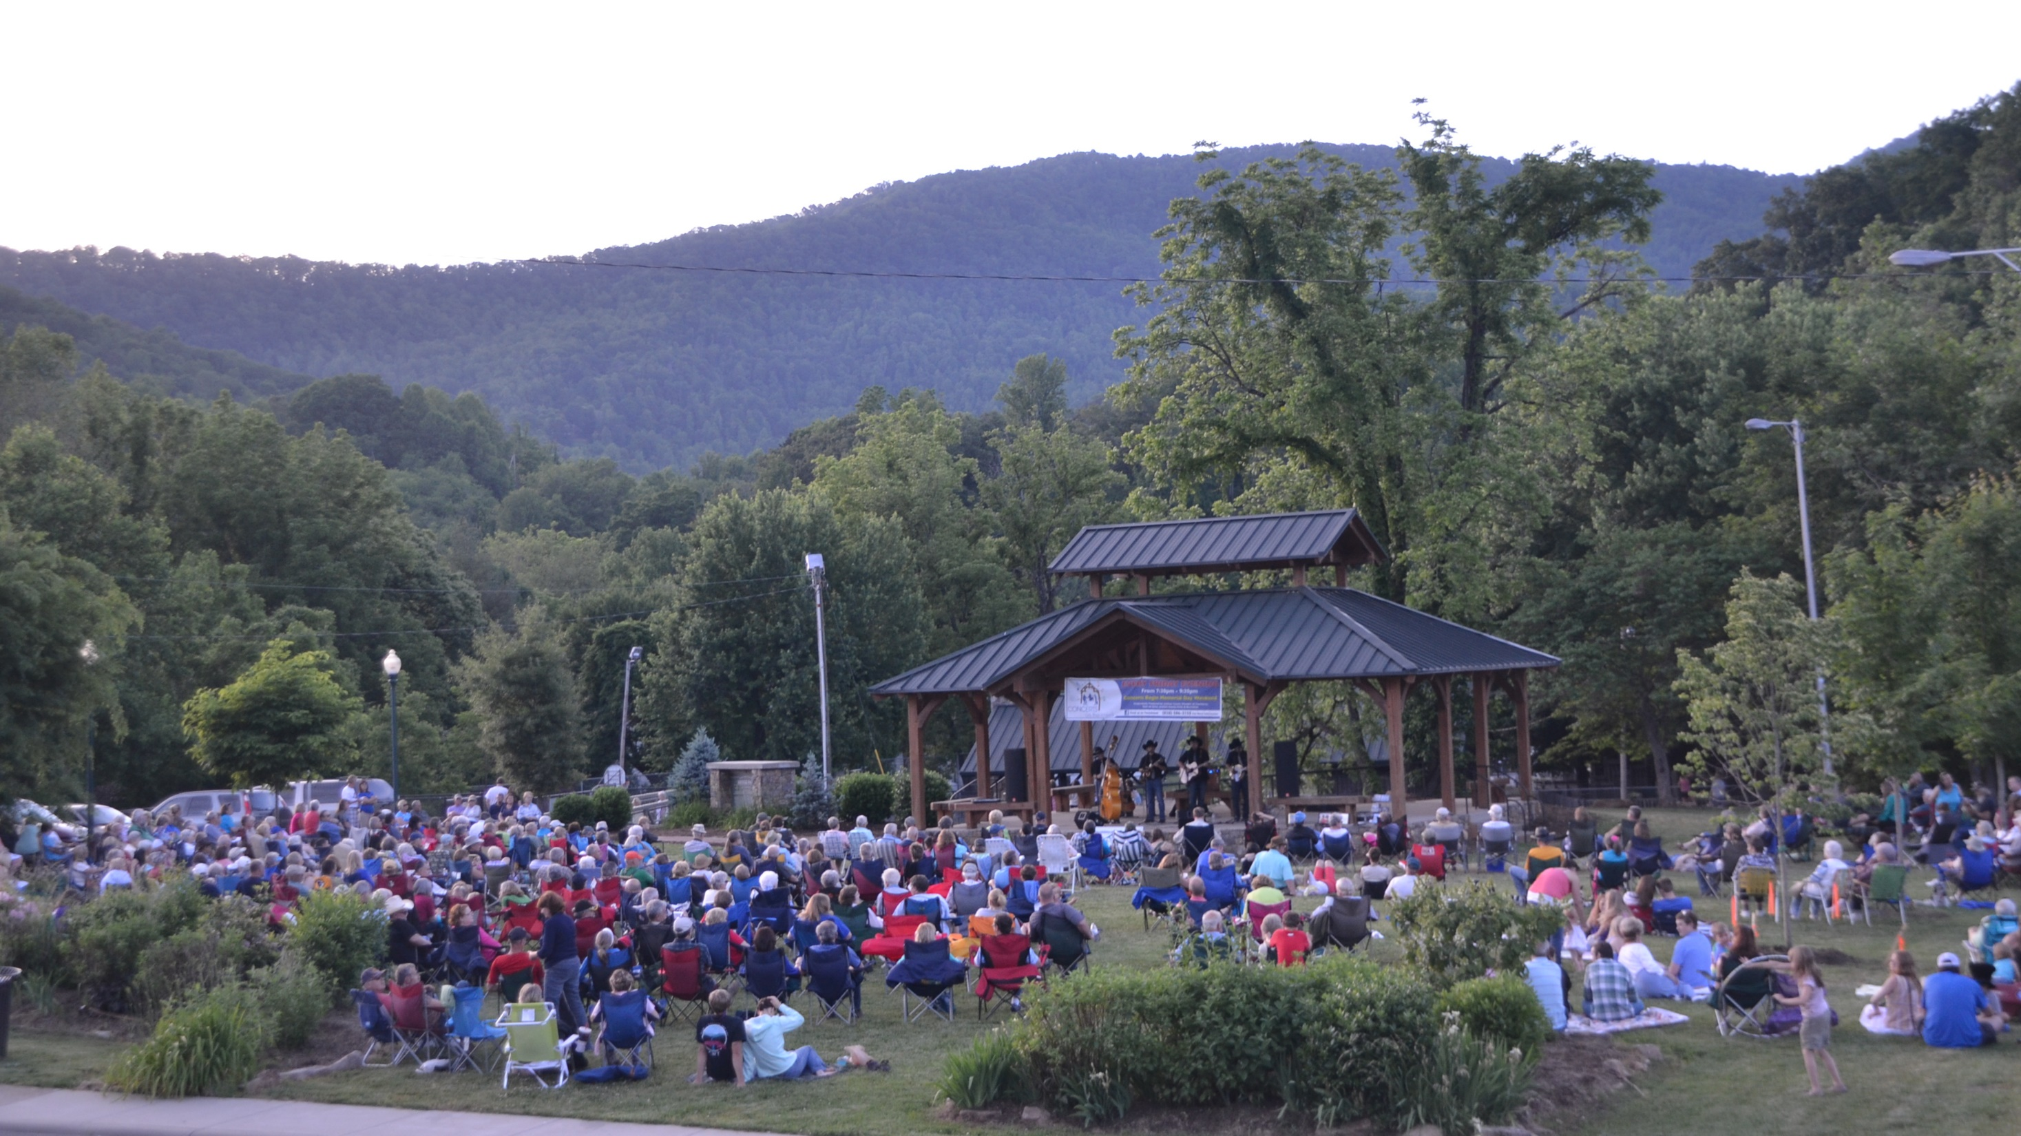

Slide 111
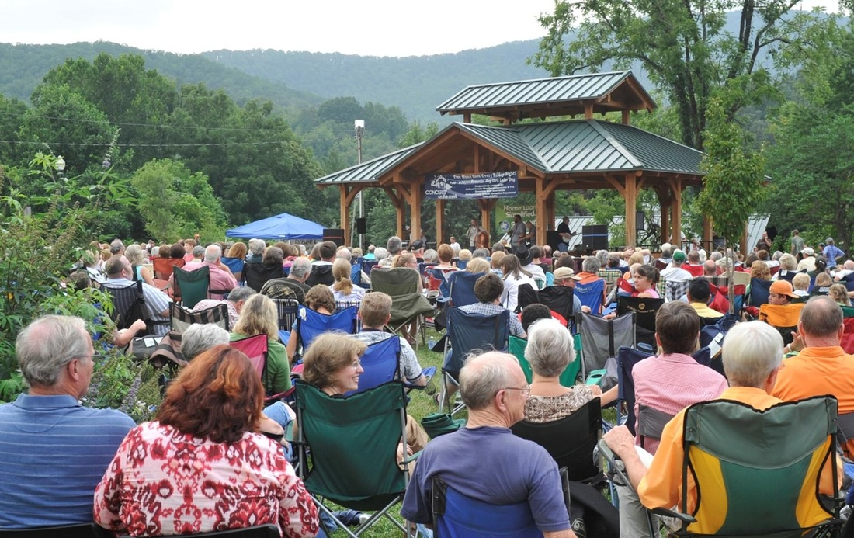
Concerts on the Creek

Slide 112
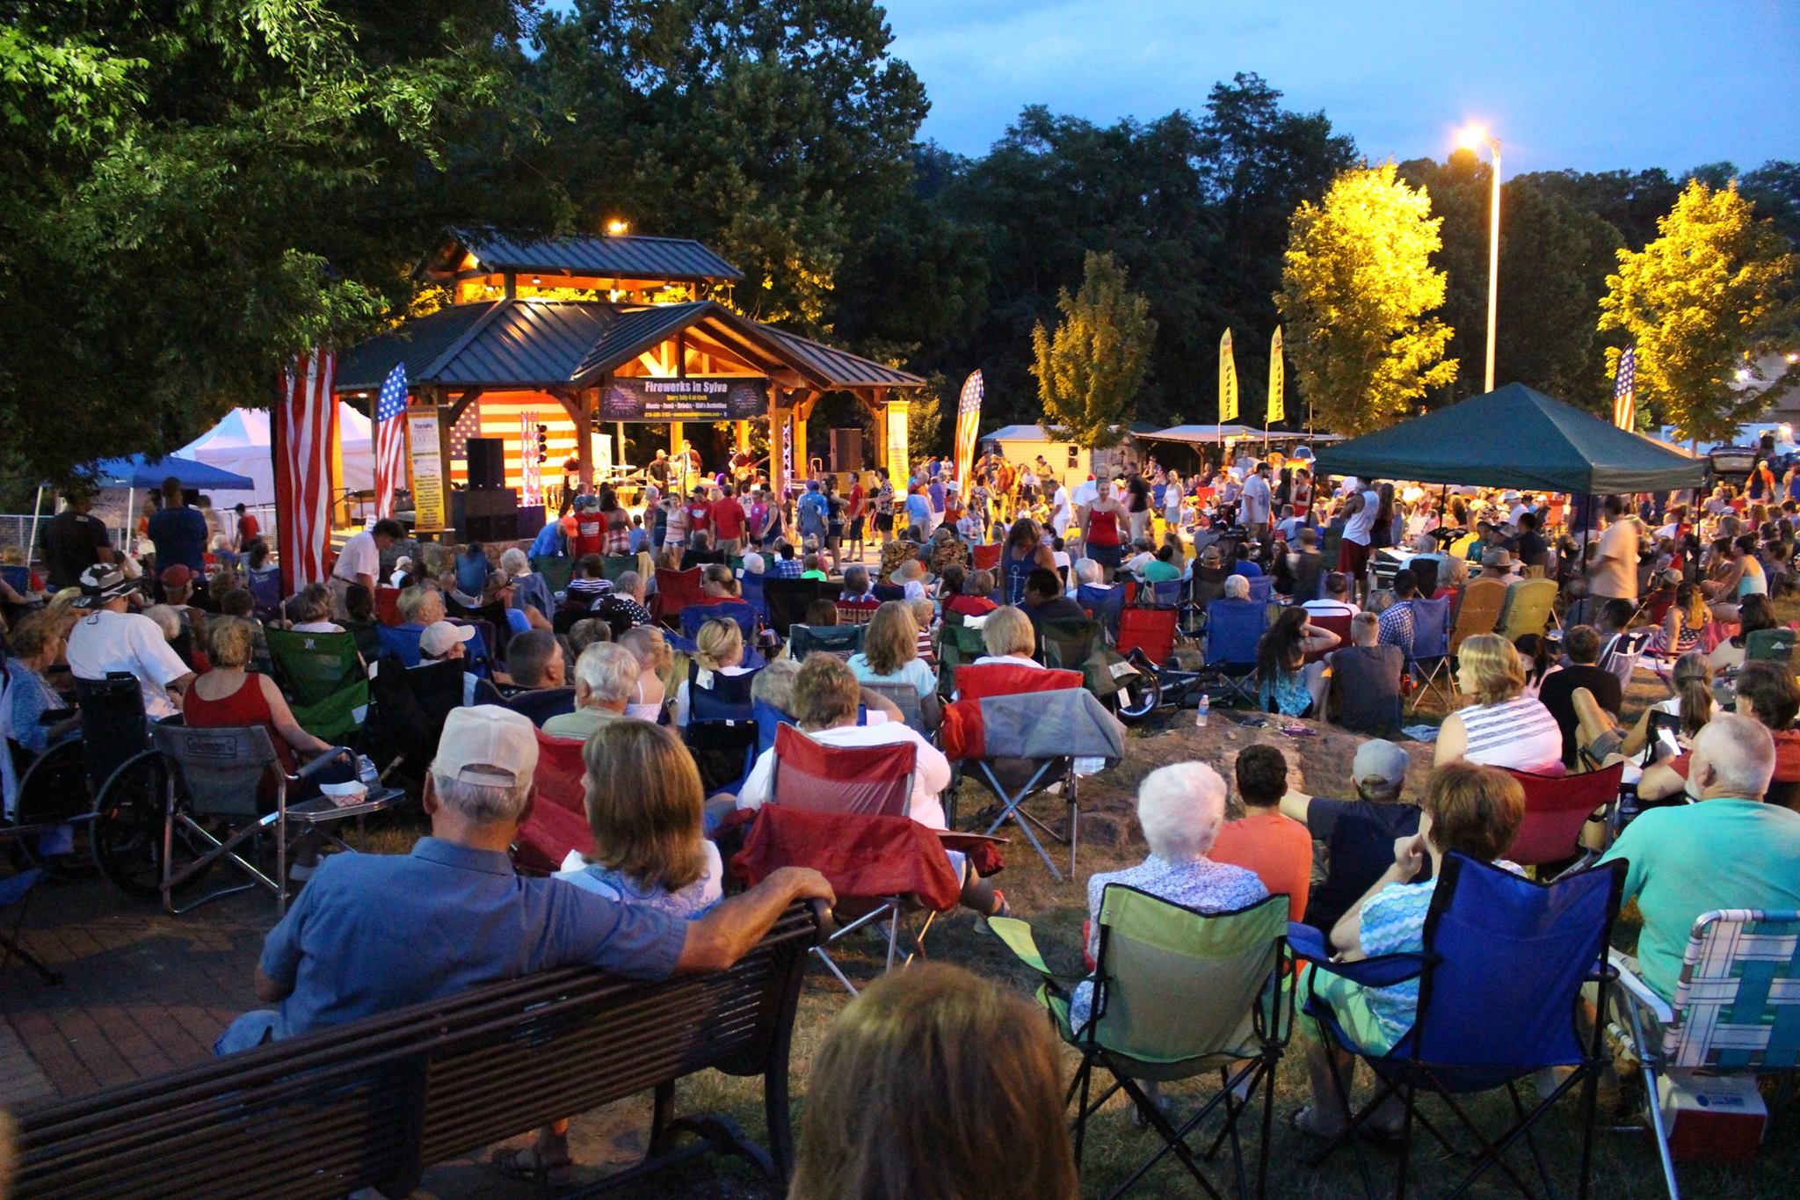
July 4th Concert and Fireworks

Slide 113
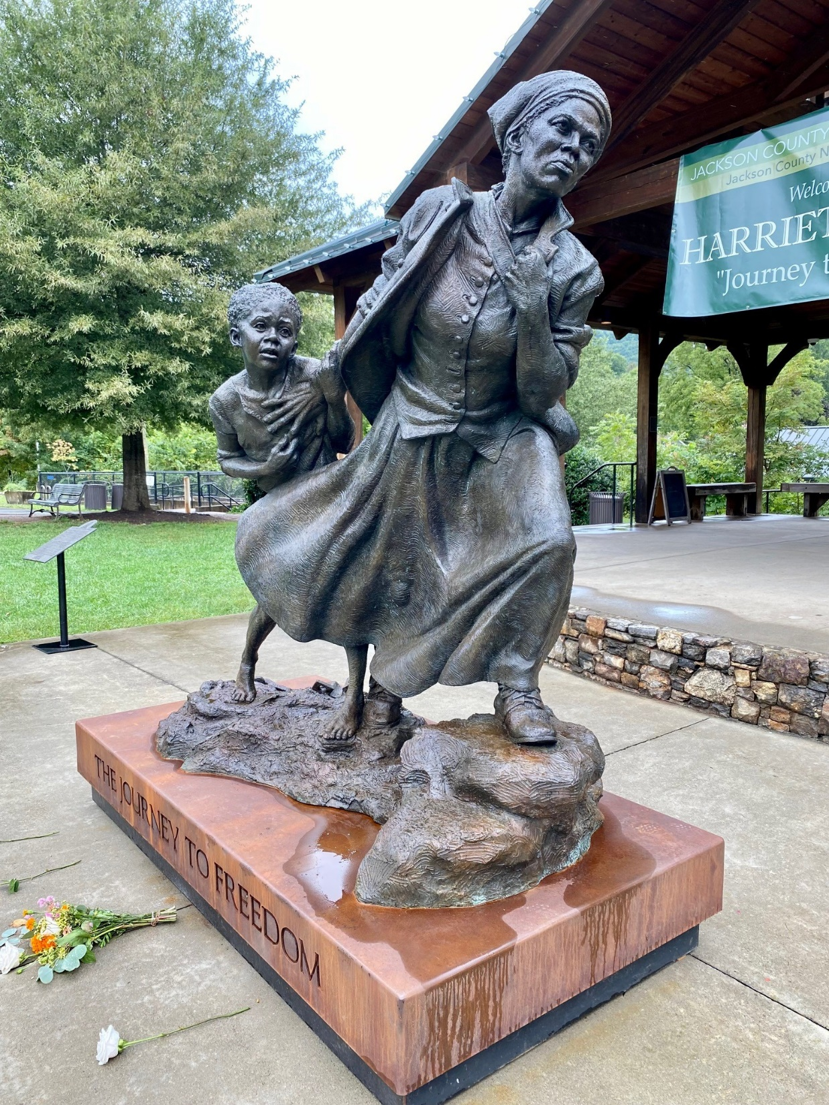
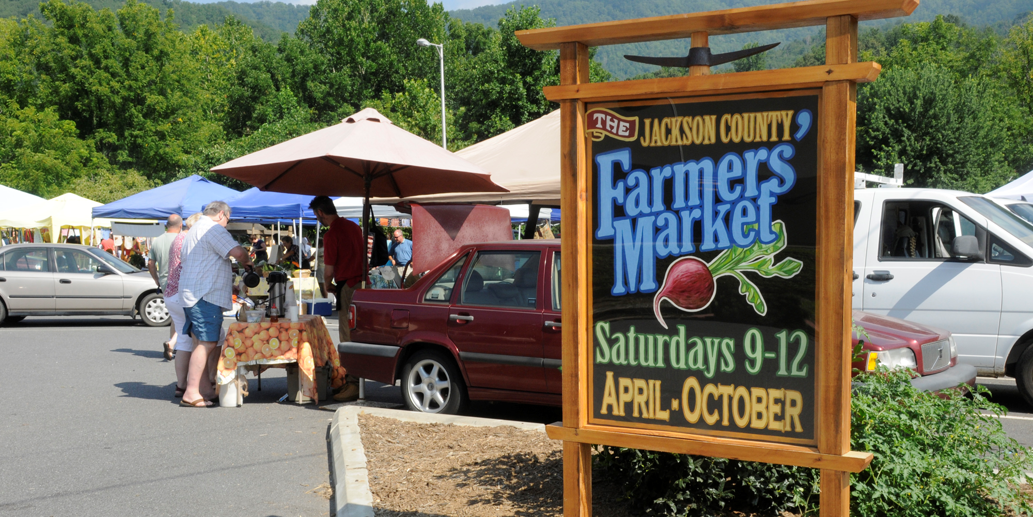
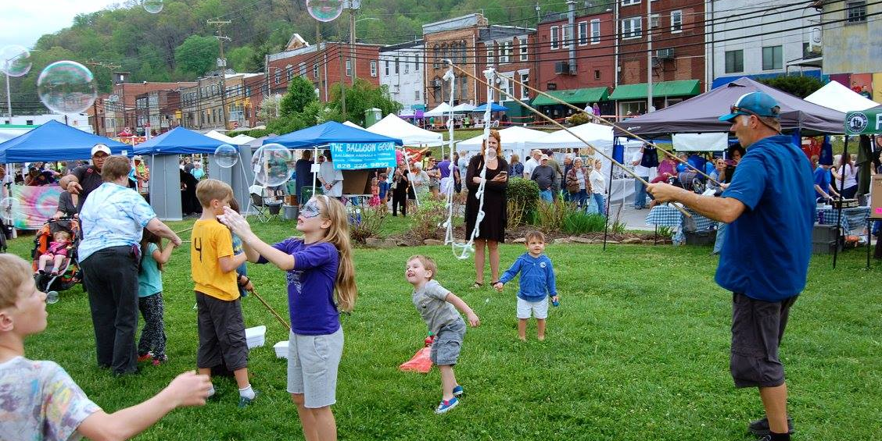
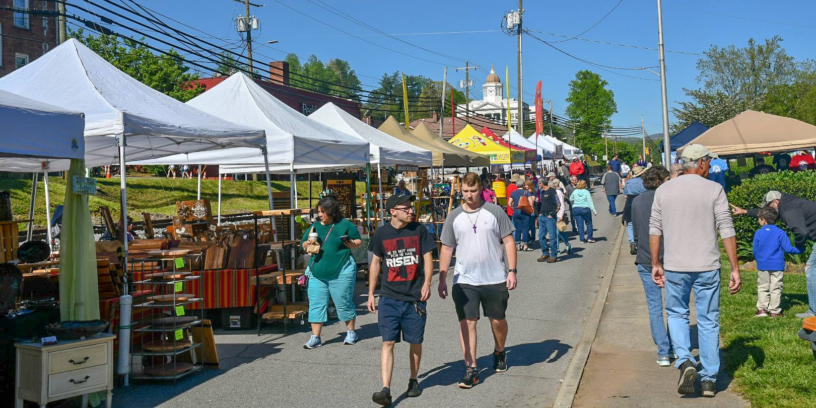

Slide 114

WNC Pottery Festival

Slide 115
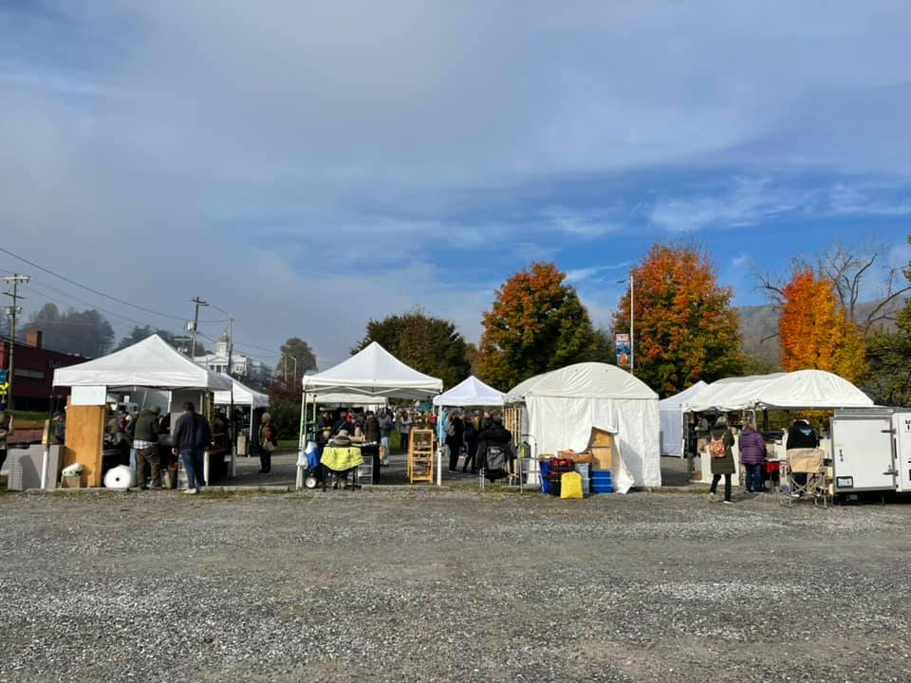
Adjacent Gravel Parking Lot

Slide 116
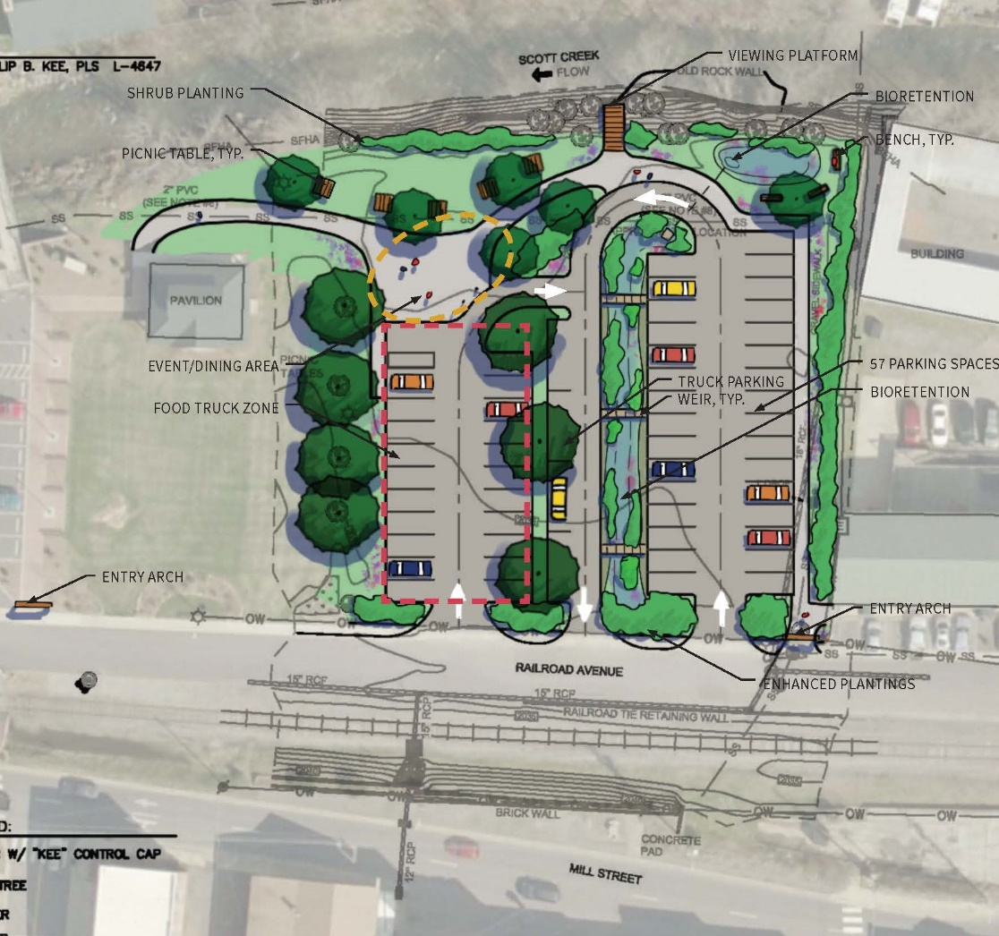
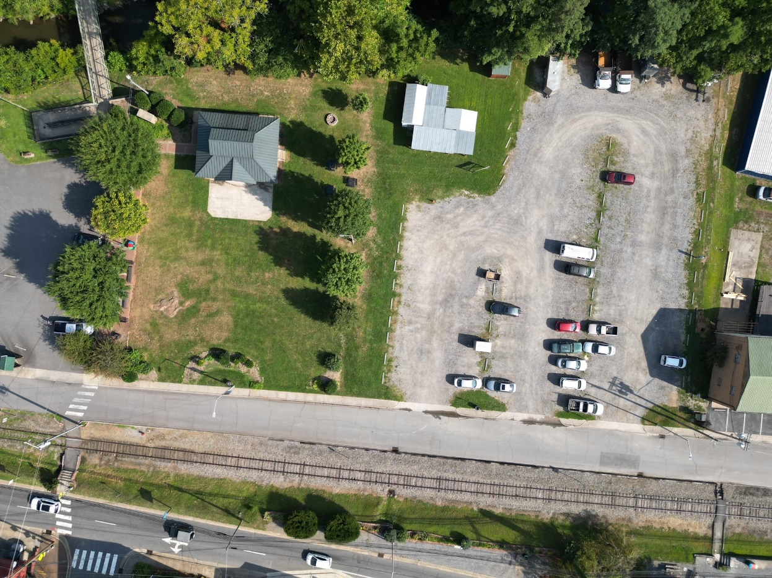
Project Area

Slide 117
American Rescue Plan Expert Tour
Department of Environmental Quality
Division of Water Infrastructure
September 8, 2022
https://deq.nc.gov/about/divisions/water-infrastructure

Slide 118
Presentation Overview
About the Division
2022 Spring Funding Round
Upcoming Fall Application Round
ARPA Funding Information
  Direct Appropriations
  Division ARPA Funding
Notes:
For those not familiar with our Division, I’ll provide some background about the types of projects we fund and our different funding programs.
Will discuss our historic spring funding round, share some information about the upcoming fall application round, and provide some information about appropriations.

Slide 119

  About the Division

Slide 120



What DWI Funds
Low-interest loans and grant funding programs for:
Drinking water infrastructure
Wastewater infrastructure
Stormwater infrastructure
CWSRF green projects: stormwater quality, reclaim water, stream restoration, energy efficiency
Pre-construction planning
Asset Inventory and Assessment (AIA) grants
Merger/Regionalization Feasibility (MRF) grants
Stormwater planning
Developing and Implementing a New Stormwater Utility

Slide 121
Funding Programs
Federal / State
  Clean Water State Revolving Fund (CWSRF)
  Drinking Water State Revolving Fund (DWSRF)
Federal
  Community Development Block Grant – Infrastructure (CDBG-I)
State Reserve Program (SRP)
  Drinking water and wastewater loans and grants
  Asset Inventory and Assessment (AIA) grants
  Merger Regionalization / Feasibility (MRF) grants
  Pre-construction planning grants
Viable Utility Reserve (VUR)
  Drinking water and wastewater grants, AIA, MRF, and rate study grants to improve long-term viability of utilities designated as distressed
Local Assistance for Stormwater Infrastructure Investments (LASII)
  Stormwater construction
  Stormwater planning
  Developing and implementing a new stormwater utility

Slide 122
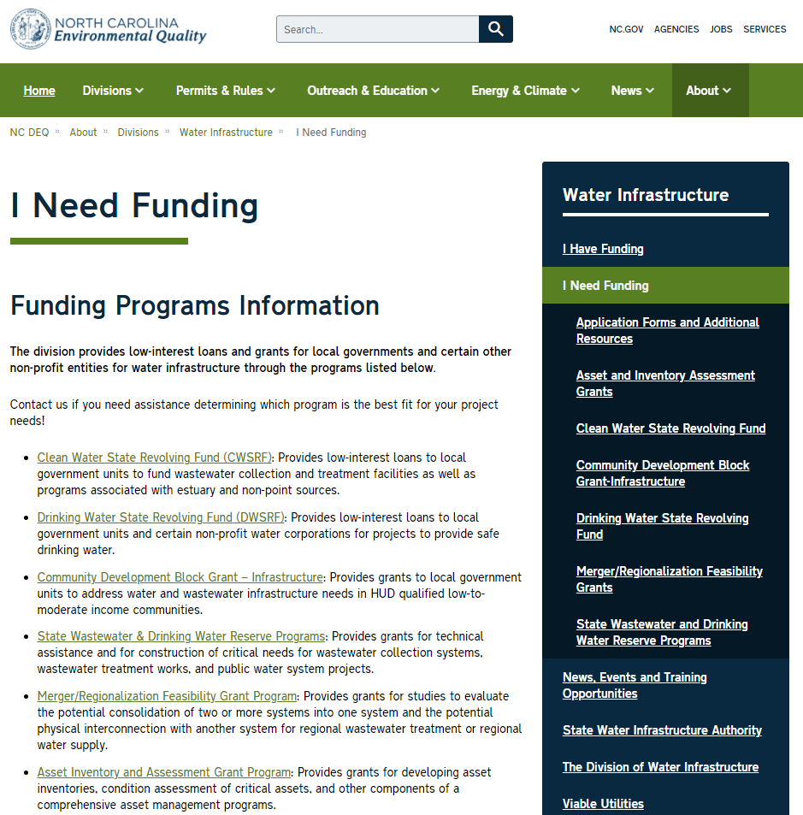
Funding Water and Wastewater Planning Projects
Notes:
All of our resources, application materials, guidance documents and training/workshop announcements on our website. Easy way to find us is to go to deq.nc.gov and click on Divisions in the banner, and then on Water Infrastructure.
If you’re not already familiar with our Division, I need to provide a very brief description of our Division and funding practices.

Slide 123
  Spring 2022 Funding Round

Slide 124
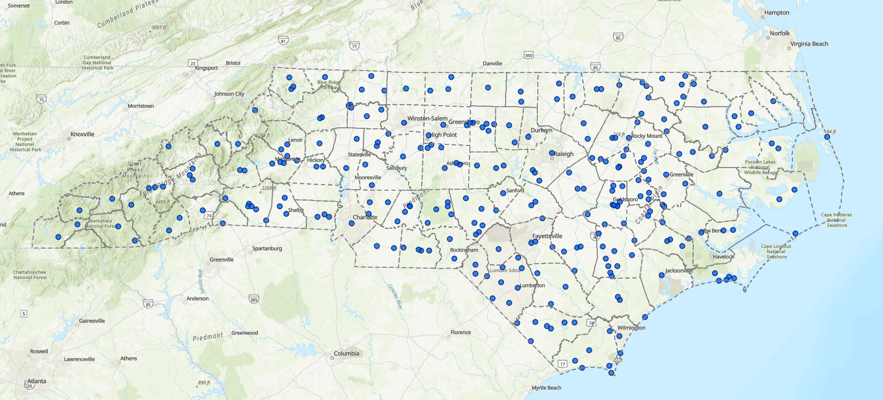
Spring 2022 Funding Applications
More than $3.1 Billionin funding requests, in 649 new applications from 94 counties. Also re-considered over 50 Fall 2021 unfunded applications.
Notes:
Unprecedented application round – record number of applications and funding requested
Received Applications from 94 of NC’s 100 Counties

Slide 125
Highlights from Spring 2022 Funding
Record number of applications
First awards from ARPA
385 projects funded statewide
85 counties
Five projects providing water connections to underserved or disadvantaged communities in Sampson, Nash, Duplin, Edgecombe, and McDowell Counties

Slide 126
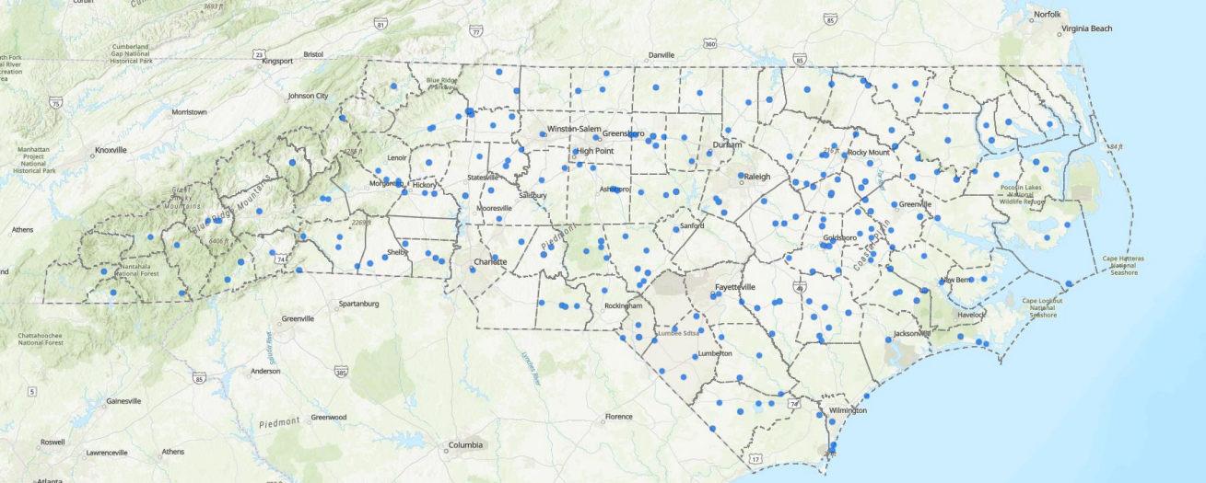
Projects Funded in Spring 2022
$789.4 Million in 385 construction and planning projects in 86 counties (ARPA, DWSRF and CWSRF funding).

Slide 127
  Fall 2022 Application Process

Slide 128
Fall 2020 Application Basics
Funding Programs
Viable Utility Reserve Program (VUR)
State Reserve Program (SRP)
Clean Water State Revolving Fund (CWSRF)
Drinking Water State Revolving Fund (DWSRF)
Community Development Block Grant – Infrastructure (CDBG-I)
Local Assistance for Stormwater Infrastructure Investments Fund (LASII)
Applications for all programs due September 30!

Slide 129
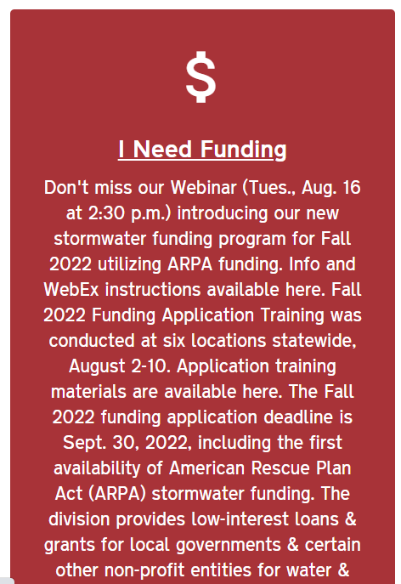
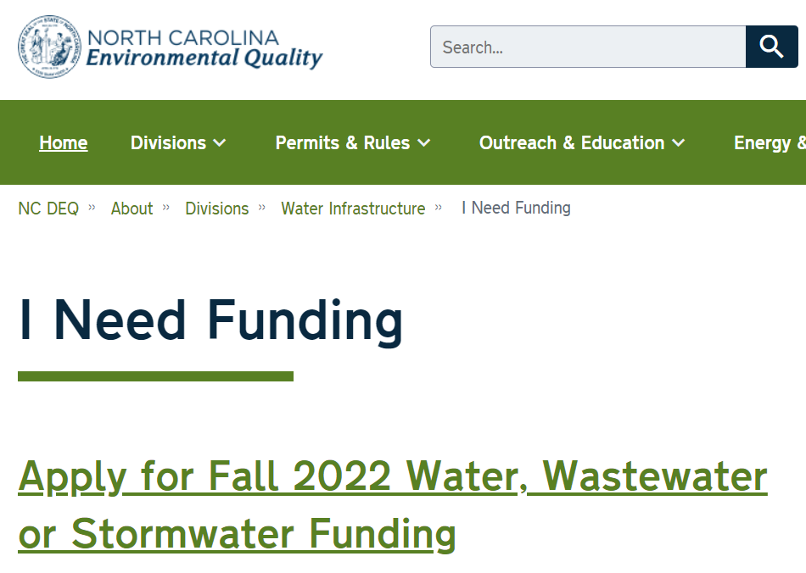
How to Apply?
Watch recording of Application for Funding training session!!
All application materials can be found on Division’s website http://deq.nc.gov/about/divisions/water-infrastructure under “I Need Funding” → “Application Forms and Additional Resources”: https://deq.nc.gov/about/divisions/water-infrastructure/i-need-funding/application-forms-and-additional-resources
Notes:
All of the Application forms are now online.
Applicants should begin the process of completing their applications very soon now.
ASAP: get familiar with the application instructions and Stormwater PRS and Guidance. Read those! Applications will take time to put together, and requires the governing board to pass a resolution in order to submit an application, so you need to plan ahead!
Applications are due Sept 30, at 5:00pm.
Here’s where to find the applications: On the Division’s main webpage (first link), scroll down to get to the red I Need Funding box. Click it, and then click on the “Apply for Fall 2022 funding link”.

Slide 130
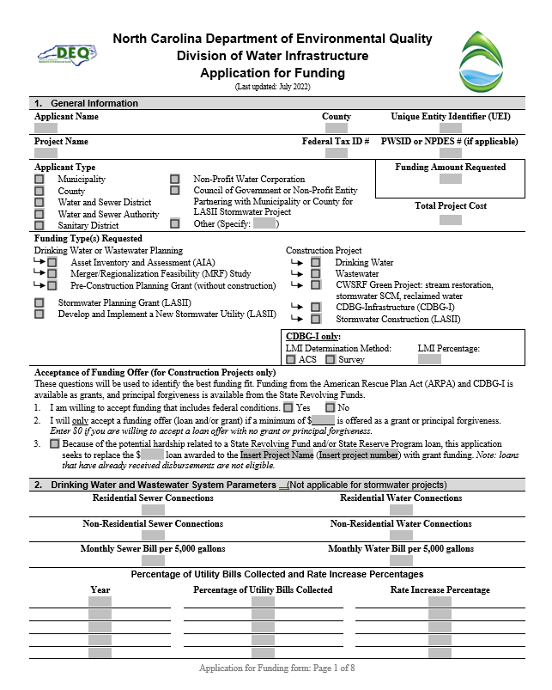
Application for Funding
One application for all Division funding programs
All sections must be completed unless specified otherwise
Follow the attached Instructions
Each application is viewed as stand-alone
Notes:
Once you click on the links, you’ll select the one for the application. You should see the application with a header like this.
Make sure that you use this application. We will not consider applications submitted on the old form because there is too much information needed related to that.
Make sure you complete all sections within the application unless specified otherwise. For LASII, look for “LASII” or “stormwater” or “construction projects” or “planning projects”.
Please make sure that you take the time to read through the instructions. If you applied to other funding programs in the past, note that there are some significant changes to this form, so please read the instructions.
There is a checklist at the end of the application to make sure you submit the rest of the required documents.
Training presentation and video are available on the website for additional information

Slide 131
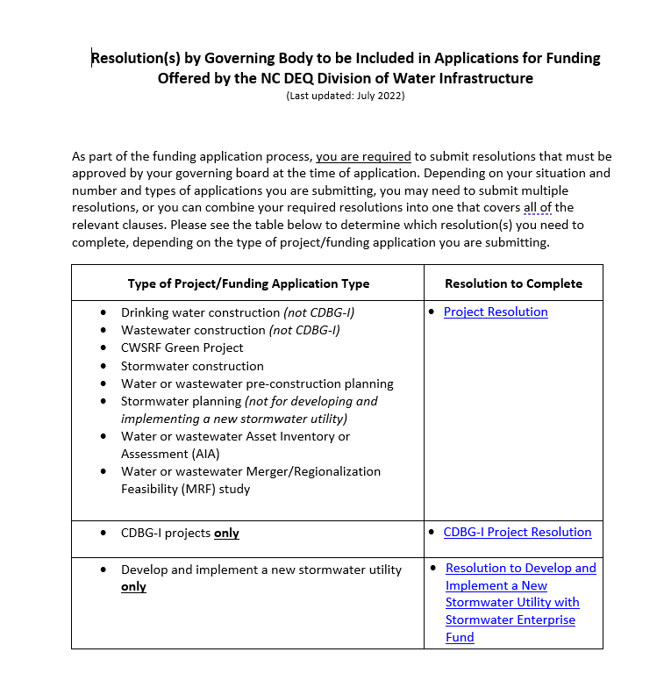
Resolution by Governing Body: Needed with Application
Notes:
Resolutions will now be due at the time of application. If needed, a template is available on the website. You need to submit one of these two resolutions, depending on the funding type. Governing body must convene and pass the resolution ahead of submitting the application. Must be part of the application package. Please plan ahead as the governing body must pass this resolution before you apply! Applications due Sept 30.

Slide 132
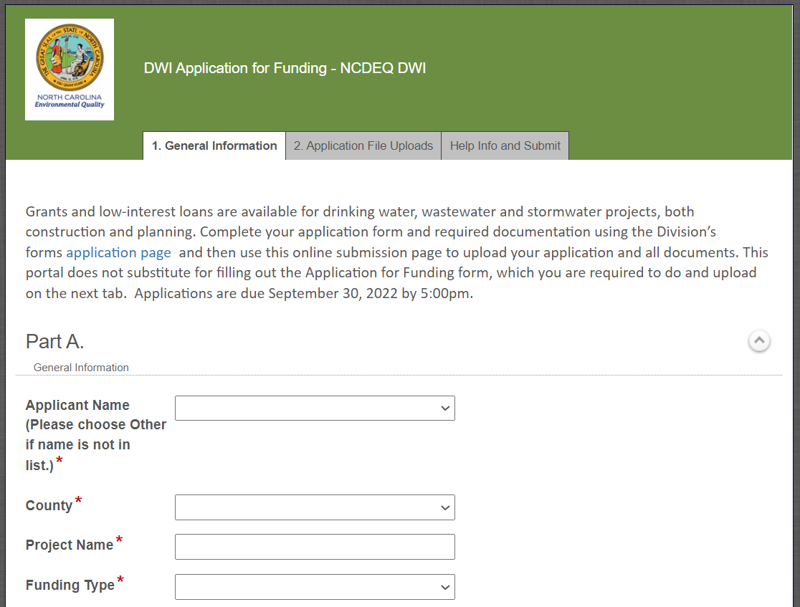
Application Submittal – Electronic (New!)
Upload and submit application documents online: https://edocs.deq.nc.gov/Forms/OPA-ARPA
Electronic submittals only accepted
Upload completed application forms and supporting documents
File size limit: 250 MB/file
Documents uploaded individually
Notes:
Watch the training recording to step through this
You upload all application files to this submittal portal and hit submit.
Do not wait until the last minute to submit applications
CDBG-I will not use the electronic submittal platform for this round.

Slide 133
Application Questions?
Name | Role | Phone Number | E-mail
Jon Risgaard | SRF Section Chief | 919.707.9175 | jon.risgaard@ncdenr.gov
Ken Pohlig, PE, PhD | WW Unit Supervisor | 919.707.9170 | ken.pohlig@ncdenr.gov
Kavitha Ambikadevi, PE | DW Unit Supervisor | 919.707.9048 | kavitha.ambikadevi@ncdenr.gov
Victor D’Amato, PE | VUU Supervisor | 919.707.9186 | victor.damato@ncdenr.gov
Matthew Rushing | AIA / MRF | 919.707.9060 | matthew.rushing@ncdenr.gov
Colleen Simmons | CDBG-I | 704.235.2022 | colleen.simmons@ncdenr.gov
Tony Evans, PE | Stormwater | 919.707.9168 | tony.evans@ncdenr.gov
Jennifer Haynie | Affordability | 919.707.9173 | jennifer.haynie@ncdenr.gov
Shadi Eskaf | Division Director | 919.707.9177 | shadi.eskaf@ncdenr.gov

Slide 134
American Rescue Plan Act (ARPA)
Direct Appropriations

Slide 135
“ARPA” in NC Direct Appropriations
November 2021 (S.L. 2021-180):
$840 million appropriated from State’s ARPA (State Fiscal Recovery Fund) to 115 water and wastewater projects and 11 stormwater projects
July 2022 (S.L. 2022-74):
Additional $387 Million appropriated to 90 water and wastewater projects

Slide 136
What’s Eligible?
Any kind of infrastructure project that is eligible under CWSRF or DWSRF.
ARPA Final Rule from US Treasury added a few additional eligibilities, but generally projects that will simply be “DWSRF” or “CWSRF” eligible.
  For appropriations through the VUR, must be a VUR-eligible project.
Notes:
Generally, projects that are eligible under CWSRF or DWSRF are eligible (funding from CWSRF or DWSR is not required)

Slide 137
Funding Process
Request for Funding form
Recipient to complete form
Division to review and approve the form
Funding Offer
Identify funding amount
Conditions must be accepted by recipient’s governing body
Disbursements
Once under construction, submit invoices for incurred expenses
Division will verify invoices and disburse funds for eligible costs
ARPA funds must be expended by Dec 31, 2026

Slide 138
Request for Funding Form
Recipients of direct appropriations through SL 2021-180 or SL 2022-74 must complete the form for approved, eligible projects
Division will review project description to ensure eligibility
Recipient to review plan as needed
Completed forms must be submitted to the Division by June 30, 2023
Unclaimed funds will revert to the Division for other funding awards as required under new S.L.
Questions?
Contact person who emailed form OR
Corey Basinger Corey.Basinger@ncdenr.gov
Notes:
Division will review submitted forms for eligibility, will communicate any need for update and additional information

Slide 139
ARPA Conditions
All ARPA conditions apply to the entire projects!
  Uniform Guidance applies to procurement of engineering services. Recipient must certify to us, using a form, that the engineering services were procured through a qualification-selection based process, and that the engineering firm did NOT assist in creating the RFQ/RFP or review the bids.
  Only expenses incurred on or after March 2021 are eligible for ARPA funds.
  ARPA funds can be expended only through December 2026. Remaining funds will revert back to the US Treasury after that date, regardless of the status of the project. Recipients will have to secure other funding to complete projects that are not done by 2026.
Notes:
As with ALL projects funded through the Division using APRA funds, ARPA conditions apply to the entire project

Slide 140
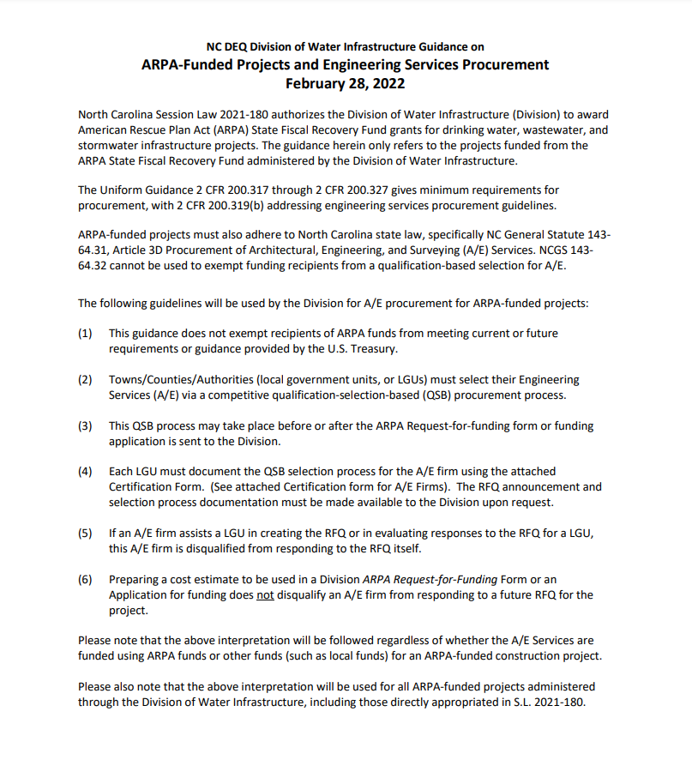
Procurement for ARPA-Funded Projects through DWI (NC DEQ)
On the Application Forms and Additional Resources webpage, or
https://deq.nc.gov/media/27973/download?attachment
A/E must be selected through a competitive qualification-selection-based process.
QSB may be before or after application.
Must document QSB process using a certification form and make RFQ process available upon request.
A/E firm cannot assist in RFQ process.
A/E firm can assist in application.

Slide 141
American Rescue Plan Act (ARPA)
General Division Funding

Slide 142
ARPA funds Available for Fall 2022
SL 2021-180 Funds
Viable Utility Reserve “Distressed”
State Reserve
“At Risk”
Local Assistance for Stormwater Infrastructure Investment
~$42 M
Available for Applications
$82 M
Available for Applications
State Reserve
Studies
~$119 M
Available for Applications
State Reserve
“All Other Systems”
Not available for Applications
~$28 M
Available for Applications
SL 2022-74 Funds
State Reserve
~$7 M
Available for Applications
$278 million available for applications
(including $82 million for stormwater)
Additional funds available in CDBG-I, DWSRF, and CWSRF in Fall 2022.
Applications due September 30, 2022.

Slide 143
ARPA Funds Available for Awards
Administered through
  Viable Utility Reserve
  State Reserve Program
  Local Assistance for Stormwater Infrastructure Investment Fund [new]
Projects must be eligible and comply with federal and state requirements
Funds must be expended (reimbursed) by December 2026
SRF loans (and principal forgiveness) will be available to fully fund or supplement funding for applicants that indicate willingness to accept loan funding.

Slide 144
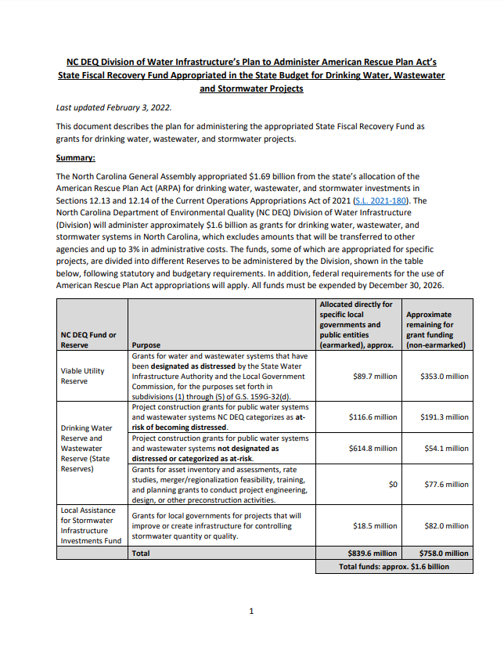
NC DEQ DWI ARPA Administration Plan
Posted on the Division of Water Infrastructure’s website, under “I Need Funding”
https://deq.nc.gov/about/divisions/water-infrastructure/i-need-funding
Public review (Dec-Jan)
Announced Feb. 10, 2022 (recorded webinar)

Slide 145
Contact
Shadi Eskaf
Shadi.Eskaf@ncdenr.gov
919-707-9177
Cathy Akroyd
Cathy.Akroyd@ncdenr.gov
919-707-9187
Or https://deq.nc.gov/water-infrastructure-contacts

Slide 146
Division of Water Infrastructure deq.nc.gov/about/divisions/water-infrastructure
State Water Infrastructure Authority deq.nc.gov/about/divisions/water-infrastructure/ state-water-infrastructure-authority

Slide 147

Rural Economic Development Division
Engaging Enhancing and Transforming Rural North Carolina

Slide 148


Rural Engagement & Investment Program
The Challenge
Rural local governments face significant systemic and economic challenges that limit their competitiveness and stifle their efforts to build strong, vibrant, and sustainable communities. Those challenges have been magnified by the COVID-19 pandemic .

Slide 149
Rural Engagement & Investment Program
The REDD Response
Rural Engagement & Investment Program (RE&I)
Grants, training, and technical assistance for local governments that help communities acquire critical resources, advance project implementation, build local capacity, and respond to critical issues relating to COVID-19 recovery.

Slide 150
Rural Engagement & Investment Program
The Rural Engagement & Investment Program (RE&I)
Support downtown economic development initiatives
Provide public improvements that help retain businesses
Enhance support for small businesses
Create resilient neighborhoods.
Increase the local government capacity.

Slide 151
Rural Transformation Grant Fund
Rural Transformation Grants
$48 Million ARPA Funds
Support innovative approaches to increasing local capacity, COVID-19 recovery, building partnerships that support small businesses, leveraging resources to support downtown development, and advancing local projects that will address critical community and economic development needs.

Slide 152
Rural Transformation Grants
Rural Transformation Grant Categories
Downtown Revitalization
Resilient Neighborhoods
Community Enhancements for Economic Growth
Rural Community Capacity Building

Slide 153
Rural Transformation Grants
Downtown Revitalization
Grant and engagement programming to help rural communities revitalize main streets, improve economic conditions in downtown districts, and spur economic recovery from COVID-19.

Slide 154
Rural Transformation Grants
Downtown Revitalization
• Public Improvements
• Mixed-use Development
• Small Business Improvements
• Planning, Training, and Technical assistance
• Industry Improvements

Slide 155
Rural Transformation Grants
Resilient Neighborhoods
Grants to help local governments address issues related to COVID-19 and advance local projects that support community growth and help build viable and more resilient neighborhoods.

Slide 156
Rural Transformation Grants
Resilient Neighborhoods
• Affordable Permanent Housing
• Neighborhood Improvements and Facilities
• Small Business Assistance
• Nutritional and Healthy Initiatives
• Mixed-use Developments

Slide 157
Rural Transformation Grants
Community Enhancements for Economic Growth
Grants to support the acquisition of land and buildings, the development of neighborhood properties and business sites, and the removal of physical barriers to economic growth.

Slide 158
Rural Transformation Grants
Community Enhancements for Economic Growth
• Property Acquisition
• Secure Abandoned Properties
• Land and Site preparation
• Environmental Remediation
• Demolition paired with Neighborhood Revitalization
• Lot Cleaning and Greening

Slide 159
Rural Transformation Grants
Rural Community Capacity (RC2)
RC2 is a university-based collaborative that will provide educational programming, technical assistance, capacity building, economic development consultation, and focused guidance to local governments in rural and distressed communities.

Slide 160
Rural Transformation Grants
RC2 Pilot at Appalachian State Univ. Walker College of Business
The RC2 campus/virtual curriculum will include core courses that are required by the Department of Commerce and targeted courses that are designed by ASU faculty.

Slide 161
Rural Transformation Grants
RC2 Community Resources
•Campus and Virtual Curriculum
•Direct Engagement App State Faculty and REDD Staff
•Community Level Technical Assistance and Focused Guidance
•Economic Development Strategic Plans
•Project Implementation Grants

Slide 162
Rural Transformation Grants
Contacts
Hazel Edmond Liz Parham
RE&I Program Director Downtown Revitalization
hazel.edmond@commerce.nc.gov lparham@commerce.nc.gov
Darren Rhodes, CPM Valerie Fegans
Rural Community Capacity Bldg. Resilient Neighborhoods
drhodes@commerce.nc.gov valerie.fegans@commerce.nc.gov
Olivia Collier Melody Adams
Rural Community Capacity Bldg. Community Enhancements for
ocollier@commerce.nc.gov Economic Growth
melody.adams@commerce.nc.gov
Nichole Gross
Community Enhancements for
Economic Growth
nichole.gross@commerce.nc.gov

Slide 163
Broadband & Digital Equity Programs
Funded by the American Rescue Plan Act
N.C. League of Municipalities
Sept. 8, 2022

Slide 164

How to Identify unserved & Underserved areas
Encourage residents in your community to participate in the N.C. Broadband Survey:
www.ncbroadband.gov/survey
Notes:
Link to share in chat: https://www.internetforall.gov/sites/default/files/2022-05/DE%20Info%20Sheet%20-%20IFA%20Launch-%20Final.pdf

Slide 165


American rescue plan act funds Investment plan
Infrastructure
$971M
Ensure availability of internet service at speeds of at least 100/20 Mbps for
more than 98% of North Carolina households.
$380M
GREAT Grant ($350M American Rescue Plan Act; $30 State CIF)
$400M
Completing Access to Broadband (CAB)
$90M
Stop Gap Solutions
$100M
Broadband Make Ready Accelerator (Pole Replacement Fund)
$1M
Broadband Mapping
Awareness and Digital Literacy
$50M
Improve awareness and enable all North Carolina citizens to realize the benefits of high-speed internet through digital literacy allowing access to the digital economy.

Slide 166

GREAT Grant program
Awarded $260 million in GREAT grants to internet service providers in counties across the state to connect more than 100,000 households and 3,300 businesses to high-speed internet
A county may contribute a match as a partner to one or more internet service providers that are applying for a GREAT grant, but are not required to do so
That partnership match provides an applicant points in the application scoring process but is not the sole basis of a GREAT grant award decision
$23.4M in 12 counties (July 18)
$30.8M in 11 counties (Aug. 1)
$206.3M in 69 counties (Aug. 31)

Slide 167

Completing access to broadband program
Scope: $400 million partnership program between counties and NCDIT to fund broadband deployment projects in unserved areas of each county
Focus: County engagement
A county may choose to select a high scoring, unfunded GREAT grant application or create a competitive bidding process for service providers
Projects require investments from counties and the selected broadband service providers
Draft program guidance posted at ncbroadband.gov
Developing convenience contract and model RFP

Slide 168




Stop gap PROGRAM
Scope: Stretching $90 million across the state to address certain last-mile issues
Focus: Hard to reach locations
Current process:
  Reviewing with local communities and service providers
  Requesting county management to suggest focus areas
  Consider Stop Gap vs. CAB vs. GREAT to maximize value of each program
Infrastructure team will collate responses and review with counties and service providers
  With minimal leverage, how do we partner to maximize results?

Slide 169
DEFINITIONS
Digital Equity: All individuals and communities have the information technology capacity needed for full participation in our society, democracy, and economy. Digital equity is necessary for civic and cultural participation, employment, lifelong learning, and access to essential services.
Digital Inclusion: Activities necessary to ensure that all individuals and communities, including the most disadvantaged, have access to and use of information and communication technologies.
  Access to affordable high-speed internet
  Access to a device that meets the needs of the user
  Digital Skills or Digital Literacy

Slide 170
State Digital Equity Grant Programs
Digital Equity Funding Program (Fall 2022) - $10 million
  Large, scalable programs that support a region or the entire state
  Eligible entities are universities and state agencies
Capacity Building Grant Program (Winter 2023) - $14 million
  Build capacity to develop or expand digital equity programs in communities across N.C. Will require partnerships between local municipalities and community-based organizations
  Eligible entities are local municipalities (county, city, town governments), nonprofit organizations, faith and community-based associations, and digital equity coalitions; Must demonstrate partnership.
  Two tracks:
    Track 1: Program Expansion/Development
    Track 2: Device support and distribution. Must also include digital literacy training for device recipients.
Notes:
Link to share in chat: https://www.internetforall.gov/sites/default/files/2022-05/DE%20Info%20Sheet%20-%20IFA%20Launch-%20Final.pdf

Slide 171



State Digital Equity Planning Grant Program
Year-long state digital equity planning process
  Listening & Feedback sessions
Goal is to support the creation of community-centric solutions. Implementation funding will provide resources to local organizations to help scale digital
literacy programs
Projects aim to help the following groups:
  Low-income households
  Aging populations
  Incarcerated individuals
  Veterans
  Certain small businesses
  People with disabilities
  People with language barriers
  Racial and ethnic minorities
  Rural inhabitants

Slide 172
How you can get involved
Partner with NCDIT, county, providers and local organizations
  Attend listening sessions
  Share feedback with us
Encourage residents in your community to participate in the N.C. Broadband Survey:
www.ncbroadband.gov/survey
Share information on the Affordable Connectivity Program:
getinternet.gov
Notes:
Link to share in chat: https://www.internetforall.gov/sites/default/files/2022-05/DE%20Info%20Sheet%20-%20IFA%20Launch-%20Final.pdf

Slide 173
ARP Succession and Planning Best Practices
Abbie Britt, ARP & Special Projects Coordinator, NCLM

Slide 174


Access to the Treasury Portal
Ensure active SAM.gov registration
  All Federal financial assistance recipients must register on SAM.gov and renew their SAM registration annually
  Free to register and renew
  Can take up to three weeks for registration
Have more than one authorized user for your account

Slide 175

Determine Any Updates
Name, title, email and phone number of an authorized representative of the entity
  Person who legally binds the entity
Name, title, email and phone number of a designed point of contact
  Will receive communication updates
  Make sure this person is active and can receive emails from Treasury (whitelisting)
Financial institution information (e.g., routing and account number, financial institution name and contact information)
  Keep ARPA fund separate from your general funds
Fields will be prepopulated from last report-make sure all information is accurate
Always click “save information”

Slide 176

Tips For Submitting
Start on your report early
  One month prior to deadline
Create a folder with all important and necessary information
  Username
  Password
  SAM.gov login
  UEI
Create an ARP specific town email
  Example: arp@nclm.org
Make note of last submitted report
  Date
  Who submitted it
Screenshot your submitted report for recordkeeping

Slide 177


Treasury Resources
Treasury's Second Tranche Submission Preparation Checklist
Treasury Second Tranche-Submission Portal Screenshots

Slide 178

If Something Does Go Wrong
Put in a ticket with the Treasury
  Have ticket in before reporting deadline
Contact the Treasury
  (844) 529-9527
  slfrp@treasury.gov
  covidreliefitsupport@treasury.gov
Contact your ARP Friends
  arp@nclm.org (919-715-3938)
  abritt@nclm.org (919-715-2918)

Slide 179
Questions?

Slide 180

Hickory ARP Expert Tour
Updates & Resources

Slide 181

Agenda
Role of NCPRO
Path forward for North Carolina: Relief, Recovery and Resilience
American Rescue Plan – State and Local Fiscal Recovery Funds

Slide 182



About NCPRO
Temporary office under the Office of the Governor and Office of State Budget & Management created in May 2020 to:
oversee and coordinate aid from federal COVID-19 recovery legislation (11 billion)
ensure proper reporting and accounting of all funds
provide guidance and technical assistance
182

Slide 183
Path Forward for North Carolina
Relief: short-term response efforts initiated by government and other entities from March 2020 – December 2020
Recovery: medium-term response efforts initiated by government and other entities that help recover economy to January 2020 baseline
Resilience: long-term policy and response efforts initiated by government and other entities to address systemic economic challenges and ensure widely-shared prosperity for all North Carolinians

Slide 184

Stakeholder Outreach
NCPRO has held over 40 technical guidance and listening sessions with over 1,200 people from all 100 counties, representing:
  Education & childcare providers
  Nonprofits
  Faith communities
  Underrepresented communities
  Businesses
  Local governments
  Housing advocates

Slide 185

Stakeholder Outreach

Slide 186

110.69 Billion in NC COVID-19 AID

Slide 187



American Rescue Plan Act
Federal Level Summary
Became law on March 11, 2021
$1.9 trillion in pandemic-related economic assistance
100+ separate programs
187
$$ in billions

Slide 188

NCPRO Data Dashboards & Research
61%
Water

Slide 189

COVID-19 Funding Dashboard
Interactive Visuals for:
Total Federal Pandemic Relief Funding
Relief Fund Allocations by County
CRF
SFRF
61%
Water

Slide 190

Economic Data Dashboard
Monthly Economic Update
Interactive Visuals for:
NC Unemployment
NC Establishment Employment
QCEW Establishment Employment By County
NC Hospitalization Rate
61%
Water

Slide 191


Economic Context - Economic Recovery by Region is Inconsistent
Percent Change in Establishment Employment by Region (Feb. 2020 to Dec. 2021)
Source: Quarterly Census of Employment and Wages

Slide 192



Community Engagement Survey
Goal - Understand the state of communities recovering from the pandemic-induced recession and how they prepare for the future. Measure the progress toward full pandemic recovery and strengthen regional economic resilience.
Approach - Monitors, measures, and evaluates the impact of economic and social interruptions found across the state. Administered by East Carolina University.
Survey Supporters – NCPRO, NC Rural Center, NC Association of County Commissioners, NC League of Municipalities, and ncIMPACT (UNC School of Government). Funded through a grant to the Governor’s Office from the U.S. Economic Development Administration.

Slide 193
Community Engagement Survey
NCPRO initiative to track the progress and resilience of North Carolina Communities.
Research began in May 2022.
Data is currently collected each month from more than 400 community leaders.
Measures long-term progress in recovery (since the onset of COVID).
Measures short-term progress (last 30 days).
Focus on four core areas of community well-being – access to:
  Food
  Housing
  Healthcare
  Childcare
Also, quarterly measures of access to eldercare, technology, and transportation.

Slide 194
Invitation to Volunteer 10 minutes a month
Why? Participation from community leaders and policymakers like you is critical to providing local and regional insights.
How? We will send invitations to all registered meeting participants. You can also go to the website.
Results? Currently for the State and Prosperity Zones (available on the website). Goal is to get to COGs and Counties level – but we need more survey participants to make this happen.

Slide 195

Community Engagement Survey Webpage
Monthly Executive Summary of Results
Survey Background
How to Get Involved
61%
Water

Slide 196
Questions?
Contact NCPRO at ncpro@osbm.nc.gov
Visit us at https://ncpro.nc.gov/

Slide 197





COG
ARPA Assistance

Slide 198
What we will cover
01. COG Association Funding
02. Opportunities & Challenges
Grants to each COG to help communities with ARPA and recovery efforts
The good and bad of once in a generation funding
03. High Country COG’s Approach
How our organization is assisting local communities

Slide 199
Funding for COG Assistance
$10M appropriation made by NC General Assembly from the State’s ARPA funds
Each of the 16 COGs received $593,750 to help with ARPA & recovery efforts in their region
Period of performance: 2/1/22 – 12/31/26 (or earlier)

Slide 200
Goals of COG Assistance
1
2
3
Assist local governments in effectively planning for COVID-19 recovery and SLFRF fund implementation
Provide technical assistance to local governments, including but not limited to project management, monitoring, reporting, grant writing, financial management, toolkits, and/or strategies for implementation
Convene local government administrators, elected officials, and other stakeholders to collaborate on regional recovery and effective SLFRF implementation

Slide 201

Opportunities & Challenges
Opportunities
Challenges
Once in a generation funding
Revenue replacement standard allowance gives much needed flexibility
Opportunity to address long-standing issues like deferred maintenance and broadband availability
Between SLFRF, grant programs, and state earmarks there is a lot to keep up with
Lack of experience with fund administration, especially Federal funds
Small towns and rural counties are short-staffed

Slide 202
High Country COG’s Approach
New Department
Long-Term Efforts
Economic Recovery & Resilience
2 full-time, temporary employees
Funded by ARPA, Disaster Recovery funding, and Dogwood Health Trust
Local & regional planning efforts
  Land Use Plans
  Resiliency Plans
  Comprehensive Plans
  Economic Development Plans
  Asset Management Plans
  Capital Improvement Plans
  Affordable Housing
  Disaster Recovery
  Sustainability Plans
Short-Term Efforts
SLFRF administration assistance
Grant application assistance for ARPA-related funds (LASII, GREAT, CAB, etc.)
Administration assistance for state earmarks
Opioid Settlement Fund assistance

Slide 203
Land of Sky
LOSRC ARPA Assistance to date:
Administration of ARPA for several jurisdictions
Policy and Grant Project Ordinances, Reporting
Developing & Coordinating Projects for local governments
Project Management for ARPA projects (local/Fed/State)
Rebounding Stronger Summit (Region A, Fed Reserve)
Grant writing – broadband, infrastructure, etc.
For Upcoming events/opportunities – Contact Erica Anderson, erica@landofsky.org

Slide 204

Thank you
Cory Osborne
Director of Recovery & Resilience
High Country Council of Governments cosborne@hccog.org

Slide 205

COG Resources
Region | Region Name | Director | Email Address
A | Southwestern Commission | Russ Harris | russ@regiona.org
B | Land-of-Sky Regional Council | Nathan Ramsey | nathan@landofsky.org
C | Foothills Council of Government(Isothermal Regional Commission) | Danna Stansbury | dstansbury@foothillsregion.org
D | High Country Council of Governments | Julie Wiggins | jwiggins@hccog.org
E | Western Piedmont Council of Governments | Anthony Starr | anthony.starr@wpcog.org

Slide 206


Slide 207

What is the League?
An association of 540 of North Carolina’s cities and towns
The one-stop municipal shop, for cities and towns, led by cities and towns
The unified voice of the state’s municipalities
Notes:
Cities and towns are the heart of North Carolina. It’s where businesses grow and communities thrive.
For more than 100 years, the League of Municipalities has stood as the unified voice of these hometowns, furthering goals through collective action.
Established in 1908 to advocate on behalf of North Carolina cities and towns.
Formed to promote excellence in municipal government, provide opportunities for officials to exchange ideas, to advocate for cities and towns, and to develop a "cooperative approach to all municipal problems of statewide import."

Slide 208

ARP Resources
ARP website/email address/phone
  www.arp.nclm.org
  arp@nclm.org
  (919) 715-3928

Slide 209

Guidance & Technical Assistance
Technical assistance available on expenditure eligibility, reporting, and more
Bringing information directly to League members where they are
  Regional events
  One-on-one assistance

Slide 210

ARP Resources
Resources available to provide assistance in specific subject matter areas
Goal is to connect cities with resources in areas they need assistance with

Slide 211

Financial Software & Assistance
Goal to assist in installation and implementation of standardized accounting software across municipalities
Pair with accounting services to assist in keeping records up to date
Targeted effort

Slide 212

Financial Software & Assistance
Cybersecurity consultation
Provide resources to assist in any needed upgrades identified

Slide 213
Hickory ARP Expert Tour
Best Practices of a Grant Management System

Slide 214
Agenda
Grant Management Considerations
Recovery collaboration and resources

Slide 215
Challenges Faced by Local Governments
Fear of misspending funds and changing US Treasury guidance
Planning needs for how to use funds
Lack staff capacity to manage funds, particularly monitoring and procurement guidelines
Reporting requirements can be cumbersome
Staff turnover

Slide 216
Grant Management Considerations
Recognize and acknowledge that all federal and state government grants have specialized requirements.
Knowledge = Success

Slide 217
Grant Management Considerations
Compliance Rules
Monitoring Requirements
Reporting
Cash Management System

Slide 218
Grant Management Considerations
Knowledge = Success

Slide 219
Knowledge Checkpoints
Applicable Legislation
Award Terms and Conditions
Agency Guidance

Slide 220
Knowledge Checkpoints
Program Updates/FAQs
Generally Accepted Accounting Principles (GAAP)

Slide 221
Planning
Develop/Review the Project Plan
Establish Timeline w/Benchmarks
Identify Responsible Staff

Slide 222
Staffing Options
Existing Internal Staff
External Grant Administrators
Subject Matter Experts

Slide 223
Implementation
Documentation is Critical!
Processes/Procedures
Review of Documents
Interactions with Funders/Awardees

Slide 224
Implementation
Financial Systems
Cash Management Drawdown
Disbursement process
Identifying eligible/ineligible expenses
Prevent co-mingling of funds

Slide 225
Implementation
DOCUMENTATION
Evidence of Compliance
Easier Reporting

Slide 226
Communication
Regular Communication is Key!
Grantor/Funder
Peers
Sub-awardees/Sub-recipients

Slide 227
Grant Management – Final Thoughts
Knowledge = Success

Slide 228

Assistance Provided by NCPRO and Partners
NCPRO’s ARPA-specific web pages: NCPRO.NC.gov: American Rescue Plan Act Information and Resources
PROtalks, a video series providing on-time guidance, tips and instruction relating to NEUs accessing and administering Local Fiscal Recovery Funds.
  Subscribe to our YouTube channel to receive alerts when new videos are released.
Training developed by UNC SOG and provided by partners
Guidance and technical assistance sessions provided by all partners on demand
Templates being developed by UNC SOG

Slide 229
Partnership

Slide 230
Questions?
Contact NCPRO at ncpro@osbm.nc.gov
Visit us at https://ncpro.nc.gov/

Slide 231
NC Hometown Strong
Opportunity Is Knocking ...
(It's practically busting down the door)
Chastan Swain
Legal & Policy Analyst
NC Hometown Strong, Office of the Governor

Slide 232
Combining
opportunities
to maximize impact
NC DEQ
NC COMMERCE NC DIT
NC DNCR
NC WORKFORCE DEVELOPMENT BOARDS APPALACHIAN REGIONAL COMMISSION
US ECONOMIC DEVELOPMENT ADMINISTRATION US CDC
US DEPT. OF EDUCATION

Slide 233


Draw your audience, & tell your story
Communities rely on workforce, industry, and infrastructure to provide opportunity, and support. Communities thrive by telling their story through culture, ritual, and place, which provide a sense of ownership to residents, and intrigue to visitors.
DNCR
Land and Water Fund Parks and Recreation Trust Fund NC Arts Council *
Getting There
DEQ Volkswagen Settlement: Phase 2 Funds State Small Business Credit Intitative *
ARC
AREA
Development Program
INSPIRE Initiative POWER Initiative WORC Initiative

Slide 234



Parks and Recreation Trust Fund
Department of Natural & Cultural Resources
Available to local governments Park and recreation opportunities
Acquisition
Recreation Infrastructure
Land & Water Fund
Available to state agencies, local governments, and nonprofits Stream restoration
Land protection
Water quality improvement
NC Arts Council
Available to nonprofits* & artists Support education, infrastructure, and economic development through the arts

Slide 235
DEQ Volkswagen Settlement
Attracting Folks & Businesses Alike
Available to local governments & businesses
Funding for electric vehicle chargers accessible to the public
State Small Business Credit Initiative
Administered by the NC Rural Center
Available to small businesses Loan Participation Program NC Venture Capitol Program Capital Access Program

Slide 236

Appalachian Regional Commission
Federal/State Partnership Covers 31 NC Counties
Grant opportunities address economic development, workforce development, and substance abuse reduction strategies

Slide 237

Be Ambitious & Creative
Build grant writing and administration capacity
Identify complimentary projects and funding opportunities
Benchmark project progress & accomplishments
Create unified narratives When in doubt, apply !

Slide 238

Grant Writing & Administration
Grants require substantial effort, from the application to the administration. Emphasizing efforts here can substantially ease the burden of pursuing, and administering grants.
Create information caches Proactively identify projects and their nature (time limited, capital Improvements, etc.)
Expand grant writing and administration capacity Leverage local and regional partnerships

Slide 239
Is it a match?
Are you eligible ?
Do your policy goals align?
What happens if the funding goes away?
What type of grant is it?
When is the submission deadline? What is the selection process?
What are the compliance requirements?

Slide 240
NC Hometown Strong
Thank You
Chastan Swain Legal & Policy Analyst
NC Hometown Strong, Office of the Governor
Chastan.swain@osbm.nc.gov

Slide 241
American rescue plan act funds Investment plan
Infrastructure
$971M
Ensure availability of internet service at speeds of at least 100/20 Mbps for
more than 98% of North Carolina households.
$380M
GREAT Grant ($350M American Rescue Plan Act; $30 State CIF)
$400M
Completing Access to Broadband (CAB)
$90M
Stop Gap Solutions
$100M
Broadband Make Ready Accelerator (Pole Replacement Fund)
$1M
Broadband Mapping
Awareness and Digital Literacy
$50M
Improve awareness and enable all North Carolina citizens to realize the benefits of high-speed internet through digital literacy allowing access to the digital economy.

Slide 242
Project FUNDING
ARP Funding Level
G.T. $8M
ISP
MAX 40%
NCBIO
MAX 35%
$4M to $8M
A
$250K to $4M
COUNTY MINIMUM 35%
B
A
B
ISP MAX 15%
NCBIO
MAX 75%
COUNTY MINIMUM 10%
ISP MIN 15%
NCBIO HALF OF REMAINDER
COUNTY HALF OF REMAINDER
ISP MAX 15%
NCBIO
MAX 80%
COUNTY MINIMUM 5%
ISP MIN 15%
NCBIO HALF OF REMAINDER
COUNTY HALF OF REMAINDER
NC Maximum is $4M per project
County contributions can be ARP or General Fund
Notes:
Link to share in chat: https://www.internetforall.gov/sites/default/files/2022-05/DE%20Info%20Sheet%20-%20IFA%20Launch-%20Final.pdf

Slide 243
Questions
Helpful Links:
ncbroadband.gov
N.C. Broadband Survey
Affordable Connectivity Program Materials
Infrastructure Contact:
Jeffrey M Brooks
Senior Program Manager – CAB and Stop Gap Programs, NCDIT Broadband Infrastructure Office
jeffrey.brooks@nc.gov
(919) 602-8080
Digital Equity and Literacy Contact:
Maggie Woods
Digital Equity Manager – NCDIT Office of Digital Equity and Literacy
maggie.woods@nc.gov
Notes:
Link to share in chat: https://www.internetforall.gov/sites/default/files/2022-05/DE%20Info%20Sheet%20-%20IFA%20Launch-%20Final.pdf

