Slide 1
ARPA Local Fiscal Recover Funds expenditures on Water/Wastewater/ Stormwater infrastructure
August 14, 2021
ARP office hours, hosted by the UNC School of Government

Slide 2
Fiscal Recovery Funds (ARPA)
State governments
May or may not be used for water/wastewater projects
Up to each state
Other direct recipients
Counties, Metropolitan cities
Tribal Governments, Territories
Indirect recipients
Non-entitlement units (NEUS)
Through the state
In all cases, water/
wastewater utility uses are one of several potential uses
*NOTE: this list does not include authorities, special districts, but other recipients can transfer funds to special units (FAQ 1.3)

Slide 3
ARP/FRF Allowable Expenditures
Address COVID Public Health
Support public health expenditures, by funding COVID-19 mitigation efforts, medical expenses, behavioral healthcare, and certain public health and safety staff;
Address COVID Economic Impact
Address negative economic impacts caused by the public health emergency, including economic harms to workers, households, small businesses, impacted industries, and the public sector;
Replace Lost Revenue
Replace lost public sector revenue, using this funding to provide government services to the extent of the reduction in revenue experienced due to the pandemic;
Premium Pay
Provide premium pay for essential workers, offering additional support to those who have borne and will bear the greatest health risks because of their service in critical infrastructure sectors; and,
Infrastructure Investments
Invest in water, sewer, and broadband infrastructure, making necessary investments to improve access to clean drinking water, support vital wastewater and stormwater infrastructure, and to expand access to broadband internet.

Slide 4
Infrastructure Investments
Invest in water, sewer, and broadband infrastructure, making necessary investments to improve access to clean drinking water, support vital wastewater and stormwater infrastructure, and to expand access to broadband internet.
Aligns eligible uses with the types or categories of projects that would be eligible to receive financial assistance through the EPA’s Clean Water State Revolving Fund (CWSRF) or Drinking Water State Revolving Fund (DWSRF).
DWSRF: Projects include treatment, transmission and distribution (including lead service line replacement), source rehabilitation and decontamination, storage, consolidation, and new systems development.
CWSRF: Projects include construction of publicly- owned treatment works, nonpoint source pollution management, national estuary program projects, decentralized wastewater treatment systems, stormwater systems, water conservation, efficiency, and reuse measures, watershed pilot projects, energy efficiency measures for publicly-owned treatment works, water reuse projects, security measures at publicly-owned treatment works, and technical assistance to ensure compliance with the Clean Water Act.
NO State Law Authority for Broadband Infrastructure (but watch for new legislation)

Slide 5
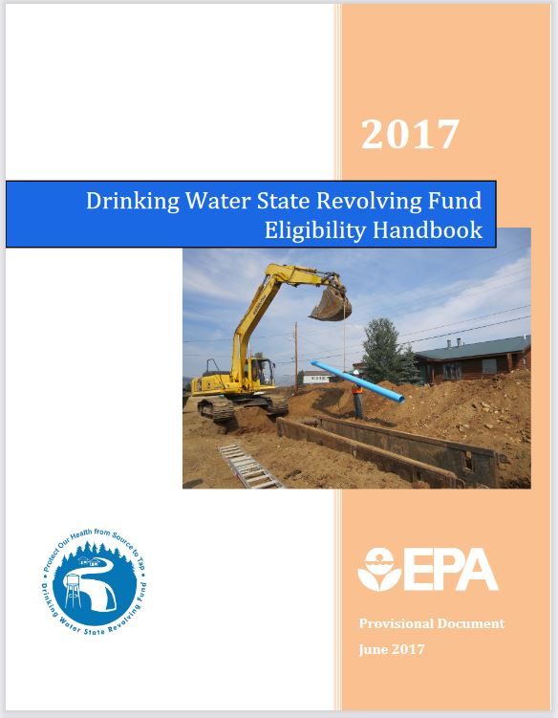
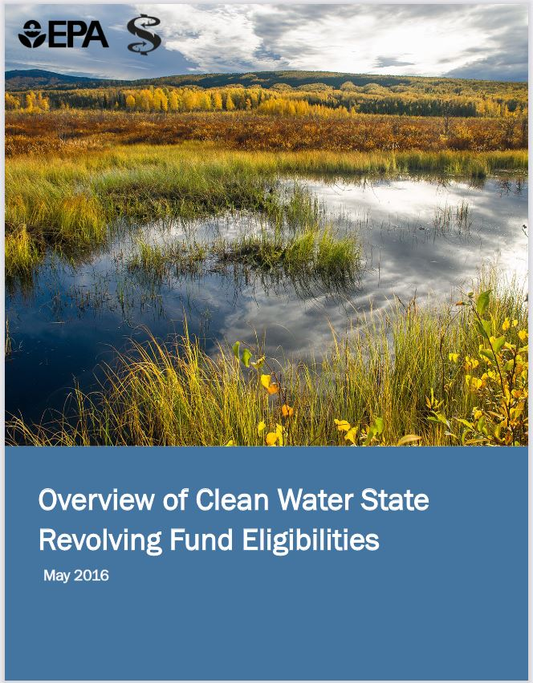
Fiscal Recovery Funds (FRF/ARPA)
Drinking Water SRF eligible projects: https://www.epa.gov/sites/default/files/2017-06/documents/dwsrf_eligibility_handbook_june_13_2017_updated_508_version.pdf
Clean Water SRF eligible projects: https://www.epa.gov/sites/default/files/2016-07/documents/overview_of_cwsrf_eligibilities_may_2016.pdf
Funds must be obligated by Dec 31, 2024 and spent by Dec 31, 2026
IMPORTANT: Final Rule yet to come!

Slide 6
Drinking Water SRF eligible projects:
Treatment
Transmission and distribution
Source (raw water intakes, wells, alternative supply)
Storage
Consolidation
Creation of a new system to address public health problems with serious risks caused by unsafe drinking water OR to create a new regional community water system to eliminate individual systems with technical, managerial and financial difficulties

Slide 7
Clean Water SRF eligible projects:
Centralized wastewater treatment
Energy conservation
Water conservation
Stormwater
Agricultural Best Management Practices
Decentralized Wastewater treatment
Resource Extraction
Contaminated Sites
Landfills
Habitat Protection and restoration
Silviculture
Desalination
Groundwater Protection and Restoration
Surface Water Protection and Restoration
Planning/Assessment

Slide 8
Fiscal Recovery Funds (ARPA)
Ineligible uses
Debt payments/refinance
Contribute to reserves (or “rainy day” fund)
As a non-Federal match for other Federal funds, included SRF grants
Day to day operating expenses
Drinking water system growth that may not materialize (See section 3.4.1, page 14, DWSRF handbook)

Slide 9
Other FAQs
Can a utility combine an eligible project with another one?
Yes, but the utility can only spend FRF/ARP money on the portion of the project that is eligible
Can a utility complete a (fill in the blank) stormwater project?
Assess the project with the CWSRF guidelines:
Stormwater projects must have a water quality benefit.
Page 13, CWSRF handbook

Slide 10
Other FAQs
Can a utility use the FRF/ARP money for planning costs?
(FAQ 6.12) Generally, yes, check out handbooks (DWSRF page 15/16; CWSRF page 24)
Pre-project costs that are tied to an eligible project, or are reasonably expected to lead to a project
Planning
Evaluation
Training and warranty for equipment
Assessment
Cost and effectiveness analysis
Water/energy audits
Conservation plans

Slide 11
Other FAQs
Does Davis Bacon and NEPA apply to infrastructure projects funded by FRF?
Not for projects under $10 million in NC, Treasury guidance states: “NEPA does not apply to Treasury’s administration of the Funds. Projects supported with payments from the Funds may still be subject to NEPA review if they are also funded by other federal financial assistance programs.” (FAQ 6.4)
There are no requirements for Davis-Bacon Labor Standards or American Iron and Steel Provisions in the interim rule for projects under $10 million.
Necessary investments “should be carried out in ways to produce high-quality infrastructure, avert disruptive and costly delays, and promote efficient”. Recipients are encouraged “to use strong labor standards, including project labor agreements………” See FAQ 6.17
For projects over $10 million, Davis-Bacon will apply (or a similar labor standard and reporting method) See FAQ 6.17 and the Reporting and Compliance Document, page 21
If combined with other funds, utility must follow requirements for those other funds.

Slide 12
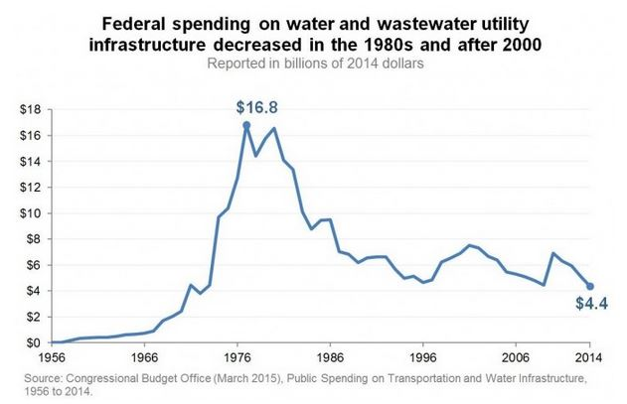
IMPORTANT
Projects should be financially sustainable going forward
Keep the long term view in mind—more grant $$ may not come
Explore regionalization options
Build/replace/rehab assets that can be maintained and operated with the utility’s revenue
Funds done Dec 2026
*Raise rates as needed*

