Slide 1

ARP/CSLFRF Office Hours
> $10 million
February 2, 2022
The FINAL RULE

Slide 2
Revamped Zoom Office Hours
https://unc.zoom.us/j/94011361206?pwd=MjIzWnlzOWxtNGtoUlNjaEV3ZWNPdz09
Meeting ID: 940 1136 1206
Passcode: 522329
Local governments receiving $0 to $10 million total ARP/CSLFRF funding
Local governments receiving over $10 million total ARP/CSLFRF funding
Monday, January 31, at 12:00pm
Friday, February 11, at 8:30am
Friday, February 18, at 12:00pm
Friday, February 25, at 8:30am
Thursday, March 3, at 12:00pm
Friday, March 18, at 8:30am
Wednesday, February 2, at 12:00pm
Thursday, February 10, at 8:30am
Wednesday, February 16, at 12:00pm
Monday, February 21, at 8:30am
Monday, March 7, at 12:00pm
Thursday, March 24, at 8:30am

Slide 3
ARP/CLFRF Allowable Expenditures
Address COVID Public Health & Negative Economic Impact
Support public health expenditures, by funding COVID-19 mitigation efforts, medical expenses, behavioral healthcare, and certain public health and safety staff;
Address negative economic impacts caused by the public health emergency, including economic harms to workers, households, small businesses, impacted industries, and the public sector;
Support disproportionately impacted communities
Replace Lost Revenue
Replace lost public sector revenue, using this funding to provide government services to the extent of the reduction in revenue experienced due to the pandemic;
Standard allowance up to $10 million
OR
Formula approach
Premium Pay
Provide premium pay for essential workers, offering additional support to those who have borne and will bear the greatest health risks because of their service in critical infrastructure sectors; and,
Infrastructure Investments
Invest in water, sewer, and broadband infrastructure, making necessary investments to improve access to clean drinking water, support vital wastewater and stormwater infrastructure, and to expand access to broadband internet.

Slide 4
Maximize Benefit, Minimize Burden
2
Engage in strategic process to identify best use of funds
1
You must spend all your ARP/CSLFRF funds! (No reserves)
Fully obligated by December 31, 2024 & fully expended by December 31, 2026
3
Supplant to the extent possible to minimize administrative/reporting burden

Slide 5

Uniform Guidance Compliance
The Assistance Listing: Coronavirus State and Local Fiscal Recovery Funds and Part 2 of the US Treasury State and Local Fiscal Recovery Funds Compliance and Reporting Guidance(Compliance Guide), the following UG provisions apply to the ARP/CSLFRF grant award (with a few modifications):
  Subpart A, Acronyms and Definitions
  Subpart B, General provisions
  Subpart C, Pre-Federal Award Requirements and Contents of Federal Awards (except 2 CFR 200.204, .205, .210, and .213)
  Subpart D, Post Federal; Award Requirements (except 2 CFR 200.305(b)(8) & (9), .308, .309, and .320(c)(4))
  Subpart E, Cost Principles
  Subpart F, Audit Requirements
  2 CFR Part 25 (Universal Identifier & System for Award Management)
  2 CFR Part 170 (Reporting Subaward and Executive Compensation Information)
  2 CFR Part 180 (OMB Guidelines to Agencies on Governmentwide Debarment and Suspension (Non-procurement)

Slide 6



Supplanting in Action
$2,500,000 law enforcement salaries/benefits claimed under ARP/CSLFRF “Revenue Replacement” category
Does UG apply to these expenditures?
$2,500,000 of general fund revenue is then used to make repair to LG building
Does UG apply to these expenditures?

Slide 7
Adopt grant project ordinance
Set up accounting system to track obligations and expenditures for general government services projects
Adopt and implement the following required written policies and procedures:
  General Financial Management & Internal Controls Policy (Internal Controls must meet federal Green Book)
  Eligible Projects (If you elected the standard allowance, this can be a basic policy establishing internal controls to ensure that funds are spent for general government services and not spent for the handful of prohibited purposes. To make it easier, you could simply establish these controls in the grant project ordinance.)
  Cost Principles/Allowable Costs Policy (see sample here)
  Human Resources / Effort Certification Policy
  Nondiscrimination Policy
  Conflict of Interest Policy
  Records Retention Policy (Note that all documentation related to the ARP/CSLFRF must be retained for at least 5 years after the end of the award term.)
Adopt and implement the following written policies and procedures, if needed:
  Procurement, Suspension, & Debarment Policy (If local government will enter any service, purchase, or construction contract with ARP/CSLFRF funds.)
  Subaward Policy (If local government will partner with another government, nonprofit, or other private entity as part of an expenditure of the ARP/CSLFRF funds).
  Program Income Policy (If local government will earn any income from ARP/CSLFRF-funded programs, such as loan programs and rentals of real or personal property.)
  Property Management Policy (If expenditures will result in the acquisition of any real or personal (supplies & equipment) property.)

Slide 8
Allowable Costs / Cost Principles Policy
Internal controls to ensure all cost items are allowable, reasonable, allocable, consistently treated, and properly documented.
Typical cost items are compensation and fringe benefits, materials and supplies, equipment and other capital, consultants/professional services, audits, communications, insurance, maintenance and repair, and rental costs.
UG also has 55 specific cost items, some of which are allowed, some of which are allowed with limitations, and some of which are disallowed.
https://canons.sog.unc.edu/2021/12/american-rescue-plan-act-of-2021-allowable-costs-and-cost-principles-including-sample-policy-and-implementation-tools/

Slide 9
Human Resources Policy: Effort Certification
Establish process for reporting, recording, and verifying employee time spent working on grant-funded projects.
Written policies and procedures for grant-funded personnel that:
  Contain prescribed measurement and tracking methods for staff effort and the sources of funds from which they are being paid. The measurement method should be consistent across staff classifications;
  Identify who will certify effort reports (supervisors, department heads, etc.);
  Identify who has oversight over reviewing, approving, tracking, and allocations (manager, administrator, finance officer, etc.); and
  Contain clear procedures to adjust effort levels when job duties change; and
  Ensure that tracking methods are documented and tie back to reporting on obligations/expenditures.
Written policies and procedures for accounting staff regarding the review of budgeted estimates against actual work (effort):
  Under the Uniform Guidance, estimates determined before the services are performed do not qualify as support for charges to Federal awards. (2 CFR 200.430(i)(1)(viii)).
  There must be a process to review after-the- fact interim charges made to federal awards based on budget estimates. All necessary adjustments must be made such that the final amount charged to the Federal award is accurate, allowable, and properly allocated.
1
Establish effort reporting forms/process for grant funded personnel
Designate appropriate staff to review and certify effort reporting forms and train on Cost Principles policy and other grant requirements
Finance or other designated personnel must periodically review effort report forms (at least biannually)
Provide sufficient training and support to ensure employee compliance
2
3
4

Slide 10
Sample Approach
Using revenue replacement funds for general salaries/benefits
Time and Effort Reporting for Employees who are paid 100% from a SINGLE program (single cost objective):
An employee whose salary is paid in whole from one federal source must certify, on a semi-annual basis, that they “worked solely on that program (single cost objective) for the period covered by the certification (e.g. Jan 1- Jun 30 and Jul 1- Dec 31)
The certification must be signed and dated by the employee and may be signed by a supervisory official having first-hand knowledge of the activities performed by the employee
Time and Effort Reporting for employees whose work effort is split between more than one federal program or multiple cost objectives:
An employee who works on more than one federal program, or on a combination of a federal programs and non-federal work, must maintain Personnel Activity Reports (PARs)/(Time and Effort Monthly Log) that accurately reflects the percentage of time/hours the employee spends performing the federal work activity and any other duties
Report must reflect an “AFTER-THE-FACT” distribution of actual activities performed
Account for TOTAL activity for which employee is compensated must be completed at LEAST MONTHLY (e.g. Jan 1 – Jan 31)
Must be signed and dated by the employee and also signed by a supervisory
official having first-hand knowledge of the activities performed by the employee
Using funds to cover full salaries/benefits for grants administrator or employee fully dedicated to an ARP/CSLFRF project
Using funds to cover a portion of employee’s salaries/benefits based on effort spent on ARP/CSLFRF-eligible project

Slide 11
Basics of Nondiscrimination Policy
1
2
5
Include statement that LG does not deny benefits or services, or otherwise discriminate on the basis of race, color, national origin (including limited English proficiency), disability, age, or sex (including sexual orientation and gender identity), in accordance with the following authorities: Title VI of the Civil Rights Act of 1964 (Title VI) Public Law 88-352, 42 U.S.C. 2000d-1 et seq., and the Department's implementing regulations, 31 CFR part 22; Section 504 of the Rehabilitation Act of 1973 (Section 504), Public Law 93-112, as amended by Public Law 93-516, 29 U.S.C. 794; Title IX of the Education Amendments of 1972 (Title IX), 20 U.S.C. 1681 et seq., and the Department's implementing regulations, 31 CFR part 28; Age Discrimination Act of 1975, Public Law 94-135, 42 U.S.C. 6101 et seq., and the Department implementing regulations at 31 CFR part 23.
Establish process for reporting violations of nondiscrimination policy (by employees and others)
Identify methods to inform staff and public of policy and provide appropriate training on compliance.
3
6
Appoint person or
persons within LG responsible for enforcing policy and addressing any claimed violations
Implement any processes, procedures, modifications, etc. to work environment, services and communications about services to comply with federal laws.
4
Collect data on any claimed violations and their disposition

Slide 12
Local Government Internal Expenses
Revenue Replacement
General government services, including LG salaries/benefits
Premium Pay
LG employees who performed essential work during pandemic
Strong emphasis on low- and moderate-income employees
Addressing COVID & Negative Impacts
Salaries/benefits for public health, public safety, human services employees to extent working on COVID
Backfilling LG positions
Addressing increased maintenance or deferred maintenance costs

Slide 13
ARP/CLFRF Allowable Expenditures
Address COVID Public Health & Economic Impact
Replace Lost Revenue
Premium Pay
Infrastructure Investments
All Revenue Replacement Funds May be Spent for “General Government Services” defined by reference to a non-exclusive list of examples
  “maintenance or pay-go funded building of infrastructure, including roads; modernization of cybersecurity, including hardware, software, and protection of critical infrastructure; health services; environmental remediation; school or educational services; and the provision of police, fire, and other public safety services.”
  US Treasury Overview Supplement:
    “[g]overnment services generally include any service traditionally provided by a government, unless Treasury has stated otherwise. Here are some common examples, although this list is not exhaustive: Construction of schools and hospitals; Road building and maintenance, and other infrastructure; Health services; General government administration, staff, and administrative facilities; Environmental remediation; [and] Provision of police, fire, and other public safety services (including purchase of fire trucks and police vehicles).”
Must track expenditures for reporting purposes
Must follow all Uniform Guidance requirements
Updated Blog Post: https://canons.sog.unc.edu/2022/01/american-rescue-plan-act-of-2021-coronavirus-state-local-fiscal-recovery-funds-final-rule-spending-funds-for-general-government-purposes-2/

Slide 14
ARP/CLFRF Allowable Expenditures
Address COVID Public Health & Economic Impact
Replace Lost Revenue
Premium Pay
Infrastructure Investments
May award premium pay to any local government employee who performed essential work during the pandemic
Essential work is work that is performed in person with regular interactions with others (including co-workers) OR regularly handling items handled by others
May pay retroactively back to January 27, 2020 or prospectively until December 31, 2026, but must be for work actually performed
Must treat as regular salary for ALL withholding purposes (taxes, retirement, health ins., etc.)
Must target low- or moderate-income employees OR be able to provide justification for including higher income employees based on their special risks due to COVID
  Employee NOT EXEMPT from FLSA overtime provisions OR
  Employee’s total wages and remuneration does not exceed 150% of the state or county average for all occupations, whichever is higher
May provide subaward to nonprofit fire departments or similar entities to provide premium pay to their employees –must be for work that LG has state statutory authority to perform itself and that is also eligible under ARP/CSLFRF
Updated Blog Post: https://canons.sog.unc.edu/2022/01/american-rescue-plan-act-coronavirus-state-and-local-fiscal-recovery-funds-final-rule-premium-pay-for-local-government-employees/

Slide 15
ARP/CLFRF Allowable Expenditures
Address COVID Public Health & Economic Impact
Replace Lost Revenue
Premium Pay
Infrastructure Investments
Re-organizes subcategories
Better defines “impacted” and “disproportionately impacted”
Adds some more “safe-harbor” examples
Imposes reasonableness and proportionality requirements
Allows qualifying capital expenditures, but extra justification/due diligence/reporting requirements if over $1 million
Retains Key Eligibility Tests & Requires Oversight to Ensure Reasonableness & Proportionality
  ”eligible uses under this category must be in response to the disease itself or the harmful consequences of the economic disruptions resulting from or exacerbated by the COVID-19 public health emergency.”

Slide 16
Address COVID Public Health & Negative Economic Impact
General Criteria | Safe Harbors
Program, service, capital expenditure eligible if LG identifies harm or impact to beneficiary or class caused or exacerbated by COVID or its negative economic impacts AND the program, service, or capital expenditure responds to the harm. | US Treasury provides safe harbor examples for both eligible beneficiaries and eligible projects
To respond to harm, program, service, or capital expenditure must be reasonably designed to benefit the beneficiary or class that experienced the harm or impact and be related and reasonably proportional to the extent and type of harm or impact. | To respond to harm, program, service, or capital expenditure must be reasonably designed to benefit the beneficiary or class that experienced the harm or impact and be related and reasonably proportional to the extent and type of harm or impact.
Additional justifications and process requirements required for capital projects over $1 million
*All programs, services, capital expenditures must also be authorized by state law.*

Slide 17
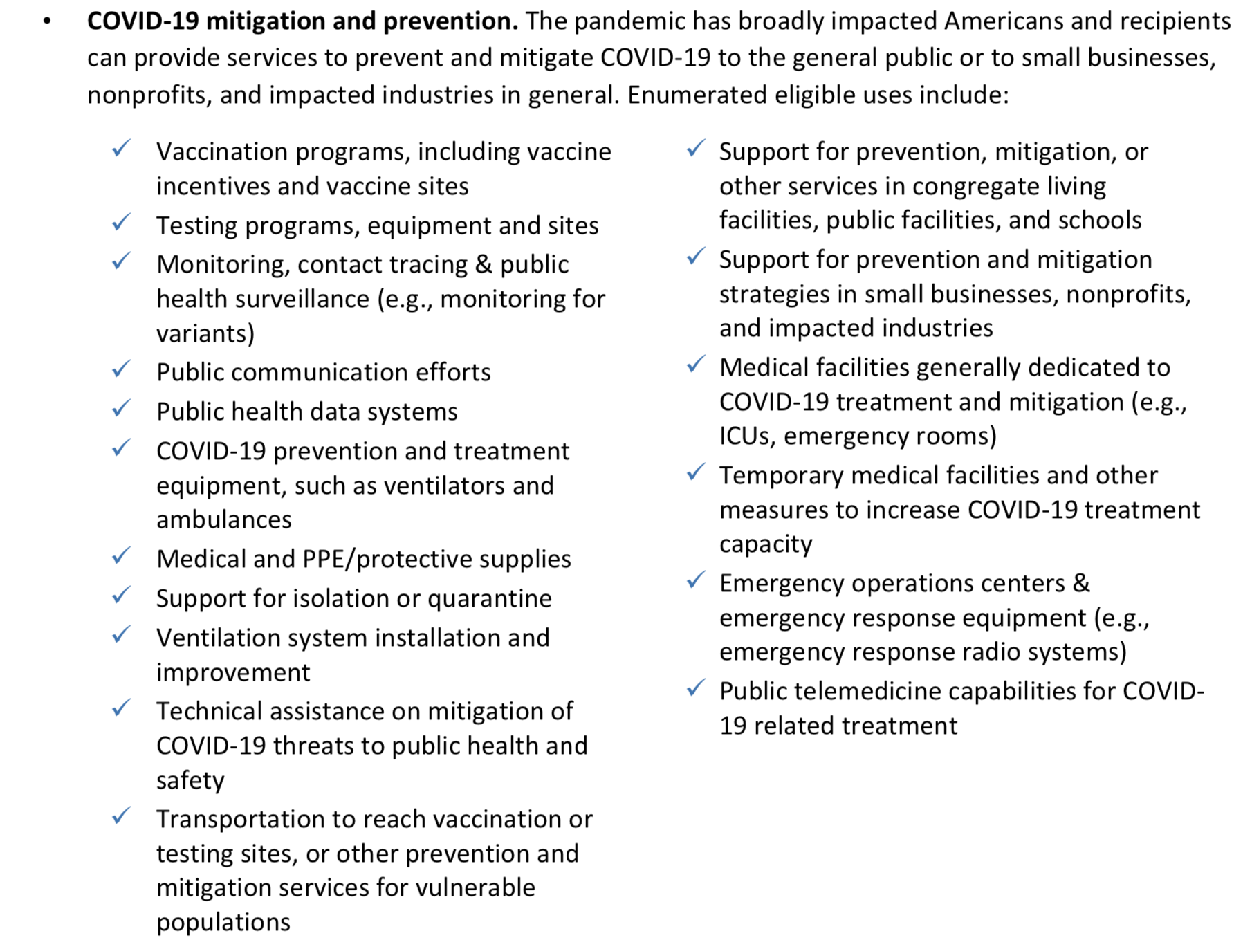
Addressing Public Health Emergency: Safe Harbors
1
There are four main areas identified in the Final Rule related to addressing the ongoing public health emergency caused by COVID-19

Slide 18
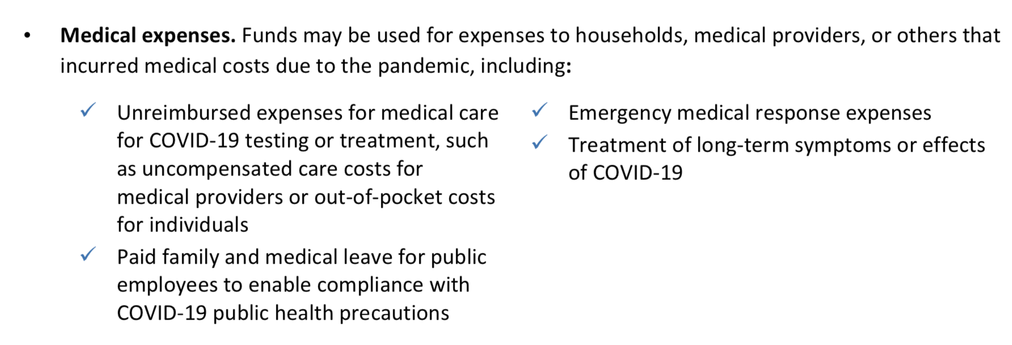
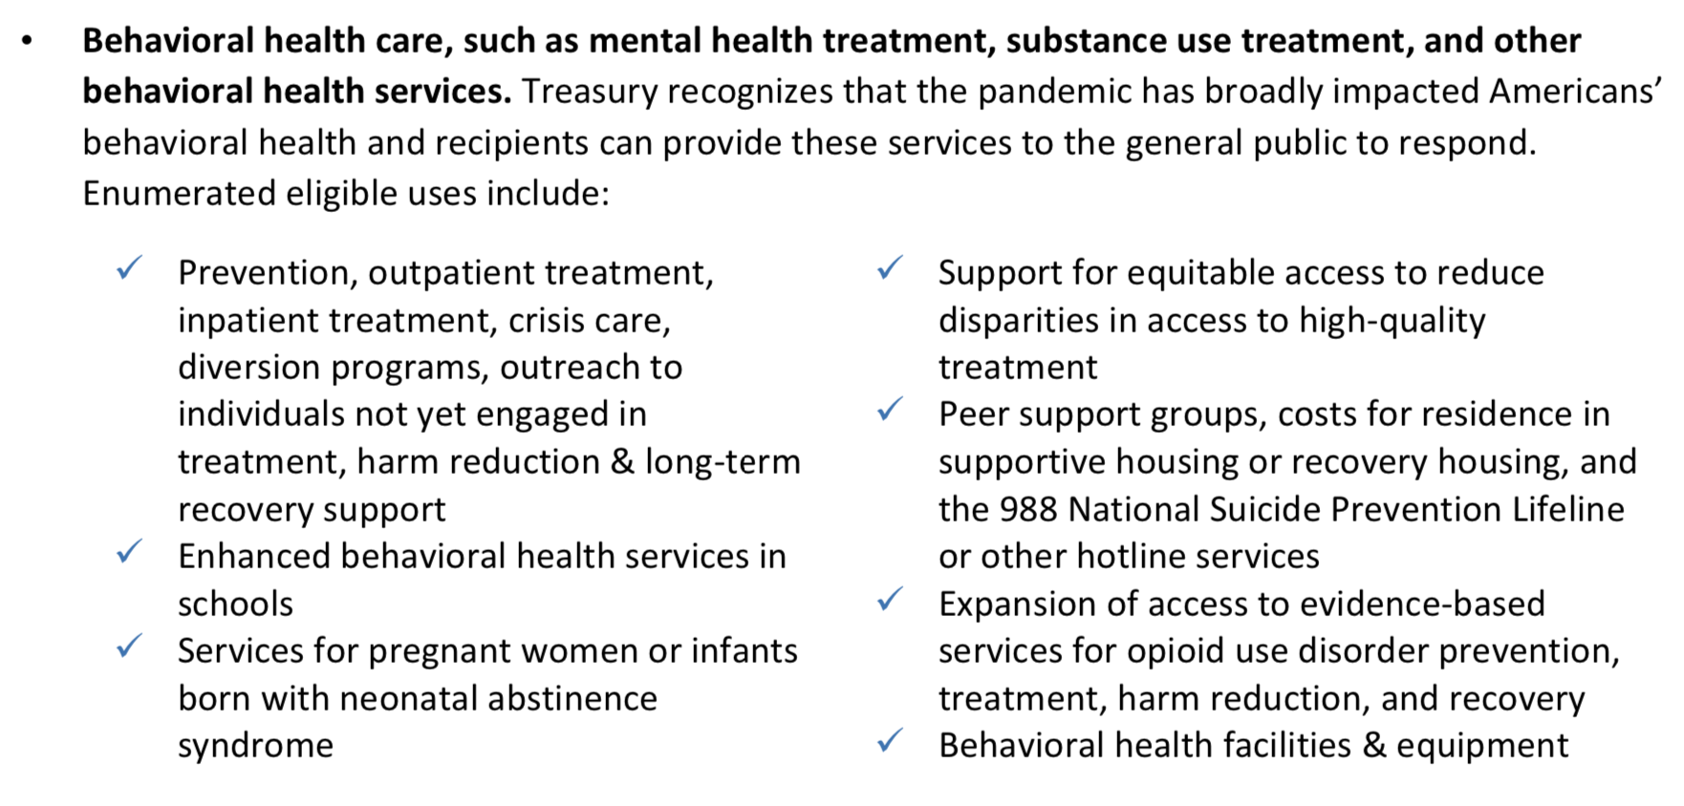
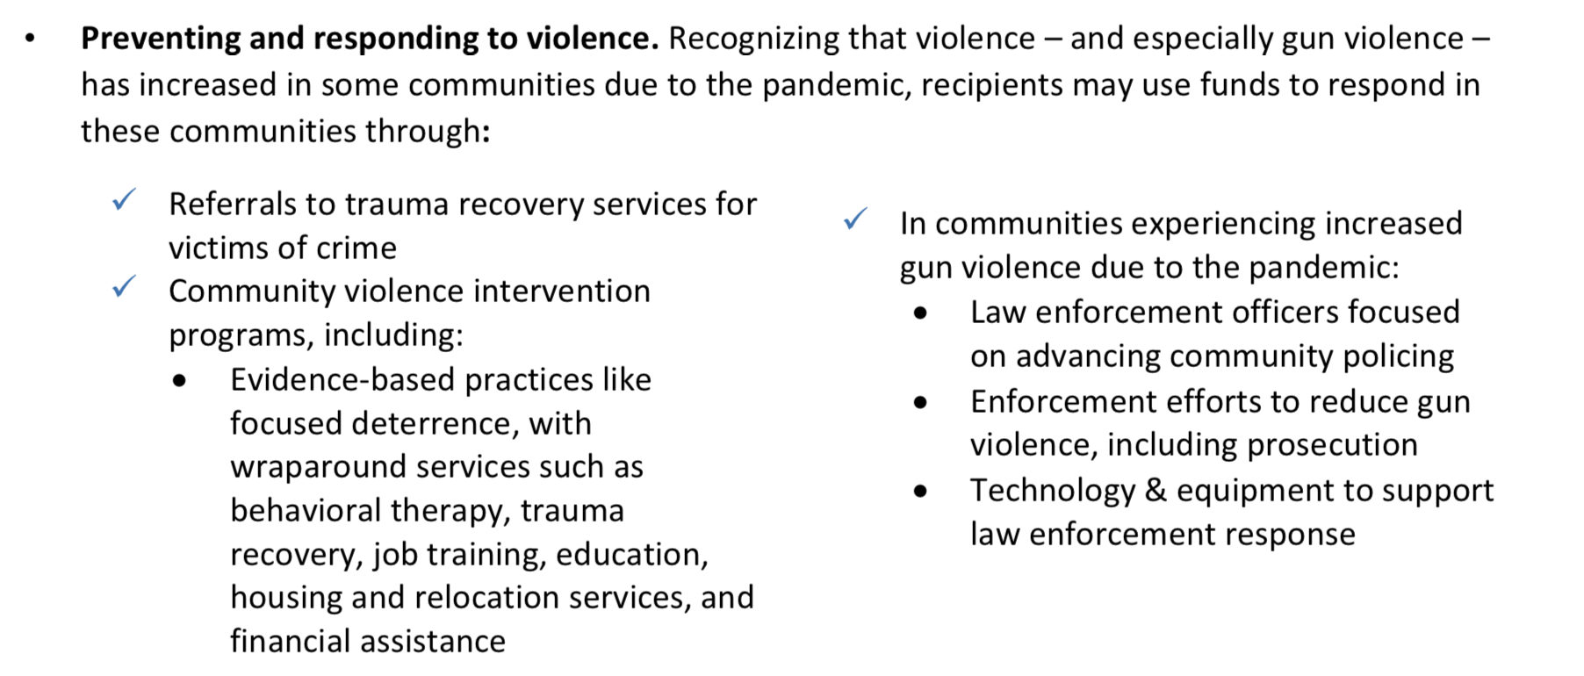
Addressing Public Health Emergency: Safe Harbors
2
3
4
All “safe harbor” projects still must be reasonable and proportional.
Additional justifications for capital outlay apply.

Slide 19
Impacted vs. Disproportionately Impacted
Most projects may target any impacted beneficiaries, consistent with state law, but some eligible projects may only target disproportionally impacted beneficiaries.
Presumptions of Impacted Beneficiaries | Presumptions of Disproportionally Impacted Beneficiaries
Households or populations that: Experienced unemployment Experienced increased housing insecurity Qualify for various other federal aid programs Any student that did not have access to in-person instruction for significant period of time (for educational expenditures) Are low- or moderate- income | Households and populations: Residing in a QCT Are low-income Qualify for various other federal aid programs Small businesses operating in a QCT Nonprofits operating in a QCT

Slide 20
Safe Harbors:
Negative Economic Impacted
Addressing Negative Economic Impact
Assistance to households and individuals (and facilities and equipment related to the provisions of services to households) for:
Food; emergency housing needs; burials, home repairs, or weatherization; internet access or digital literacy; cash assistance; and assistance accessing public benefits;
Paid sick, medical, or family leave programs, or assistance to expand access to health insurance;
Childcare, early learning services, home visiting, or assistance for child welfare- involved families or foster youth;
Programs to address the impacts of lost instructional time for students in kindergarten through twelfth grade;
Development, repair, and operation of affordable housing and services or programs to increase long-term housing security;
Financial services that facilitate the delivery of Federal, State, or local benefits for unbanked and underbanked individuals;
Benefits for the surviving family members of individuals who have died from COVID-19, including cash assistance to surviving spouses or dependents of individuals who died of COVID-19; and
Assistance for unemployed.
Assistance to small businesses, including programs, services, or capital expenditures that respond to the negative economic impacts of the COVID-19 public health emergency, including loans or grants to mitigate financial hardship such as declines in revenues or impacts of periods of business closure, or providing technical assistance;
Assistance to nonprofit organizations including programs, services, or capital expenditures, including loans or grants to mitigate financial hardship such as declines in revenues or increased costs, or technical assistance
Assistance to tourism, travel, hospitality, and other impacted industries for programs, services, or capital expenditures, including support for payroll costs and covered benefits for employees, compensating returning employees, support for operations and maintenance of existing equipment and facilities, and technical assistance

Slide 21

Safe Harbors: Disproportionately Negative Economic Impact
Addressing Disproportionately Negative Economic Impact
A program, service, capital expenditure, or other assistance that is provided to a disproportionately impacted household, population, or community, including:
  Services to address health disparities of the disproportionately impacted household, population, or community;
  Housing vouchers and relocation assistance;
  Investments in communities to promote improved health outcomes and public safety such as parks, recreation facilities, and programs that increase access to healthy foods;
  Capital expenditures and other services to address vacant or abandoned properties;
  Services to address educational disparities; and
  Facilities and equipment related to the provision of these services to the disproportionately impacted household, population, or community.
A program, service, capital expenditure, or other assistance that responds to disproportionately impacted small businesses, including rehabilitation of commercial properties; storefront and façade improvements; technical assistance, business incubators, and grants for start-ups or expansion costs for small businesses; and programs or services to support micro- businesses

Slide 22
Capital Outlay for Address COVID-19 Public Health and Negative Economic Impact Category
If a project has total expected capital expenditures of | and the use is enumerated in (b)(3), then | and the use is not enumerated in (b)(3), then
Less than $1 million | No Written Justification required | No Written Justification required
Greater than or equal to $1 million, but less than $10 million | Written Justification required but recipients are not required to submit as part of regular reporting to Treasury | Written Justification required and recipients must submit as part of regular reporting to Treasury
$10 million or more | Written Justification required and recipients must submit as part of regular reporting to Treasury
Written justification must include the following elements:
Describe the harm or need to be addressed;
Explain why a capital expenditure is appropriate; and
Compare the proposed capital expenditure to at least two alternative capital expenditures and demonstrate why the proposed capital expenditure is superior.

Slide 23
Public Sector Capacity & Workforce
Payroll and covered benefit expenses for public safety, public health, health care, human services, and similar employees to the extent that the employee’s time is spent mitigating or responding to the COVID-19 public health emergency;
Payroll, covered benefit, and other costs associated with programs or services to support the public sector workforce and with the LG:
  Hiring or rehiring staff to fill budgeted full-time equivalent positions that existed on January 27, 2020 but that were unfilled or eliminated as of March 3, 2021; or
  Increasing the number of its budgeted full-time equivalent employees by up to the difference between the number of its budgeted full-time equivalent employees on January 27, 2020, multiplied by 1.075, and the number of its budgeted full-time equivalent employees on March 3, 2021, provided that funds shall only be used for additional budgeted full-time equivalent employees above the recipient’s number of budgeted full-time equivalent employees as of March 3, 2021;
Costs to improve the design and execution of programs responding to the COVID-19 pandemic and to administer or improve the efficacy of programs addressing the public health emergency or its negative economic impacts
Costs associated with addressing administrative needs of recipient governments that were caused or exacerbated by the pandemic.

Slide 24
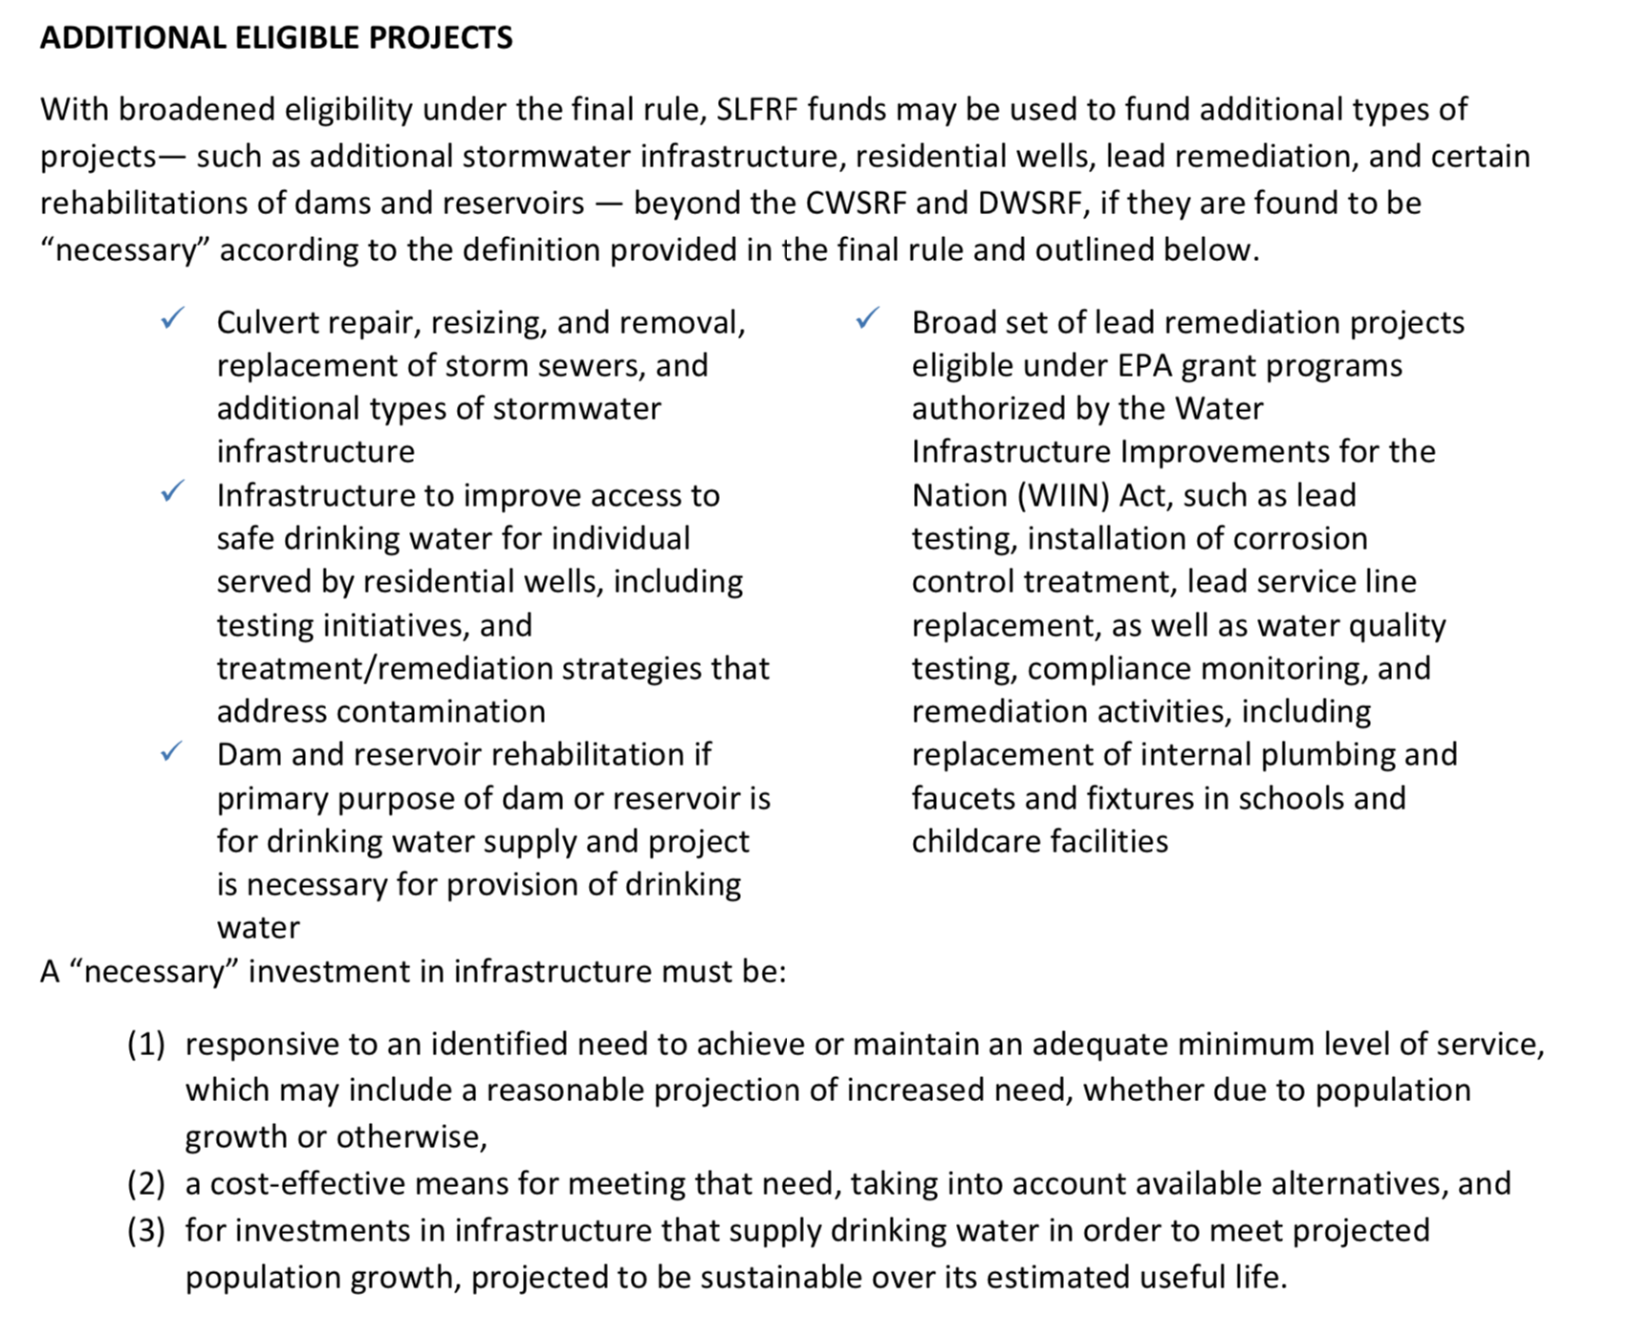
ARP/CLFRF Allowable Expenditures
Address COVID Public Health & Economic Impact
Replace Lost Revenue
Premium Pay
Infrastructure Investments
Treasury encourages recipients to adhere to strong labor standards, including project labor agreements and community benefits agreements that offer wages at or above the prevailing rate and include local hire provisions. Treasury also encourages recipients to prioritize in their procurements employers with high labor standards and to prioritize employers without recent violations of federal and state labor and employment laws.
Presumed Eligible: Projects allowed under CWSRF and DWSRF programs

