Slide 1

ARP/CSLFRF
Office Hours:
$0-$10 million LGs

Slide 2
ARP Zoom Office Hours
https://unc.zoom.us/j/94011361206?pwd=MjIzWnlzOWxtNGtoUlNjaEV3ZWNPdz09
Meeting ID: 940 1136 1206
Passcode: 522329
Local governments receiving $0 to $10 million total ARP/CSLFRF funding
Local governments receiving over $10 million total ARP/CSLFRF funding
Friday, February 18, at 12:00pm
Friday, February 25, at 8:30am
Thursday, March 3, at 12:00pm
Friday, March 18, at 8:30am
Wednesday, February 16, at 12:00pm*
Monday, February 21, at 8:30am*
Monday, March 7, at 12:00pm
Thursday, March 24, at 8:30am
*February 16 (focus broadband) & February 21 (focus on water/sewer/stormwater) are open to ALL local governments!!!

Slide 3
ARP/CSLFRF Allowable Expenditures
Address COVID Public Health & Negative Economic Impact
Support public health expenditures, by funding COVID-19 mitigation efforts, medical expenses, behavioral healthcare, and certain public health and safety staff;
Address negative economic impacts caused by the public health emergency, including economic harms to workers, households, small businesses, impacted industries, and the public sector;
Support disproportionately impacted communities
Replace Lost Revenue
Replace lost public sector revenue, using this funding to provide government services to the extent of the reduction in revenue experienced due to the pandemic;
$10 million standard allowance, OR formula approach, whichever is higher
Premium Pay
Provide premium pay for essential workers, offering additional support to those who have borne and will bear the greatest health risks because of their service in critical infrastructure sectors;
Target low-and moderate- income employees or employees who face(d) added risks during pandemic
Infrastructure Investments
Invest in water, sewer, and broadband infrastructure, making necessary investments to improve access to clean drinking water, support vital wastewater and stormwater infrastructure, and to expand access to broadband internet.

Slide 4
Revenue Replacement: Standard Allowance
May expend up to $10 million as revenue replacement
Examples
If LG allocation is $20,000: Expend up to $20,000 as revenue replacement
If LG allocation is $1.2 million: Expend up to $1.2 million as revenue replacement
If LG allocation is $10 million: Expend up to $10 million as revenue replacement
Will elect standard allowance on Project & Expenditure Report (report deadline by April 30, 2022)
Electing the standard allowance and spending 100% of your ARP/CSLFRF funds as revenue replacement, will significantly reduce reporting requirements. BUT IT DOES NOT CONVERT THESE FUNDS INTO GENERAL FUNDS. THEY ARE STILL GRANT FUNDS, SUBJECT TO GRANT AWARD TERMS AND UNIFORM GUIDANCE COMPLIANCE REQUIREMENTS.

Slide 5
100% OF ARP/CSLFRF Funds as Revenue Replacement
Allowable Expenditures = General Government Services
May fund any project that is eligible under the other ARP/CSLFRF categories with revenue replacement funds, with the possible exception of Premium Pay. It is probably best to fund/report Premium Pay under the Premium Pay category.
  “maintenance or pay-go funded building of infrastructure, including roads; modernization of cybersecurity, including hardware, software, and protection of critical infrastructure; health services; environmental remediation; school or educational services; and the provision of police, fire, and other public safety services.”
  US Treasury Overview Supplement:
    “[g]overnment services generally include any service traditionally provided by a government, unless Treasury has stated otherwise. Here are some common examples, although this list is not exhaustive: Construction of schools and hospitals; Road building and maintenance, and other infrastructure; Health services; General government administration, staff, and administrative facilities; Environmental remediation; [and] Provision of police, fire, and other public safety services (including purchase of fire trucks and police vehicles).”
Translation: General government services are anything that a local government has state law authority to engage in, including public enterprise activities.

Slide 6
Maximize Benefit: Minimize Burden
Strategic Planning to Identify Programs / Projects
Can we use general fund or enterprise fund monies for any of these projects?
If yes, consider using ARP/CSLFRF funds for departmental salaries/benefits and other LG funds for special programs/projects to minimize compliance burden
Note that this will not work for all projects – eg. Broadband likely will have to be funded directly with ARP/CSLFRF monies

Slide 7
Different Revenue Replacement Expenditures have Different Compliance Requirements
Purchase Equipment
Financial mgmt./internal controls
Conflict of interest
Eligibility documentation
Allowable costs
Civil Rights compliance
Records retention
Procurement
Property Management
Program Income
Partnering with Nonprofit
Financial mgmt./internal controls
Conflict of interest
Eligibility documentation
Allowable costs
Civil Rights compliance
Records retention
Procurement
Property Management
Program Income
Subaward
LG Personnel
Financial mgmt./internal controls
Conflict of interest
Eligibility documentation
Allowable costs
Civil Rights compliance
Records retention

Slide 8
Sample Grant Project Ordinance: Standard Allowance
Salaries/Benefits Only

Slide 9
Grant Project Ordinance for the Town of TarHeel American Rescue Plan Act of 2021: Coronavirus State and Local Fiscal Recovery Funds
BE IT ORDAINED by the town council of the Town of TarHeel, North Carolina that, pursuant to Section 13.2 of Chapter 159 of the General Statutes of North Carolina, the following grant project ordinance is hereby adopted:
Section 1: This ordinance is to establish a budget for a project to be funded by the Coronavirus State and Local Fiscal Recovery Funds of H.R. 1319 American Rescue Plan Act of 2021 (CSLFRF). The Town of TarHeel (Town) has received the first tranche in the amount of $1,000,000 of CSLFRF funds. The total allocation is $2,000,000, with the remainder to be distributed to the Town within 12 months. These funds may be used for the following categories of expenditures, to the extent authorized by state law.
Support public health expenditures, by funding COVID-19 mitigation efforts, medical expenses, behavioral healthcare, and certain public health and safety staff;
Address negative economic impacts caused by the public health emergency, including economic harms to workers, households, small businesses, impacted industries, and the public sector;
Replace lost public sector revenue, using this funding to provide government services to the extent of the reduction in revenue experienced due to the pandemic;
Provide premium pay for essential workers, offering additional support to those who have borne and will bear the greatest health risks because of their service in critical infrastructure sectors; and,
Invest in water, sewer, and broadband infrastructure, making necessary investments to improve access to clean drinking water, support vital wastewater and stormwater infrastructure, and to expand access to broadband internet.
Section 2: The Town has elected to take the standard allowance, as authorized by 31 CFR Part 35.6(d)(1) and expend all its CSLFRF funds for the provision of government services.
Standard allowance election

Slide 10
The following amounts are appropriated for the project and authorized for expenditure:
Even if supplanting, must still track as “projects ” Salaries/ benefits are cost items within government services project
Internal Project Code | Project Description | Expenditure Category (EC) | Cost Object | Appropriation of CSLFRF Funds
0001 | Law Enforcement Services for period of July 1, 2021 through December 31, 2024 | 6.1 | Salaries | $500,000
 |  |  | Benefits | $35,000
0002 | Parks and Recreation Services for period of July 1, 2021 through December 31, 2024 | 6.1 | Salaries | $200,000
 |  |  | Benefits | $14,000
0003 | General Administration Services for period of July 1, 2021 through December 31, 2024 | 6.1 | Salaries | $320,000
 |  |  | Benefits | $21,700
 | Unassigned |  |  | $909,300
 |  |  |  | $2,000,000
Safest approach is to stop with salary/benefit supplanting by December 31, 2024
Can reimburse back to 3/3/2021, but must be able to meet effort certification req’ts
Section 3: The following revenues are anticipated to be available to complete the project:
  CSLFRF Funds: $2,000,000
  General Fund Transfer: $0
  Total: $2,000,000
Section 4: The Finance Officer is hereby directed to maintain sufficient specific detailed accounting records to satisfy the requirements of the grantor agency and the grant agreements, including payroll documentation and effort certifications, in accordance with 2 CFR 200.430 & 2 CFR 200.431.
Section 5: The Finance Officer is hereby directed to report the financial status of the project to the governing board on a quarterly basis.
Section 6: Copies of this grant project ordinance shall be furnished to the Budget Officer, the Finance Officer and to the Clerk to Town Council.
Section 7: This grant project ordinance expires on December 31, 2026, or when all the CSLFRF funds have been obligated and expended by the Town, whichever occurs sooner.

Slide 11
Allowable Costs / Cost Principles Policy
Internal controls to ensure all cost items are allowable, reasonable, allocable, consistently treated, and properly documented.
Typical cost items are compensation and fringe benefits, materials and supplies, equipment and other capital, consultants/professional services, audits, communications, insurance, maintenance and repair, and rental costs.
UG also has 55 specific cost items, some of which are allowed, some of which are allowed with limitations, and some of which are disallowed.
Compensation & Fringe Benefits are among the specific cost items, with special documentation requirements
https://canons.sog.unc.edu/2021/12/american-rescue-plan-act-of-2021-allowable-costs-and-cost-principles-including-sample-policy-and-implementation-tools/

Slide 12
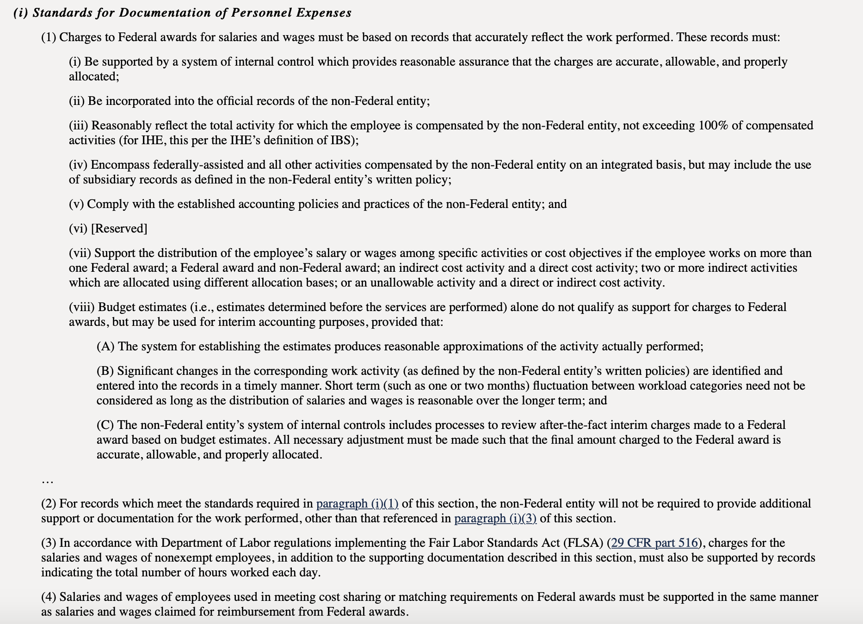
Effort Certification: 2 CFR 200.430

Slide 13
Effort Certification
Establish process for reporting, recording, and verifying employee time spent working on grant-funded projects.
Written policies and procedures for grant-funded personnel that:
  Contain prescribed measurement and tracking methods for staff effort and the sources of funds from which they are being paid. The measurement method should be consistent across staff classifications;
  Identify who will certify effort reports (supervisors, department heads, etc.);
  Identify who has oversight over reviewing, approving, tracking, and allocations (manager, administrator, finance officer, etc.); and
  Contain clear procedures to adjust effort levels when job duties change; and
  Ensure that tracking methods are documented and tie back to reporting on obligations/expenditures.
Written policies and procedures for accounting staff regarding the review of budgeted estimates against actual work (effort):
  Under the Uniform Guidance, estimates determined before the services are performed do not qualify as support for charges to Federal awards. (2 CFR 200.430(i)(1)(viii)).
  There must be a process to review after-the- fact interim charges made to federal awards based on budget estimates. All necessary adjustments must be made such that the final amount charged to the Federal award is accurate, allowable, and properly allocated.
1
Establish effort reporting forms/process for grant funded personnel
Designate appropriate staff to review and certify effort reporting forms and train on Cost Principles policy and other grant requirements
Finance or other designated personnel must periodically review effort report forms
Provide sufficient training and support to ensure employee compliance
2
3
4

Slide 14
Sample Approach
Time and Effort Reporting for Employees who are paid 100% from a SINGLE program (single cost objective):
An employee whose salary is paid in whole from one federal source must certify, on an annual basis, that they “worked solely on that program (single cost objective) for the period covered by the certification (e.g. Jan 1- Jun 30 and Jul 1- Dec 31)
The certification must be signed and dated by the employee and co-signed by a supervisory official having first-hand knowledge of the activities performed by the employee
Time and Effort Reporting for employees whose work effort is split between more than one federally-funded project or a mix of federally-funded projects and non-federal work:
An employee who works on more than one federal program, or on a combination of a federal programs and non-federal work, must maintain Personnel Activity Reports (PARs) that accurately reflects the percentage of time/hours the employee spends performing the federal work activity and any other duties
Report must reflect an “AFTER-THE-FACT” distribution of actual activities performed
Account for TOTAL activity for which employee is compensated must be completed at LEAST MONTHLY (e.g. Jan 1 – Jan 31)
Must be signed and dated by the employee and also signed by a supervisory official having first-hand knowledge of the activities performed by the employee

Slide 15
