Slide 1
ARP/CSLFRF Office Hours
January 25, 2022
The FINAL RULE

Slide 2
ARP/CLFRF Allowable Expenditures
Address COVID Public Health & Negative Economic Impact
Support public health expenditures, by funding COVID-19 mitigation efforts, medical expenses, behavioral healthcare, and certain public health and safety staff;
Address negative economic impacts caused by the public health emergency, including economic harms to workers, households, small businesses, impacted industries, and the public sector;
Support disproportionately impacted communities
Replace Lost Revenue
Replace lost public sector revenue, using this funding to provide government services to the extent of the reduction in revenue experienced due to the pandemic;
Premium Pay
Provide premium pay for essential workers, offering additional support to those who have borne and will bear the greatest health risks because of their service in critical infrastructure sectors; and,
Infrastructure Investments
Invest in water, sewer, and broadband infrastructure, making necessary investments to improve access to clean drinking water, support vital wastewater and stormwater infrastructure, and to expand access to broadband internet.

Slide 3
ARP/CLFRF Allowable Expenditures
Replace Lost Revenue
Replace lost public sector revenue, using this funding to provide government services to the extent of the reduction in revenue experienced due to the pandemic;
Premium Pay
Provide premium pay for essential workers, offering additional support to those who have borne and will bear the greatest health risks because of their service in critical infrastructure sectors; and,

Slide 4
Revamped Zoom Office Hours
https://unc.zoom.us/j/94011361206?pwd=MjIzWnlzOWxtNGtoUlNjaEV3ZWNPdz09
Meeting ID: 940 1136 1206
Passcode: 522329
Local governments receiving $0 to $10 million total ARP/CSLFRF funding
Local governments receiving over $10 million total ARP/CSLFRF funding
Monday, January 31, at 12:00pm
Friday, February 11, at 8:30am
Friday, February 18, at 12:00pm
Friday, February 25, at 8:30am
Thursday, March 3, at 12:00pm
Friday, March 18, at 8:30am
Wednesday, February 2, at 12:00pm
Thursday, February 10, at 8:30am
Wednesday, February 16, at 12:00pm
Monday, February 21, at 8:30am
Monday, March 7, at 12:00pm
Thursday, March 24, at 8:30am

Slide 5
Project & Expenditure Reports!!
First P&E Report Due by January 31, 2022:
If you are a county with over 250K population
If you are a metropolitan city with over 250K population
If you are a county receiving $10 million or more in total ARP/CSLFRF funding
If you are a metropolitan city (over 50K population) AND you are receiving $10 million or more in total ARP/CSLFRF funding
First P&E Report Due by April 30, 2022:
If you are an NEU (municipality under 50K population)
If you are a county under 250K population and receiving less than $10 million in total ARP/CSLFRF funding
If you are a metropolitan city under 250K population and receiving less than $10 million in total ARP/CSLFRF funding
EVERYONE – WATCH THIS! https://www.youtube.com/watch?v=6YTsxrEMS1o

Slide 6
ARP/CLFRF Allowable Expenditures
Address COVID Public Health & Economic Impact
Replace Lost Revenue
Premium Pay
Infrastructure Investments
Re-organizes subcategories
Better defines “impacted” and “disproportionately impacted”
Adds some more “safe-harbor” examples
Imposes reasonableness and proportionality requirements
Allows qualifying capital expenditures, but extra justification/due diligence/reporting requirements if over $1 million
Retains Key Eligibility Tests & Requires Oversight to Ensure Reasonableness & Proportionality
  ”eligible uses under this category must be in response to the disease itself or the harmful consequences of the economic disruptions resulting from or exacerbated by the COVID-19 public health emergency.”

Slide 7
Address COVID Public Health & Negative Economic Impact
General Criteria | Safe Harbors
Program, service, capital expenditure eligible if LG identifies harm or impact to beneficiary or class caused or exacerbated by COVID or its negative economic impacts AND the program, service, or capital expenditure responds to the harm. | US Treasury provides safe harbor examples for both eligible beneficiaries and eligible projects
To respond to harm, program, service, or capital expenditure must be reasonably designed to benefit the beneficiary or class that experienced the harm or impact and be related and reasonably proportional to the extent and type of harm or impact. | To respond to harm, program, service, or capital expenditure must be reasonably designed to benefit the beneficiary or class that experienced the harm or impact and be related and reasonably proportional to the extent and type of harm or impact.
Additional justifications and process requirements required for capital projects over $1 million
*All programs, services, capital expenditures must also be authorized by state law.*

Slide 8
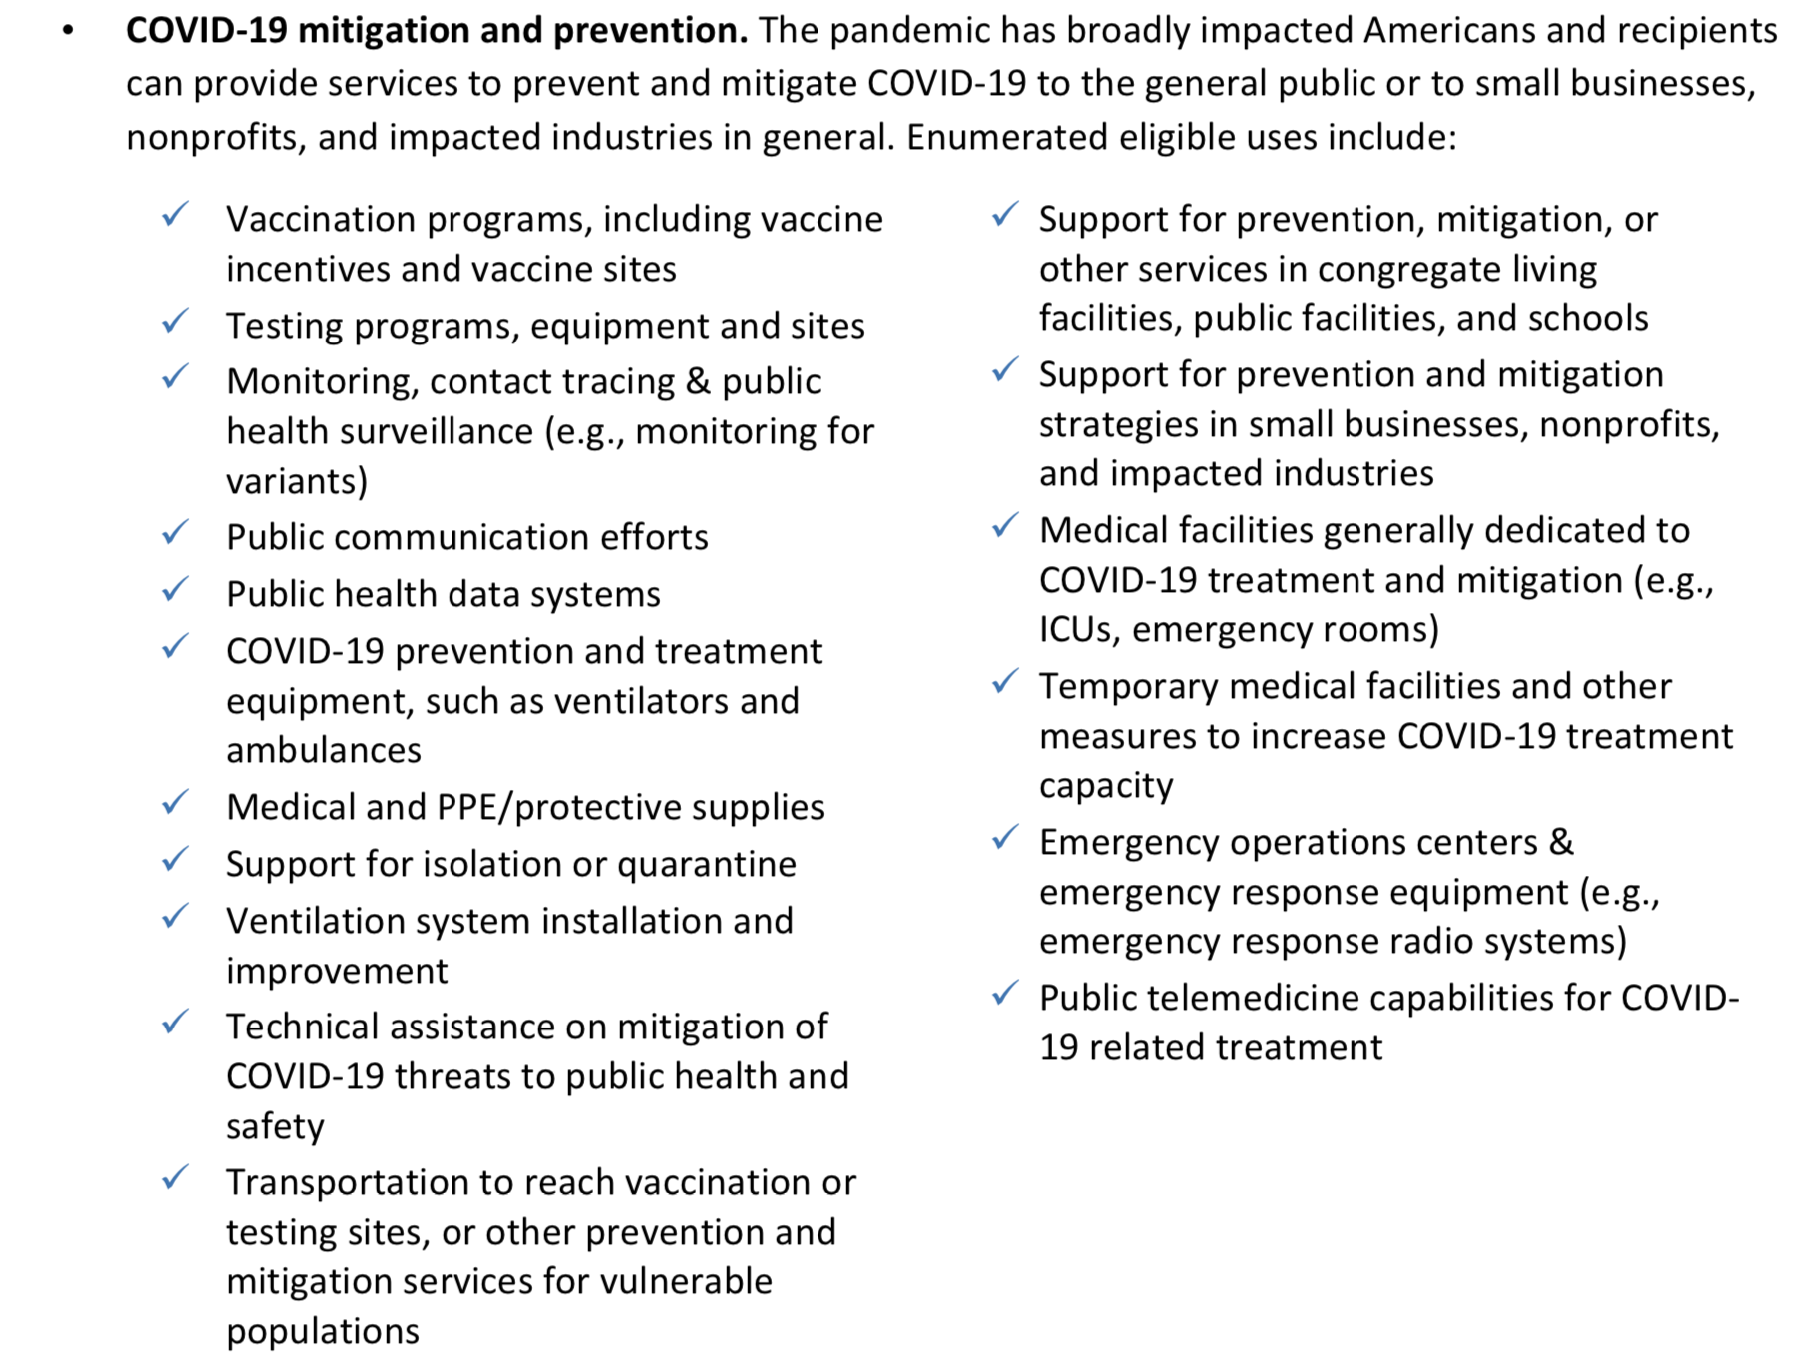
Addressing Public Health Emergency: Safe Harbors
1
There are four main areas identified in the Final Rule related to addressing the ongoing public health emergency caused by COVID-19

Slide 9
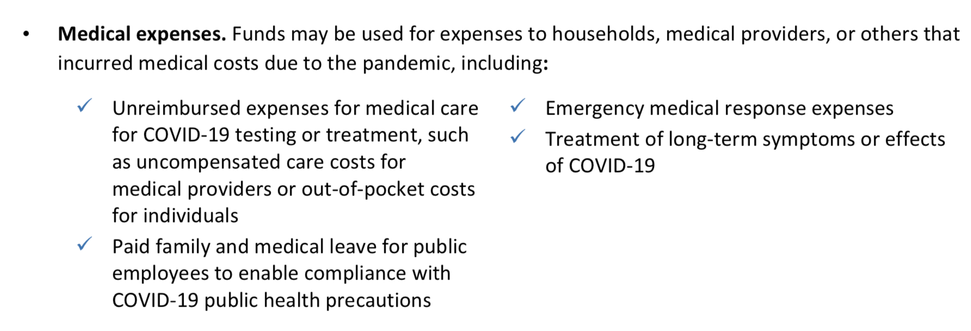
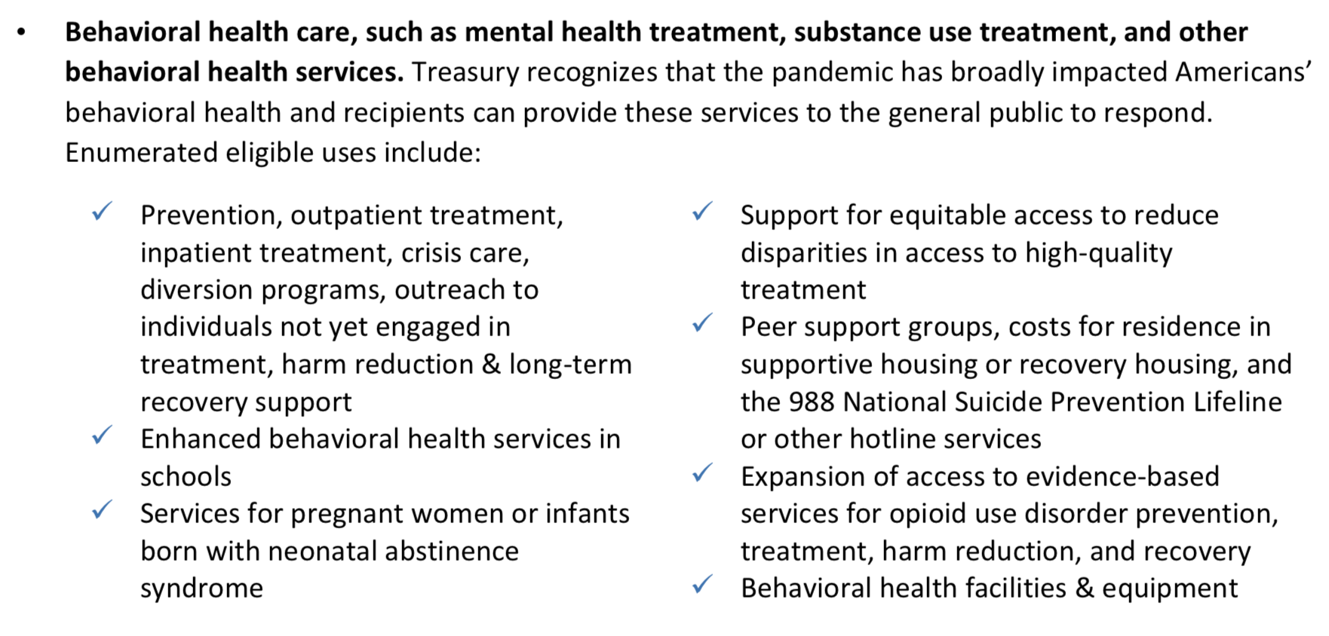
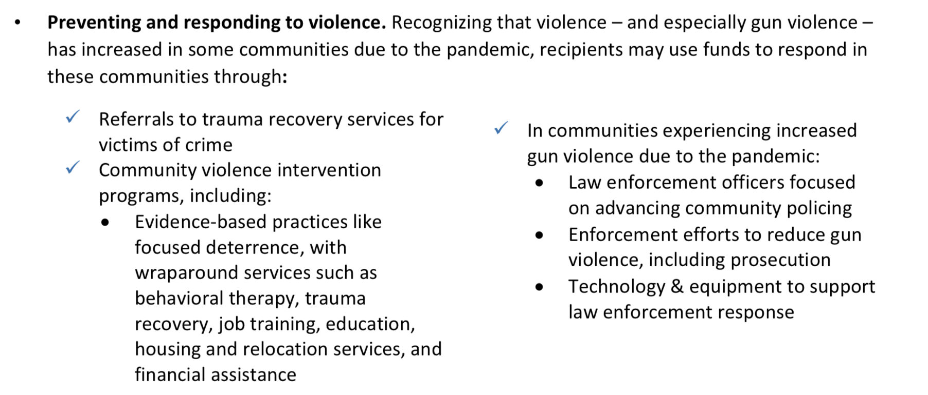
Addressing Public Health Emergency: Safe Harbors
2
3
4
All “safe harbor” projects still must be reasonable and proportional.
Additional justifications for capital outlay apply.

Slide 10
Impacted vs. Disproportionately Impacted
Most projects may target any impacted beneficiaries, consistent with state law, but some eligible projects may only target disproportionally impacted beneficiaries.
Presumptions of Impacted Beneficiaries | Presumptions of Disproportionally Impacted Beneficiaries
Households or populations that: Experienced unemployment Experienced increased housing insecurity Qualify for various other federal aid programs Any student that did not have access to in-person instruction for significant period of time (for educational expenditures) Are low- or moderate- income | Households and populations: Residing in a QCT Are low-income Qualify for various other federal aid programs Small businesses operating in a QCT Nonprofits operating in a QCT

Slide 11
Safe Harbors:
Negative Economic Impacted
Addressing Negative Economic Impact
Assistance to households and individuals (and facilities and equipment related to the provisions of services to households) for:
Food; emergency housing needs; burials, home repairs, or weatherization; internet access or digital literacy; cash assistance; and assistance accessing public benefits;
Paid sick, medical, or family leave programs, or assistance to expand access to health insurance;
Childcare, early learning services, home visiting, or assistance for child welfare- involved families or foster youth;
Programs to address the impacts of lost instructional time for students in kindergarten through twelfth grade;
Development, repair, and operation of affordable housing and services or programs to increase long-term housing security;
Financial services that facilitate the delivery of Federal, State, or local benefits for unbanked and underbanked individuals;
Benefits for the surviving family members of individuals who have died from COVID-19, including cash assistance to surviving spouses or dependents of individuals who died of COVID-19; and
Assistance for unemployed.
Assistance to small businesses, including programs, services, or capital expenditures that respond to the negative economic impacts of the COVID-19 public health emergency, including loans or grants to mitigate financial hardship such as declines in revenues or impacts of periods of business closure, or providing technical assistance;
Assistance to nonprofit organizations including programs, services, or capital expenditures, including loans or grants to mitigate financial hardship such as declines in revenues or increased costs, or technical assistance
Assistance to tourism, travel, hospitality, and other impacted industries for programs, services, or capital expenditures, including support for payroll costs and covered benefits for employees, compensating returning employees, support for operations and maintenance of existing equipment and facilities, and technical assistance

Slide 12

Safe Harbors: Disproportionately Negative Economic Impact
A program, service, capital expenditure, or other assistance that is provided to a disproportionately impacted household, population, or community, including:
  Services to address health disparities of the disproportionately impacted household, population, or community;
  Housing vouchers and relocation assistance;
  Investments in communities to promote improved health outcomes and public safety such as parks, recreation facilities, and programs that increase access to healthy foods;
  Capital expenditures and other services to address vacant or abandoned properties;
  Services to address educational disparities; and
  Facilities and equipment related to the provision of these services to the disproportionately impacted household, population, or community.
A program, service, capital expenditure, or other assistance that responds to disproportionately impacted small businesses, including rehabilitation of commercial properties; storefront and façade improvements; technical assistance, business incubators, and grants for start-ups or expansion costs for small businesses; and programs or services to support micro- businesses

Slide 13
Capital Outlay for Address COVID-19 Public Health and Negative Economic Impact Category
If a project has total expected capital expenditures of | and the use is enumerated in (b)(3), then | and the use is not enumerated in (b)(3), then
Less than $1 million | No Written Justification required | No Written Justification required
Greater than or equal to $1 million, but less than $10 million | Written Justification required but recipients are not required to submit as part of regular reporting to Treasury | Written Justification required and recipients must submit as part of regular reporting to Treasury
$10 million or more | Written Justification required and recipients must submit as part of regular reporting to Treasury
Written justification must include the following elements:
Describe the harm or need to be addressed;
Explain why a capital expenditure is appropriate; and
Compare the proposed capital expenditure to at least two alternative capital expenditures and demonstrate why the proposed capital expenditure is superior.

Slide 14
Local Government
Revenue Replacement
General government services, including LG salaries/benefits
Premium Pay
LG employees who performed essential work during pandemic
Strong emphasis on low- and moderate-income employees
Addressing COVID & Negative Impacts
Salaries/benefits for public health, public safety, human services employees to extent working on COVID
Backfilling LG positions
Addressing increased maintenance or deferred maintenance costs

Slide 15
Public Sector Capacity & Workforce
Payroll and covered benefit expenses for public safety, public health, health care, human services, and similar employees to the extent that the employee’s time is spent mitigating or responding to the COVID-19 public health emergency;
Payroll, covered benefit, and other costs associated with programs or services to support the public sector workforce and with the LG:
  Hiring or rehiring staff to fill budgeted full-time equivalent positions that existed on January 27, 2020 but that were unfilled or eliminated as of March 3, 2021; or
  Increasing the number of its budgeted full-time equivalent employees by up to the difference between the number of its budgeted full-time equivalent employees on January 27, 2020, multiplied by 1.075, and the number of its budgeted full-time equivalent employees on March 3, 2021, provided that funds shall only be used for additional budgeted full-time equivalent employees above the recipient’s number of budgeted full-time equivalent employees as of March 3, 2021;
Costs to improve the design and execution of programs responding to the COVID-19 pandemic and to administer or improve the efficacy of programs addressing the public health emergency or its negative economic impacts
Costs associated with addressing administrative needs of recipient governments that were caused or exacerbated by the pandemic.

Slide 16
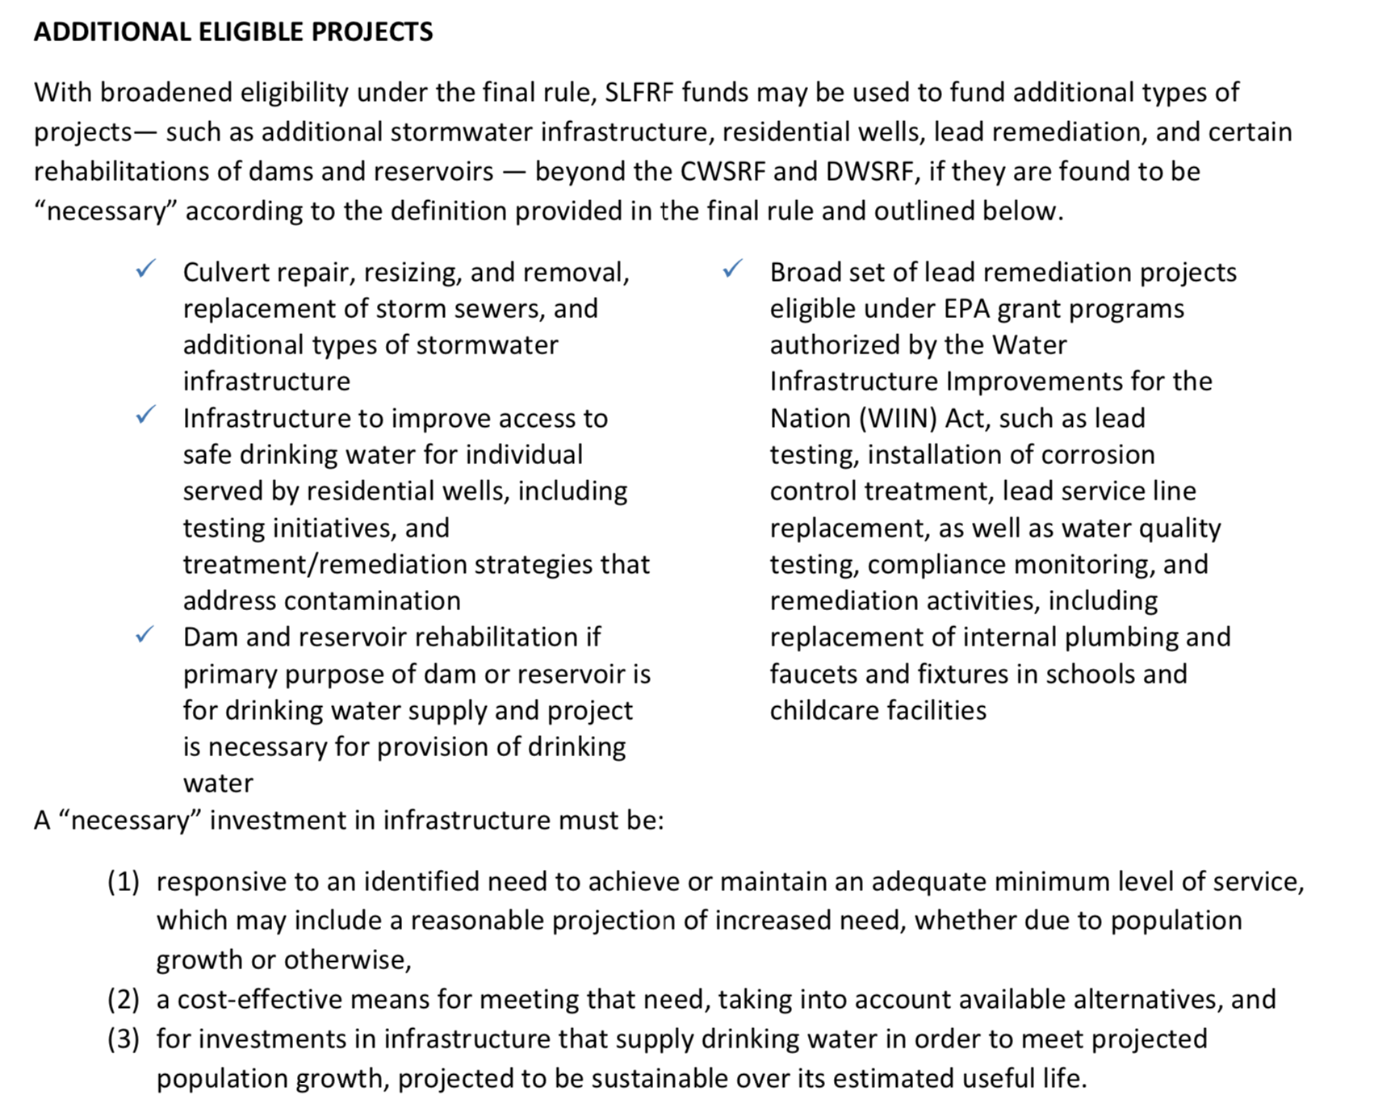
ARP/CLFRF Allowable Expenditures
Address COVID Public Health & Economic Impact
Replace Lost Revenue
Premium Pay
Infrastructure Investments
Treasury encourages recipients to adhere to strong labor standards, including project labor agreements and community benefits agreements that offer wages at or above the prevailing rate and include local hire provisions. Treasury also encourages recipients to prioritize in their procurements employers with high labor standards and to prioritize employers without recent violations of federal and state labor and employment laws.
Presumed Eligible: Projects allowed under CWSRF and DWSRF programs

Slide 17
ARP/CLFRF Allowable Expenditures
Address COVID Public Health & Economic Impact
Replace Lost Revenue
Premium Pay
Infrastructure Investments
Gives local governments the option to either:
  Use a default minimum lost revenue growth amount of $10 million (standard allowance); or
  Use the (modified) lost revenue growth formula.
All Revenue Replacement Funds May be Spent for “General Government Services” defined by reference to a non-exclusive list of examples
  “maintenance or pay-go funded building of infrastructure, including roads; modernization of cybersecurity, including hardware, software, and protection of critical infrastructure; health services; environmental remediation; school or educational services; and the provision of police, fire, and other public safety services.”
Must track expenditures for reporting purposes
Must follow all Uniform Guidance requirements
Updated Blog Post: https://canons.sog.unc.edu/2022/01/american-rescue-plan-act-of-2021-coronavirus-state-local-fiscal-recovery-funds-final-rule-spending-funds-for-general-government-purposes-2/

Slide 18
Revenue Replacement vs Other Categories
Address COVID Public Health & Economic Impact
Replace Lost Revenue
Premium Pay
Infrastructure Investments
Grant Administration
Revenue Replacement:
Standard Allowance
May spend up to $10 million for General Government Services
May use to cover general government services projects that fall within other eligible ARP/CSLFRF categories.
Should NOT use for premium pay or grant administration costs.
Revenue Replacement:
Formula Option
May spend up to full amount of actual lost revenue growth for General Government Services
May use to cover general government services projects that fall within other eligible ARP/CSLFRF categories.
Should NOT use for premium pay or grant administration costs.

Slide 19
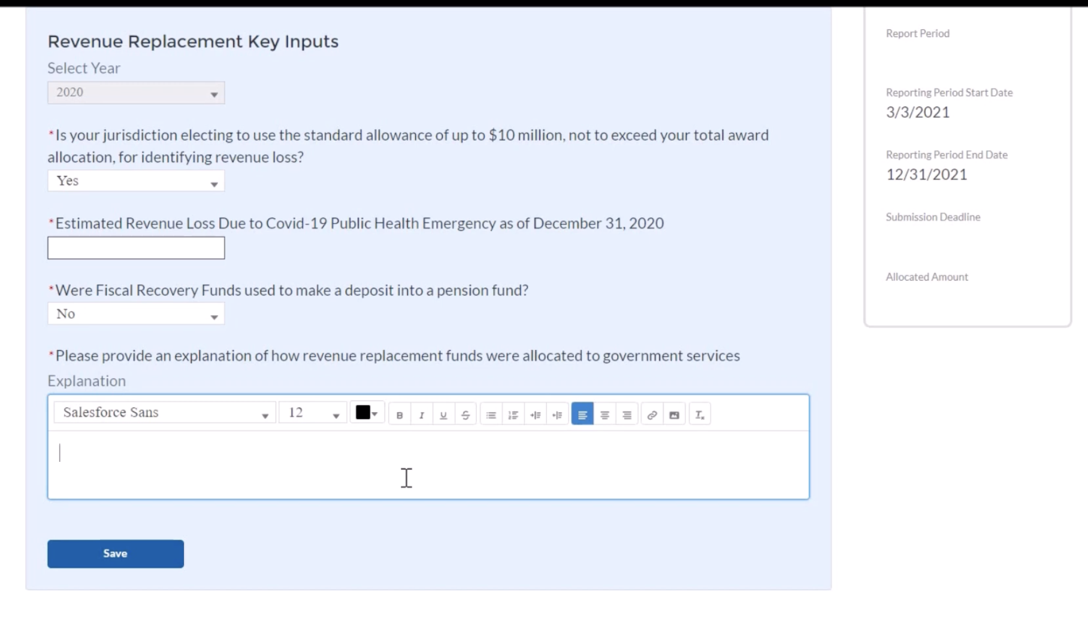
Project & Expenditure Report: Revenue Replacement

Slide 20
ARP/CLFRF Allowable Expenditures
Address COVID Public Health & Economic Impact
Replace Lost Revenue
Premium Pay
Infrastructure Investments
May award premium pay to any local government employee who performed essential work during the pandemic
Essential work is work that is performed in person with regular interactions with others (including co-workers) OR regularly handling items handled by others
May pay retroactively back to January 27, 2020 or prospectively until December 31, 2026, but must be for work actually performed
Must treat as regular salary for ALL withholding purposes (taxes, retirement, health ins., etc.)
Must target low- or moderate-income employees OR be able to provide justification for including higher income employees based on their special risks due to COVID
  Employee NOT EXEMPT from FLSA overtime provisions OR
  Employee’s total wages and remuneration does not exceed 150% of the state or county average for all occupations, whichever is higher
May provide subaward to nonprofit fire departments or similar entities to provide premium pay to their employees –must be for work that LG has state statutory authority to perform itself and that is also eligible under ARP/CSLFRF
Updated Blog Post: https://canons.sog.unc.edu/2022/01/american-rescue-plan-act-coronavirus-state-and-local-fiscal-recovery-funds-final-rule-premium-pay-for-local-government-employees/

Slide 21

Uniform Guidance Compliance
The Assistance Listing: Coronavirus State and Local Fiscal Recovery Funds and Part 2 of the US Treasury State and Local Fiscal Recovery Funds Compliance and Reporting Guidance(Compliance Guide), the following UG provisions apply to the ARP/CSLFRF grant award (with a few modifications):
  Subpart A, Acronyms and Definitions
  Subpart B, General provisions
  Subpart C, Pre-Federal Award Requirements and Contents of Federal Awards (except 2 CFR 200.204, .205, .210, and .213)
  Subpart D, Post Federal; Award Requirements (except 2 CFR 200.305(b)(8) & (9), .308, .309, and .320(c)(4))
  Subpart E, Cost Principles
  Subpart F, Audit Requirements
  2 CFR Part 25 (Universal Identifier & System for Award Management)
  2 CFR Part 170 (Reporting Subaward and Executive Compensation Information)
  2 CFR Part 180 (OMB Guidelines to Agencies on Governmentwide Debarment and Suspension (Non-procurement)

