Slide 1
American Rescue Plan Act Weekly Office Hours

Slide 2
ARP Zoom Office Hours Bring Your Coffee/Lunch & Your Questions
Tuesday, September 14, at 12:00pm
We will prioritize questions on water/sewer/stormwater infrastructure expenditures but will address other questions as time allows
Thursday, September 23, at 8:30am
Monday, September 27, at 12:00pm
Monday, October 4, at 8:30am
Thursday, October 14, at 12:00pm
Friday, October 22, at 8:30am
We will focus on the Project and Expenditure Report (deadline Oct. 31, 2021) but will address other questions as time allows
Tuesday, October 26, at 12:00pm

Slide 3
ARP/CSLRF Course
Online, with Tracks based on size
Multi-day (October 5, 8, 13, 15, 19, & 20)
Basics of CSLRF & State Law Expenditure Authority
Detailed Compliance Instruction / Uniform Guidance
Opportunities to Brainstorm with Other Local Government Officials
Strategic Planning
Performance Evaluation
National Best Practices
Working with Other Governments, Nonprofits, and Other Organizations
Registration Required

Slide 4
Forthcoming Resources
For NEUs: Annotated guide to registering with ID.Me, designating employees, and accessing US Treasury Portal for Oct. 31 report
For All: Updated grant project ordinance template formatted by EC to allow better tracking for Report purposes
For All: Sample subrecipient policies and award agreements
What Else is Needed?

Slide 5
Can we provide funds to Nonprofit or Another Government to do X?
EC Category | Project Description | State Law Authority | Contractor or Subrecipient? | Estimated Costs and Revenue Sources | If Contractor, federal procurement rules and state contracting requirements | If subrecipient, federal selection, risk assessment, and monitoring rules and state law contracting requirements

Slide 6
ARP Compliance
Uniform Guidance (CFR Part 200 & Compliance Supplement)
Procurement/Contracting Requirements
Allowable Costs
Internal Controls
Reporting
Subrecipient Monitoring
Program Income
Equipment and Real Property Management
Cash Management
Audit Requirements
State Law (LGBFCA & Procurement Rules)
Budgeting
Accounting
Reporting
Independent Audit
Procurement/Contracting Requirements

Slide 7
Contractor/ Vendor vs. Subrecipient

Slide 8
LG Partner
Subrecipient
Risk assessment
Subaward agreement with specific UG language
Contractor / Vendor
Contract/PO complies with state law
Subrecipient monitoring and reporting
Subaward complies with state law requirements
Follow state and UG procurement processes
Performance accounting under state law

Slide 9
Contractor or Subrecipient?
Scenario 1:
A nonprofit organization provides after school programs, specifically targeting at-risk children. The city wants to address learning loss that occurred among at-risk students during the pandemic. It wants to contract with the nonprofit to provide after school programs for qualifying students who reside within QCTs and pay for the contract with CSLFRFs. The city sets the eligibility criteria and registers eligible students. The nonprofit hires additional staff and otherwise adds capacity to serve these additional students in its existing after school programs. The contracting party will be paid based on number of students who participate in the nonprofit’s after school programs each month. The city will complete all required reporting on the program. The city will monitor program outcomes.

Slide 10
Contractor or Subrecipient?
Scenario 2:
A nonprofit organization provides after school programs, specifically for at-risk children. The nonprofit wants to serve students who experienced learning loss due to the pandemic. It proposes to add specialty after school programs to target these students. It approaches the city for CSLFRF monies to pay for these additional programs. The nonprofit designs eligibility criteria and will register students based on these criteria. The CSLFRF monies will only be used to fund the new, targeted after school programs. CSLFRF will establish performance metrics and report on program progress towards these metrics. Nonprofit will make changes to program based on ongoing assessment of these metrics.

Slide 11
LG Partner
Subrecipient
Risk assessment
Subaward agreement with specific UG language
Contractor / Vendor
Contract/PO complies with state law
Subrecipient monitoring and reporting
Subaward complies with state law requirements
Follow state and UG procurement processes
Performance accounting under state law
Recipient government should develop written policies and procedures for subrecipient monitoring and risk assessment.
Subaward must clearly state in writing:
That award is subaward of ARP/FRF funds,
Specific purposes for which ARP/FRF funds will be spent, and
Performance accounting and other process/ compliance/ reporting/ documentation requirements (see 2 CFR 200.332)
State law authority for undertaking and contract
Additional finance and performance accounting requirements
Recipient government must maintain records of all award agreements identifying or otherwise documenting subrecipients’ compliance obligations.
Recipient government must monitor subrecipient for risk factors and compliance.

Slide 13
Subaward Requirements for Local Governments 200.332
Subaward document
Risk assessment
Speical terms and conditions (when appropriate)
Monitor subrecipient activities
Monitor performance goals
Verify past subrecipient audits / financial reporting
Review audits for deficiencies
Enforcement of non-compliance

Slide 14
Initial Risk Assessments
Low Risk
No audit findings
Medium Risk
Minor audit findings & assessed as low risk by auditor
Organization without prior experience with federal awards
High Risk
Prior audit findings with major deficiencies / material weakness
Organization without sufficient accounting systems & internal controls
Newer staff or systems
Successful past history with federal awards
Subrecipient’s prior experience with similar subawards
Results of previous audits and whether subrecipient has been subject to Single Audit
Whether subrecipient has new personnel or substantially changed systems
Extents and results of federal awarding agency monitoring if subrecipient gets money directly from federal government

Slide 15
Higher Risk Subrecipients
More Frequent Monitoring
More Frequent Communication
Site Visits
Stringent Review of Audits
Prompt Action when Noncompliance Occurs
Training and Technical Assistance
Include additional conditions in subaward. See 200.208

Slide 16
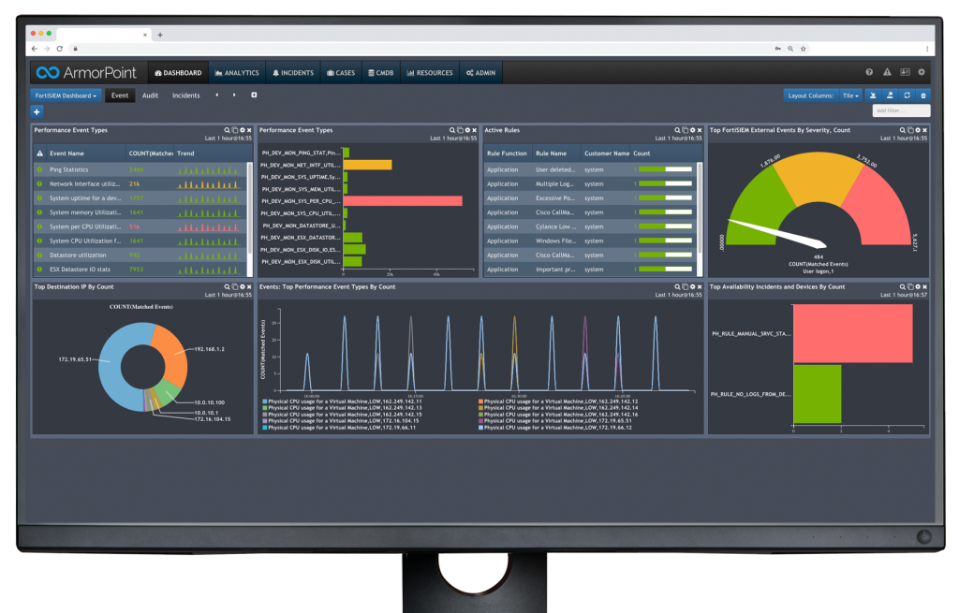
Monitor Subrecipient for
Use of funds for authorized purposes
Compliance with requirements
Performance goal achievement

Slide 17
How to Monitor Subrecipient
Review financial and performance reports
Ensure timely and appropriate subrecipient action to address any deficiencies
Issue management decision for applicable audit findings (200.521)
Resolve audit findings specifically related to subaward

Slide 18
LG Partner
Subrecipient
Risk assessment
Subaward agreement with specific UG language
Contractor
Contract/PO complies with state law
Subrecipient monitoring and reporting
Subaward complies with state law requirements
Follow state and UG procurement processes
Performance accounting under state law
Follow federal procurement requirements in 2 CFR 200.317 through 200.327
“Must have infrastructure for competitive bidding and contractor oversight, including maintaining written standards of conduct and prohibitions on dealing with suspended or debarred parties.”
Must also follow state law procurement and contracting requirements.

Slide 19
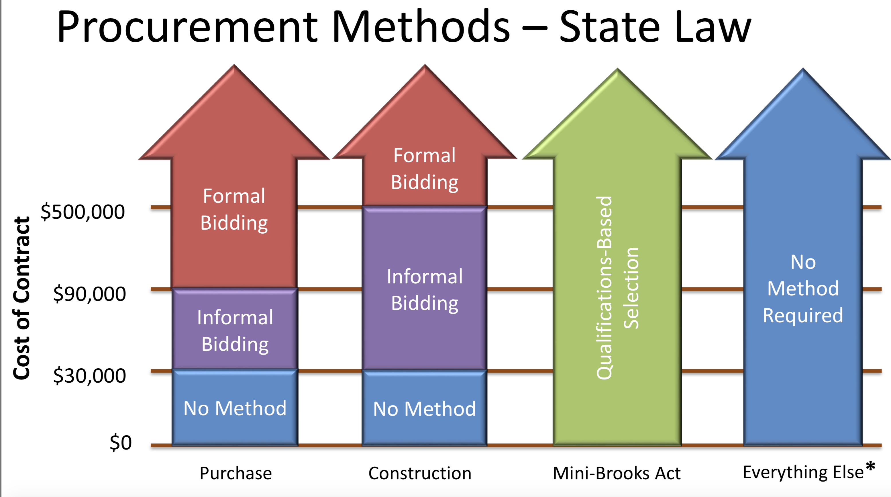

Slide 21
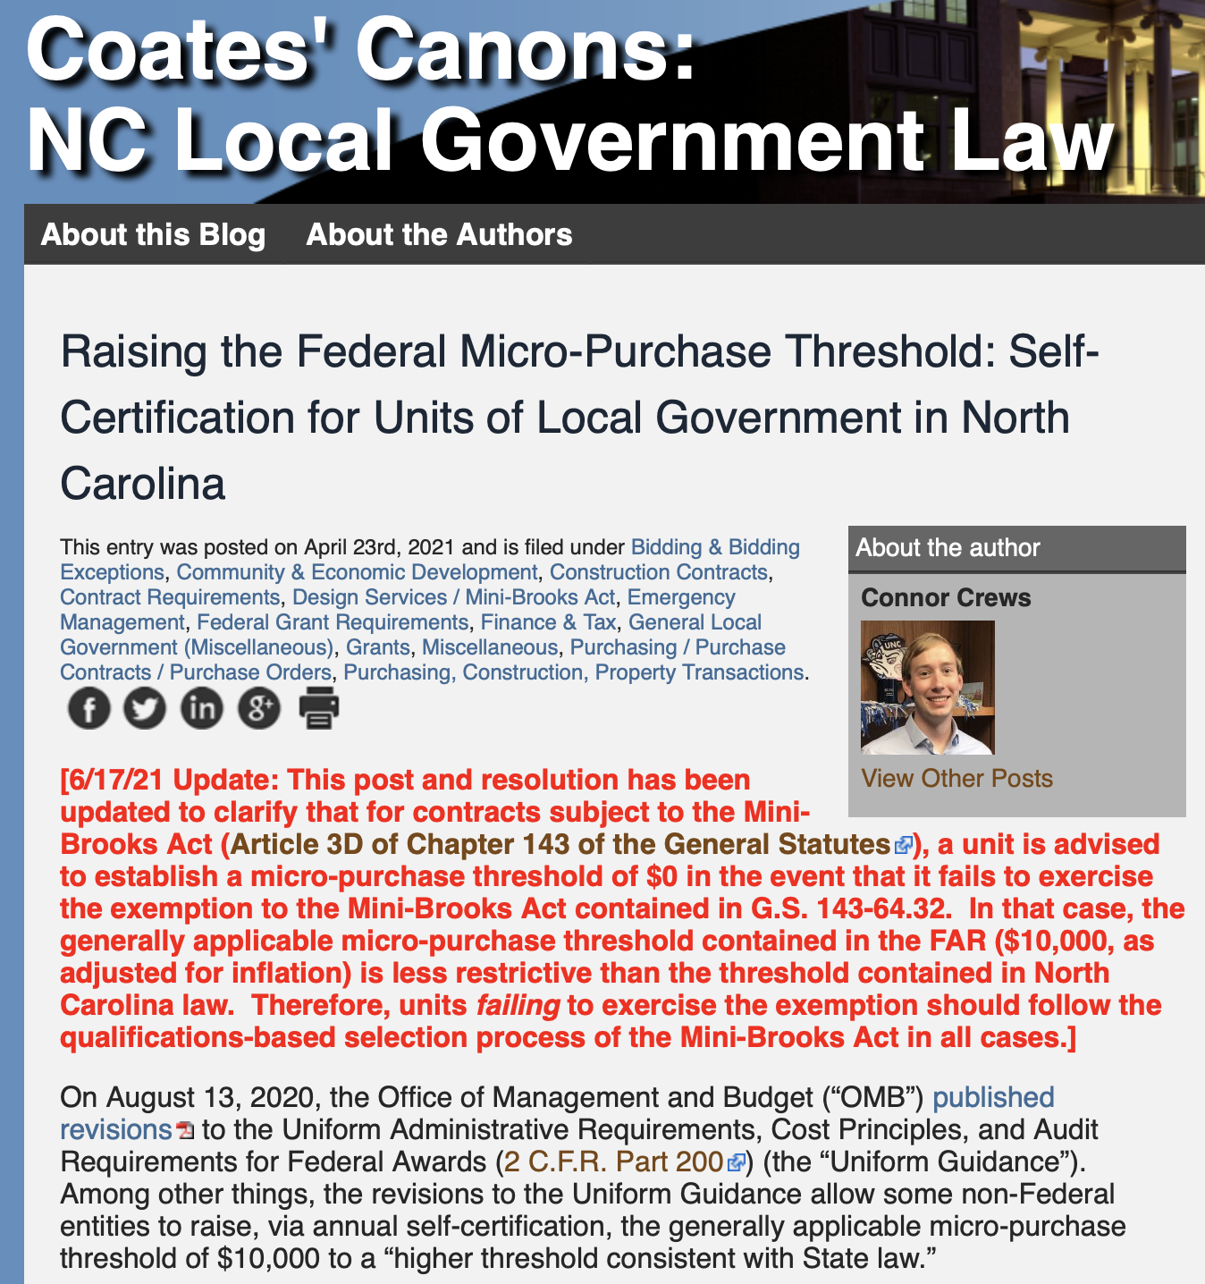
https://canons.sog.unc.edu/raising-the-federal-micro-purchase-threshold-self-certification-for-units-of-local-government-in-north-carolina/

Slide 22
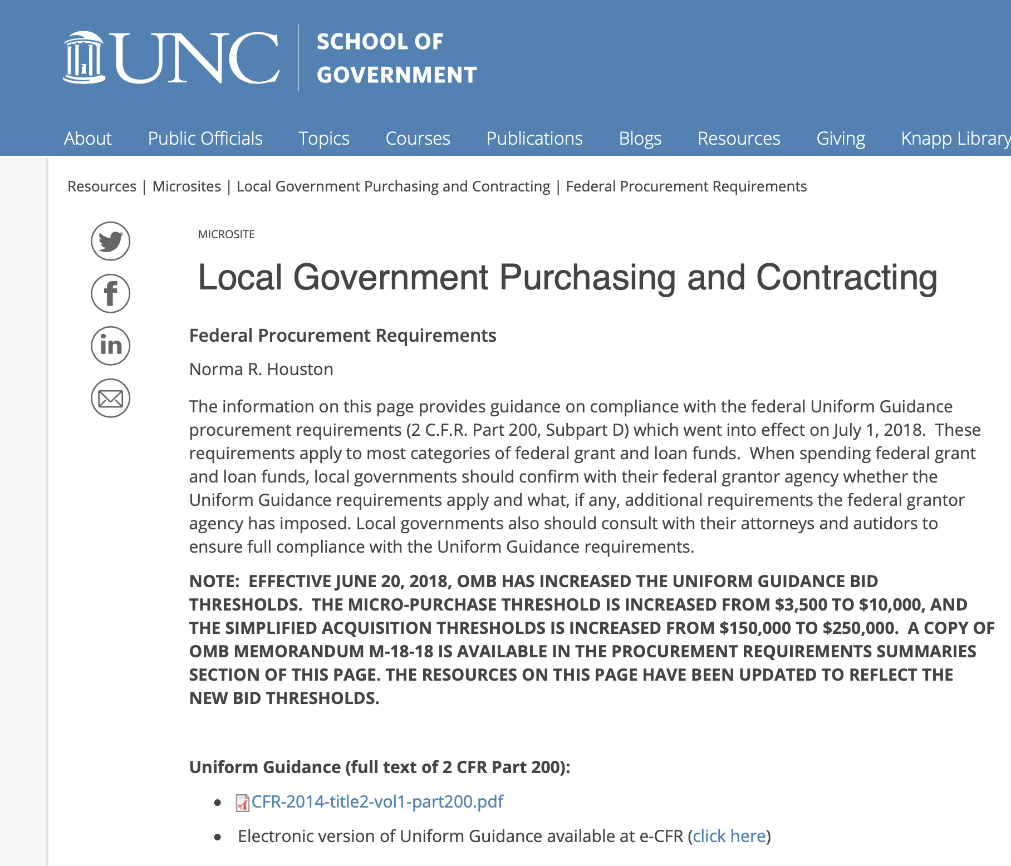

Slide 23
What Determines ARP/FRF Allowable Expenditures?
Federal Law
Part 8, Subtitle M—Coronavirus State and Local Fiscal Recovery Funds of H.R. 1319 American Rescue Plan Act of 2021
US Treasury Regulations & Guidance
31 CFR Part 35 (Interim Final Rule; Will be Final Soon)
US Treasury FAQs (updated periodically)
Compliance and Reporting Guidance: State and Local Fiscal Recovery Funds
US Treasury Compliance Webpage
Treasury User Guide for Reporting

Slide 24
ARP/FRF Allowable Expenditures
State Law Expenditure Authority

Slide 25
ARP/FRF Allowable Expenditures
Address COVID Public Health
Support public health expenditures, by funding COVID-19 mitigation efforts, medical expenses, behavioral healthcare, and certain public health and safety staff;
Address COVID Economic Impact
Address negative economic impacts caused by the public health emergency, including economic harms to workers, households, small businesses, impacted industries, and the public sector;
Replace Lost Revenue
Replace lost public sector revenue, using this funding to provide government services to the extent of the reduction in revenue experienced due to the pandemic;
Premium Pay
Provide premium pay for essential workers, offering additional support to those who have borne and will bear the greatest health risks because of their service in critical infrastructure sectors; and,
Infrastructure Investments
Invest in water, sewer, and broadband infrastructure, making necessary investments to improve access to clean drinking water, support vital wastewater and stormwater infrastructure, and to expand access to broadband internet.

Slide 26
Reporting
Recipient Local Government | Interim Report | Project and Expenditure Report | Recovery Plan Performance Report
Counties & Metropolitan Cities with a population > 250,000 | By August 31, with expenditures by category | By October 31, 2021, and then 30 days after the end of each quarter thereafter | By August 31, 2021, and annually thereafter by July 31
Counties & Metropolitan Cities with a population < 250,000, which receive > $5 million in ARP funding | By August 31, with expenditures by category | By October 31, 2021, and then 30 days after the end of each quarter thereafter | Not required
Counties & Metropolitan Cities with a population < 250,000, which receive < $5 million in ARP funding | By August 31, with expenditures by category | By October 31, 2021, and then annually thereafter | Not required
NEUs (all other municipalities) | Not required | By October 31, 2021, and then annually thereafter | Not required
More info on Report requirements is available here.

Slide 27
Address COVID Public Health
Support public health expenditures, by funding COVID-19 mitigation efforts, medical expenses, behavioral healthcare, and certain public health and safety staff;
Address COVID Economic Impact
Address negative economic impacts caused by the public health emergency, including economic harms to workers, households, small businesses, impacted industries, and the public sector;
“[E]ligible uses under this category must be in response to the disease itself or the harmful consequences of the economic disruptions resulting from or exacerbated by the COVID-19 public health emergency”
Assess short and long-term effects on public health of COVID-19 and identify how program/project/activity addresses them
Specifically identify negative impact from COVID-19 and identify how program/project/activity addresses the negative impact
Focus on those most disproportionately impacted by the pandemic; broader expenditure authority in Qualify Census Tracts (QCT)
Make sure there is state law authority for the particular program/project/activity

Slide 28
Replace Lost Revenue
Replace lost public sector revenue, using this funding to provide government services to the extent of the reduction in revenue experienced due to the pandemic;
Allows a local government to use ARP monies to fund (most) general government services, to the extent that the local government experiences a reduction in general revenue during the pandemic, according to specified formula.
Compares “general revenue,” as defined by US Treasury in each of four calendar years (2020-2023) to artificially inflated base year general revenue
Any resulting “lost revenue" may be expended for most general government services authorized by state law
See American Rescue Plan Act of 2021 (ARP): Local Government Expenditures of ARP funds for General Government Purposes

Slide 29
Premium Pay
Provide premium pay for essential workers, offering additional support to those who have borne and will bear the greatest health risks because of their service in critical infrastructure sectors;
“[T]o provide premium pay to eligible workers performing essential work during the COVID-19 public health emergency….”
Local governments have broad authority to determine which workers are essential, but they must regularly perform in-person work, interact with others at work, or physically handle items handled by others.
May not be used as substitute for regular earnings.
May be retroactive to the start of the pandemic; but check with your attorney for potential state law issues.
US Treasury emphasizes the need for recipients to prioritize premium pay for lower income workers. Premium pay that would increase a worker’s total pay above 150% of the greater of the state or county average annual wage requires specific justification for how it responds to the needs of these workers.
All premium pay must comply with state law authority.

Slide 30
Infrastructure Investments
Invest in water, sewer, and broadband infrastructure, making necessary investments to improve access to clean drinking water, support vital wastewater and stormwater infrastructure, and to expand access to broadband internet.
Aligns eligible uses with the types or categories of projects that would be eligible to receive financial assistance through the EPA’s Clean Water State Revolving Fund (CWSRF) or Drinking Water State Revolving Fund (DWSRF).
DWSRF: Projects include treatment, transmission and distribution (including lead service line replacement), source rehabilitation and decontamination, storage, consolidation, and new systems development.
CWSRF: Projects include construction of publicly- owned treatment works, nonpoint source pollution management, national estuary program projects, decentralized wastewater treatment systems, stormwater systems, water conservation, efficiency, and reuse measures, watershed pilot projects, energy efficiency measures for publicly-owned treatment works, water reuse projects, security measures at publicly-owned treatment works, and technical assistance to ensure compliance with the Clean Water Act.
NO State Law Authority for Broadband Infrastructure (but watch for new legislation)

